Slide 1
Midterm project - Ps-Ks Phase diagram -
20100380 유종명

Slide 2
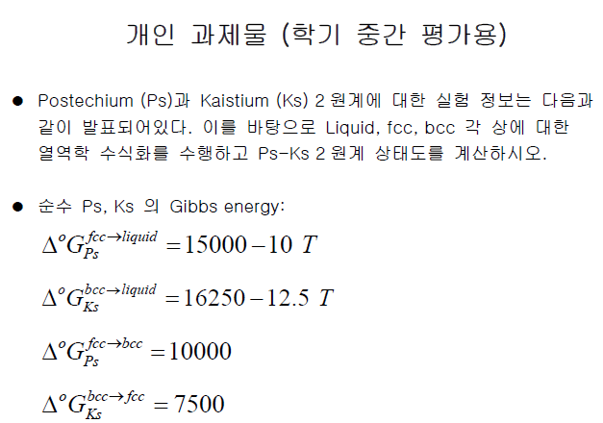
Given Experimental Data :
(1) 액상에서의 enthalpy of mixing (J/mol)
(2) 1500K 액상에서 Ks의 활동도 (reference state : Liquid Ks)
(3) FCC에서의 enthalpy of formation (J/mol)
(4) 1100K FCC에서의 Ks의 활동도 (reference state : BCC Ks)
(5) BCC에서의 enthalpy of formation (J/mol)
(6) 1100K BCC에서의 Ps의 활동도 (reference state : FCC Ps)

Slide 3
1. Liquid, fcc, bcc 각 phase에 대한 Ω 구하기
For liquid,
Enthalpy of mixing
Activity
$$μ_{Ks}^{L}=∆G_{Ks}^{B→L}+{\left(1−X_{Ks}\right)}^{2}\left(Ω^{L}+\frac{dΩ^{L}}{dX_{Ks}}X_{Ks}\right)+RTlnX_{Ks}$$
= $∆G_{Ks}^{B→L}+RTlna_{Ks}(wrt.L)$
$∴\frac{RTln\left(\frac{a_{Ks}\left(wrt.L\right)}{X_{Ks}}\right)}{{(1−X_{Ks})}^{2} }=Ω^{L}+\frac{dΩ^{L}}{dX_{Ks}}X_{Ks}=L_{0}+{2L}_{1}X_{Ks}$
$$∆H_{mix}=ΩX_{A}X_{B}=(L_{0}+L_{1}X_{B})(1−X_{B})X_{B}$$
$$y= \frac{ΔH_{mix}}{(1−X_{B})X_{B}}=L_{0}+L_{1}X_{B}=a_{0}+a_{1}x$$

Slide 4
For FCC,
Enthalpy of formation
Activity
$$∆H_{f}^{F}=Ω^{F}X_{Ps}X_{Ks}+X_{Ks}∆G_{Ks}^{B→F}$$
$$Ω^{F}= \frac{∆H_{f}^{F}−X_{Ks}∆G_{Ks}^{B→F}}{(1−X_{Ks})X_{Ks}}=L_{0}+L_{1}X_{Ks}$$
$$μ_{Ks}^{F}=∆G_{Ks}^{B→F}+{\left(1−X_{Ks}\right)}^{2}\left(Ω^{F}+\frac{dΩ^{F}}{dX_{Ks}}X_{Ks}\right)+RTlnX_{Ks}$$
= $∆G_{Ks}^{B→F}+RTlna_{Ks}(wrt.F)$
= $RTlna_{Ks}(wrt.B)$
$∴\frac{RTln\left(\frac{a_{Ks}\left(wrt.B\right)}{X_{Ks}}\right)−∆G_{Ks}^{B→F}}{{(1−X_{Ks})}^{2} }=Ω^{F}+\frac{dΩ^{F}}{dX_{Ks}}X_{Ks}=L_{0}+{2L}_{1}X_{Ks}$
For BCC,
Enthalpy of formation
Activity
$$∆H_{f}^{B}=Ω^{B}X_{Ps}X_{Ks}+X_{Ps}∆G_{Ps}^{F→B}$$
$$Ω^{B}= \frac{∆H_{f}^{B}−(1−X_{Ks})∆G_{Ps}^{F→B}}{(1−X_{Ks})X_{Ks}}=L_{0}+L_{1}(1−X_{Ks})$$
$$μ_{Ks}^{B}=∆G_{Ps}^{F→B}+{\left(X_{Ks}\right)}^{2}\left(Ω^{B}+\frac{dΩ^{B}}{dX_{Ps}}X_{Ps}\right)+RTlnX_{Ps}$$
= $∆G_{Ps}^{F→B}+RTlna_{Ps}(wrt.B)$
= $RTlna_{Ps}(wrt.F)$
$∴\frac{RTln\left(\frac{a_{Ks}\left(wrt.B\right)}{1−X_{Ks}}\right)−∆G_{Ps}^{F→B}}{{(X_{Ks})}^{2} }=Ω^{B}+\frac{dΩ^{B}}{dX_{Ps}}X_{Ps}=L_{0}+{2L}_{1}X_{Ps}$
= $L_{0}+L_{1}−L_{13}X_{Ks}$

Slide 5
Solution model
Liquid, FCC의 경우 sub-regular, BCC의 경우 regular solution model이 적합!
$$Ω$$
$$Ω^{L}$$
Liquid
$$Ω^{F}$$
FCC
$$Ω^{B}$$
$$X_{Ks}$$

Slide 6
$Ω^{L}$ = (14894.230619-7.9914838T)+(-4794.925467-0.011056T)$X_{Ks}$
$$Ω^{F}\text{= (1}\text{2597.6094622}\text{-}\text{4.997605}\text{T}\text{)+(-71}\text{99.97792+0.0217635}\text{T}\text{)}X_{Ks}$$
$Ω^{B}$= 6994.2426-4.05635T+6.654231+0.133T (Regular Solution)

Slide 7
2. Ps-Ks Binary phase diagram
Chemical potential equations
Ps
Ks
Phase equilibrium conditions
BCC-FCC
Liquid-BCC
Liquid-FCC
$$μ_{Ps}^{B}=μ_{Ps}^{F}$$
$$μ_{Ps}^{L}=μ_{Ps}^{B}$$
$$μ_{Ps}^{L}=μ_{Ps}^{F}$$
$$μ_{Ks}^{B}=μ_{Ks}^{F}$$
$$μ_{Ks}^{L}=μ_{Ks}^{B}$$
$$μ_{Ks}^{L}=μ_{Ks}^{F}$$

Slide 8
Result
T (K)
BCC-FCC: 376K~
Liquid-BCC: 511K~1296K
Liquid-FCC: 706K~1496K
$$X_{Ks}$$

Slide 9
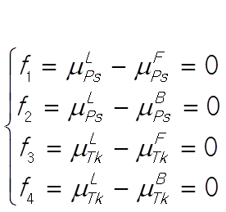
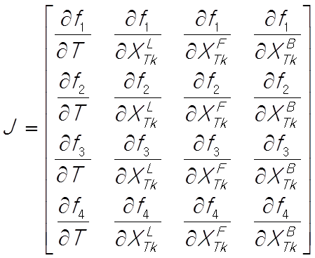
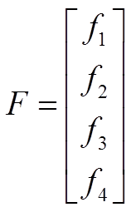
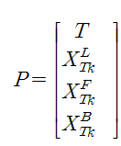
Finding Eutectic boundary (invariant line)

Slide 10
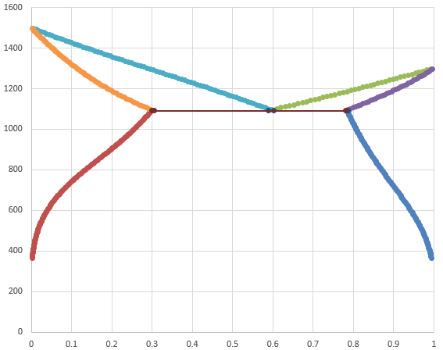
Result
T (K)
Liquid
FCC+Liquid
BCC+Liquid
1091
Eutectic point
BCC
FCC
FCC+BCC
0.2987
0.58825
0.7856
$$X_{Ks}$$

