Slide 1
소재수치해석 기말평가 보고서
Numerical Method Final-term Report
신소재공학과 20190322 이은애

Slide 2
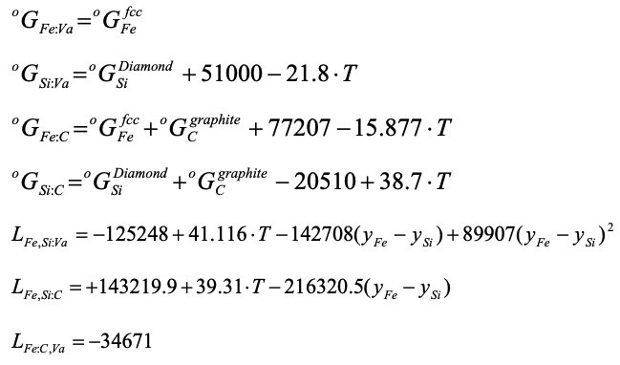
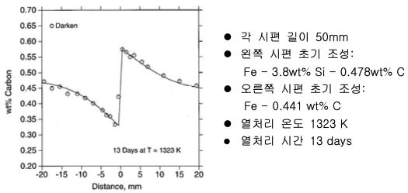
01_Introduction
Computer Simulation of Darken’s Uphill Diffusion
Problem
Given information
다음의 Mobility 정보와 initial condition을 이용하여 Darken의 uphill diffusion 실험을 FDM으로 simulation 하시오. (SI unit)
o
d

Slide 3
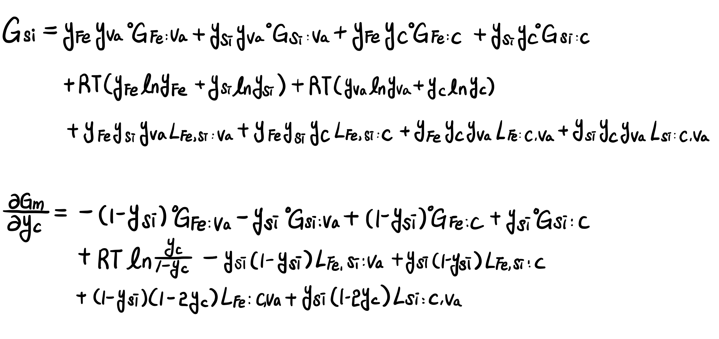
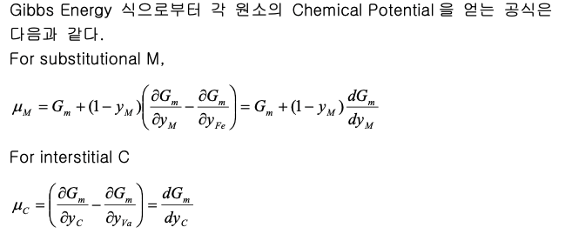
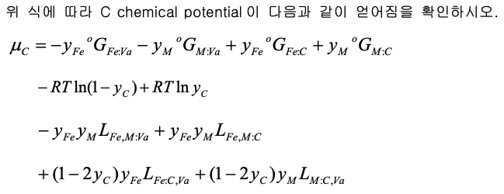
02_Theoretical background
Computer Simulation of Darken’s Uphill Diffusion
Background Calculation_Problem #1
=> i.e. C chemical potential이 제시된 바와 같이 얻어진다.

Slide 4
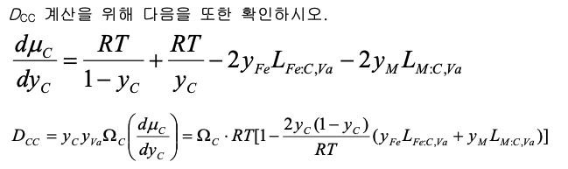
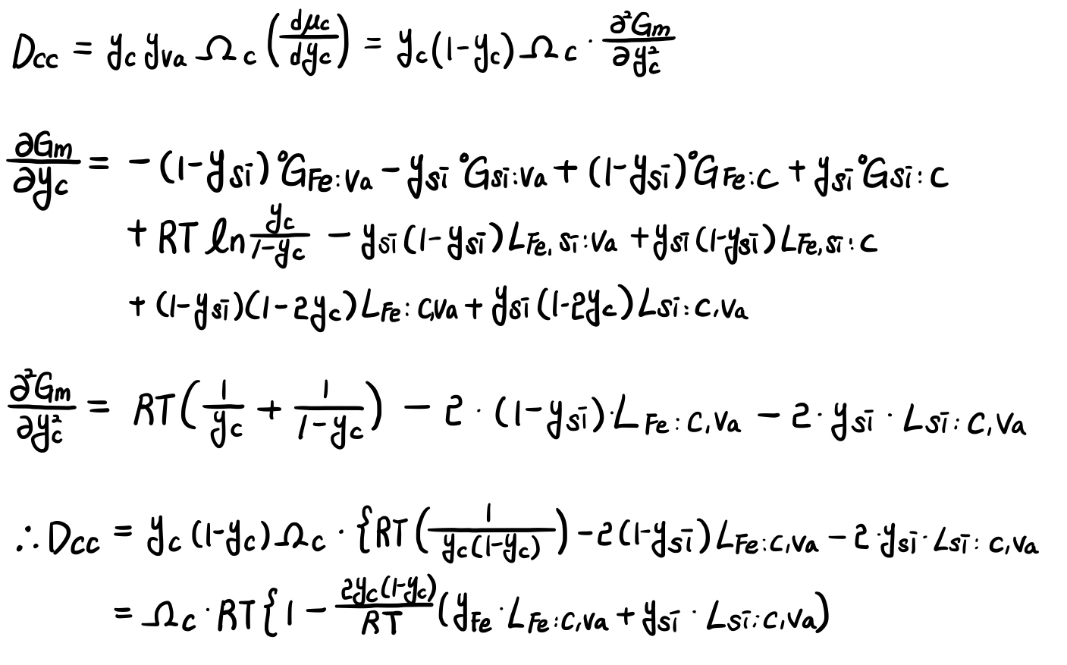
02_Theoretical background
Computer Simulation of Darken’s Uphill Diffusion
Background Calculation_Problem #2
=> i.e. Dcc 또한 제시된 바와 같이 얻어진다.

Slide 5
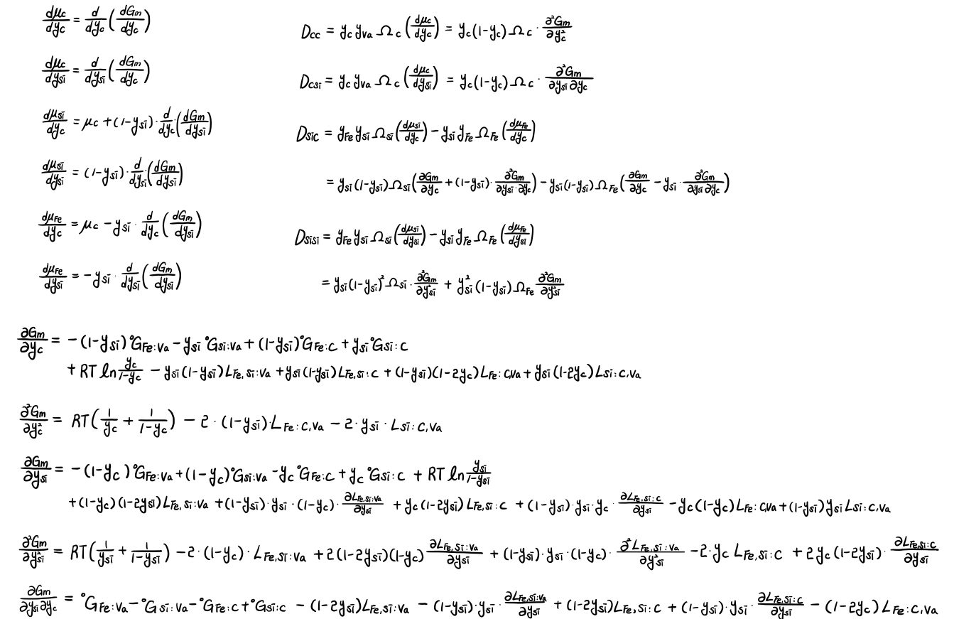
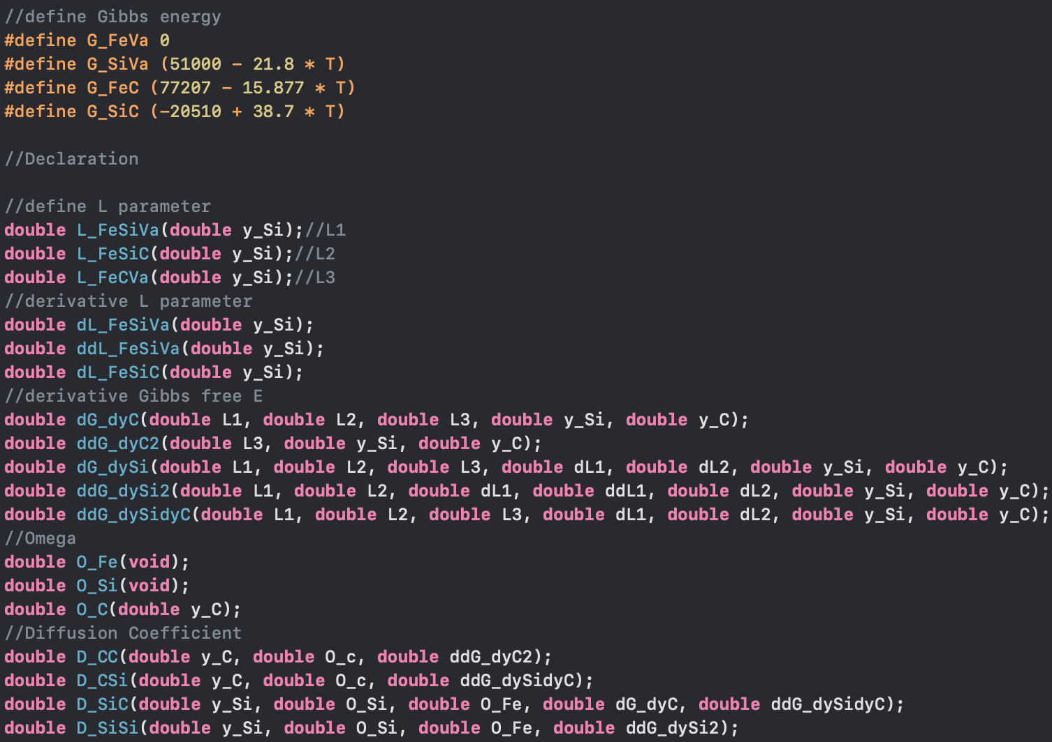
02_Theoretical background
Computer Simulation of Darken’s Uphill Diffusion
Background Calculation (Additional)

Slide 6
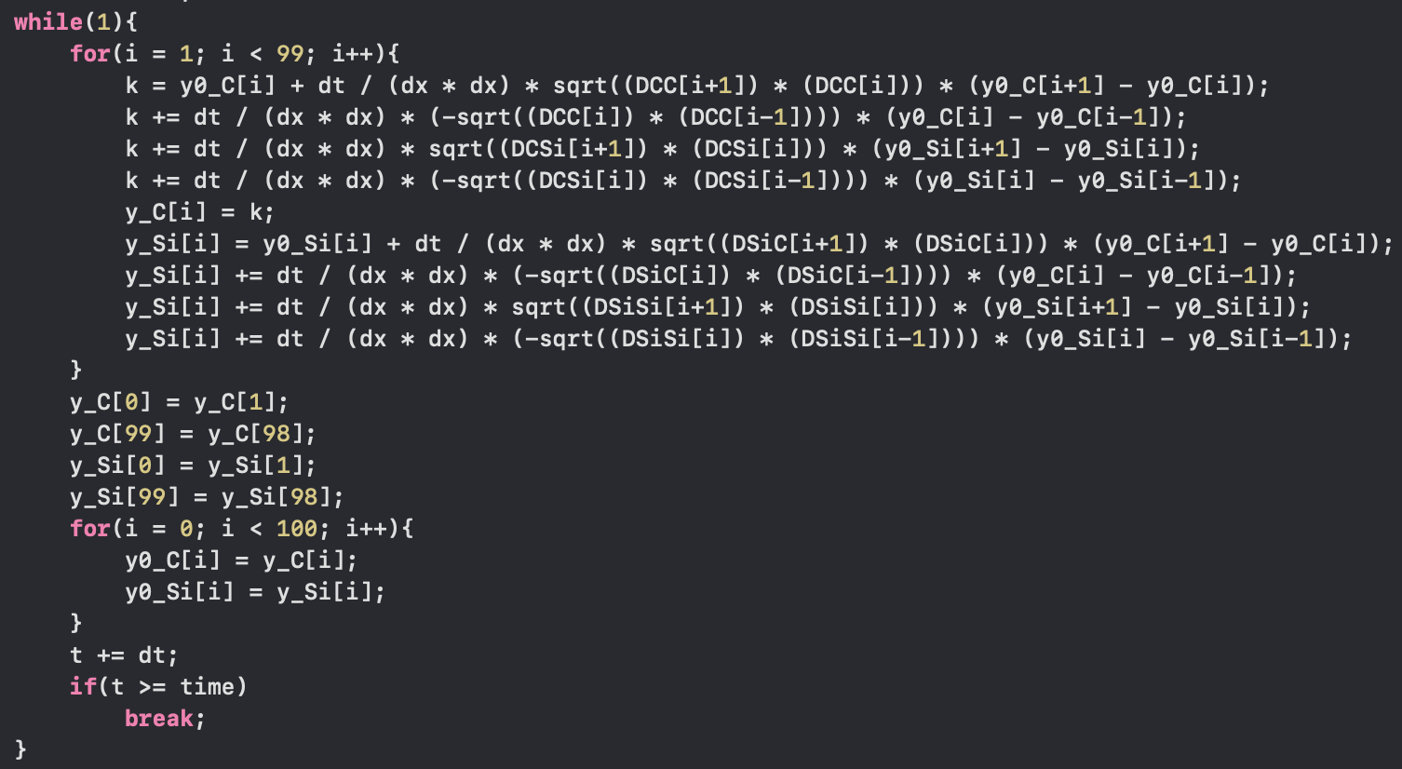
02_Theoretical background
Computer Simulation of Darken’s Uphill Diffusion
FDM (Explicit)
Flow chart
Initial condition 입력
Weight percent => y fraction
FDM
y fraction => Weight percent

Slide 7
03_Result
Computer Simulation of Darken’s Uphill Diffusion
Result
<Experiment vs. Calculation>
=> Darken의 uphill diffusion 실험을 FDM으로 simulation 하여 실험값과 유사한 값을 얻을 수 있다.

Slide 8
03_Result
Computer Simulation of Darken’s Uphill Diffusion
Result
<Darken’s uphill diffusion about Carbon>
<Darken’s uphill diffusion about Silicon>
=> carbon의 diffusion(interstitial)이 silicon의 diffusion(substitial)보다 더 빠르게 일어남을 알 수 있다.

Slide 9
소재수치해석 기말평가_자유주제
Steady-state Carrier Injection

Slide 10
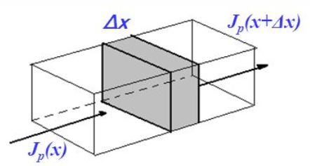
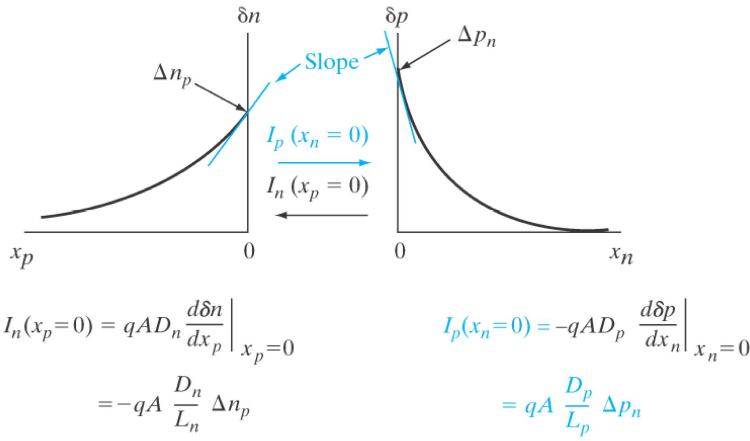
01_Theoretical background
Steady-state carrier injection
In the Steady-state case,
$$\frac{δp}{δt}= D_{p}\frac{∂^{2}δp}{∂x^{2}} − \frac{δp}{τ_{p}}=0 → \frac{∂^{2}δp}{∂x^{2}}=\frac{δp}{{D_{p}τ}_{p}}$$
$∴ δp\left(x\right)= ∆pe^{− \frac{x}{L_{p}}} ,$ (단, $L_{p}= \sqrt{D_{p}τ_{p}}$)
$\& δn\left(x\right)= ∆ne^{− \frac{x}{L_{n}}} ,$ (단, $L_{n}= \sqrt{D_{n}τ_{n}}$)

Slide 11
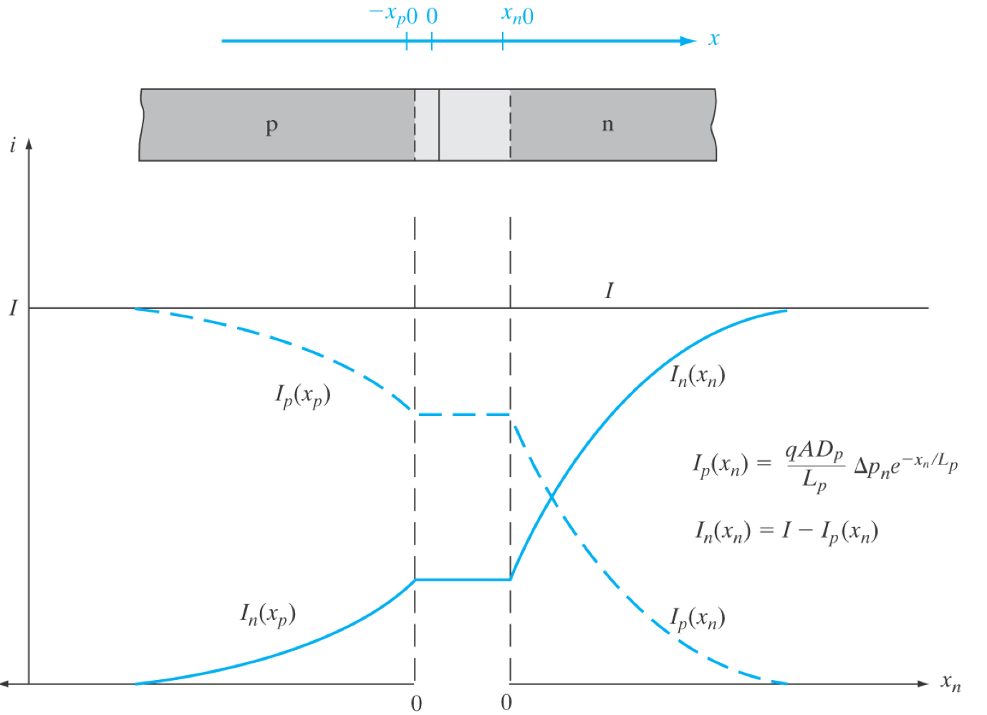
01_Theoretical background
Steady-state carrier injection
Electron and hole components of current in a forward-biased p-n junction

Slide 12
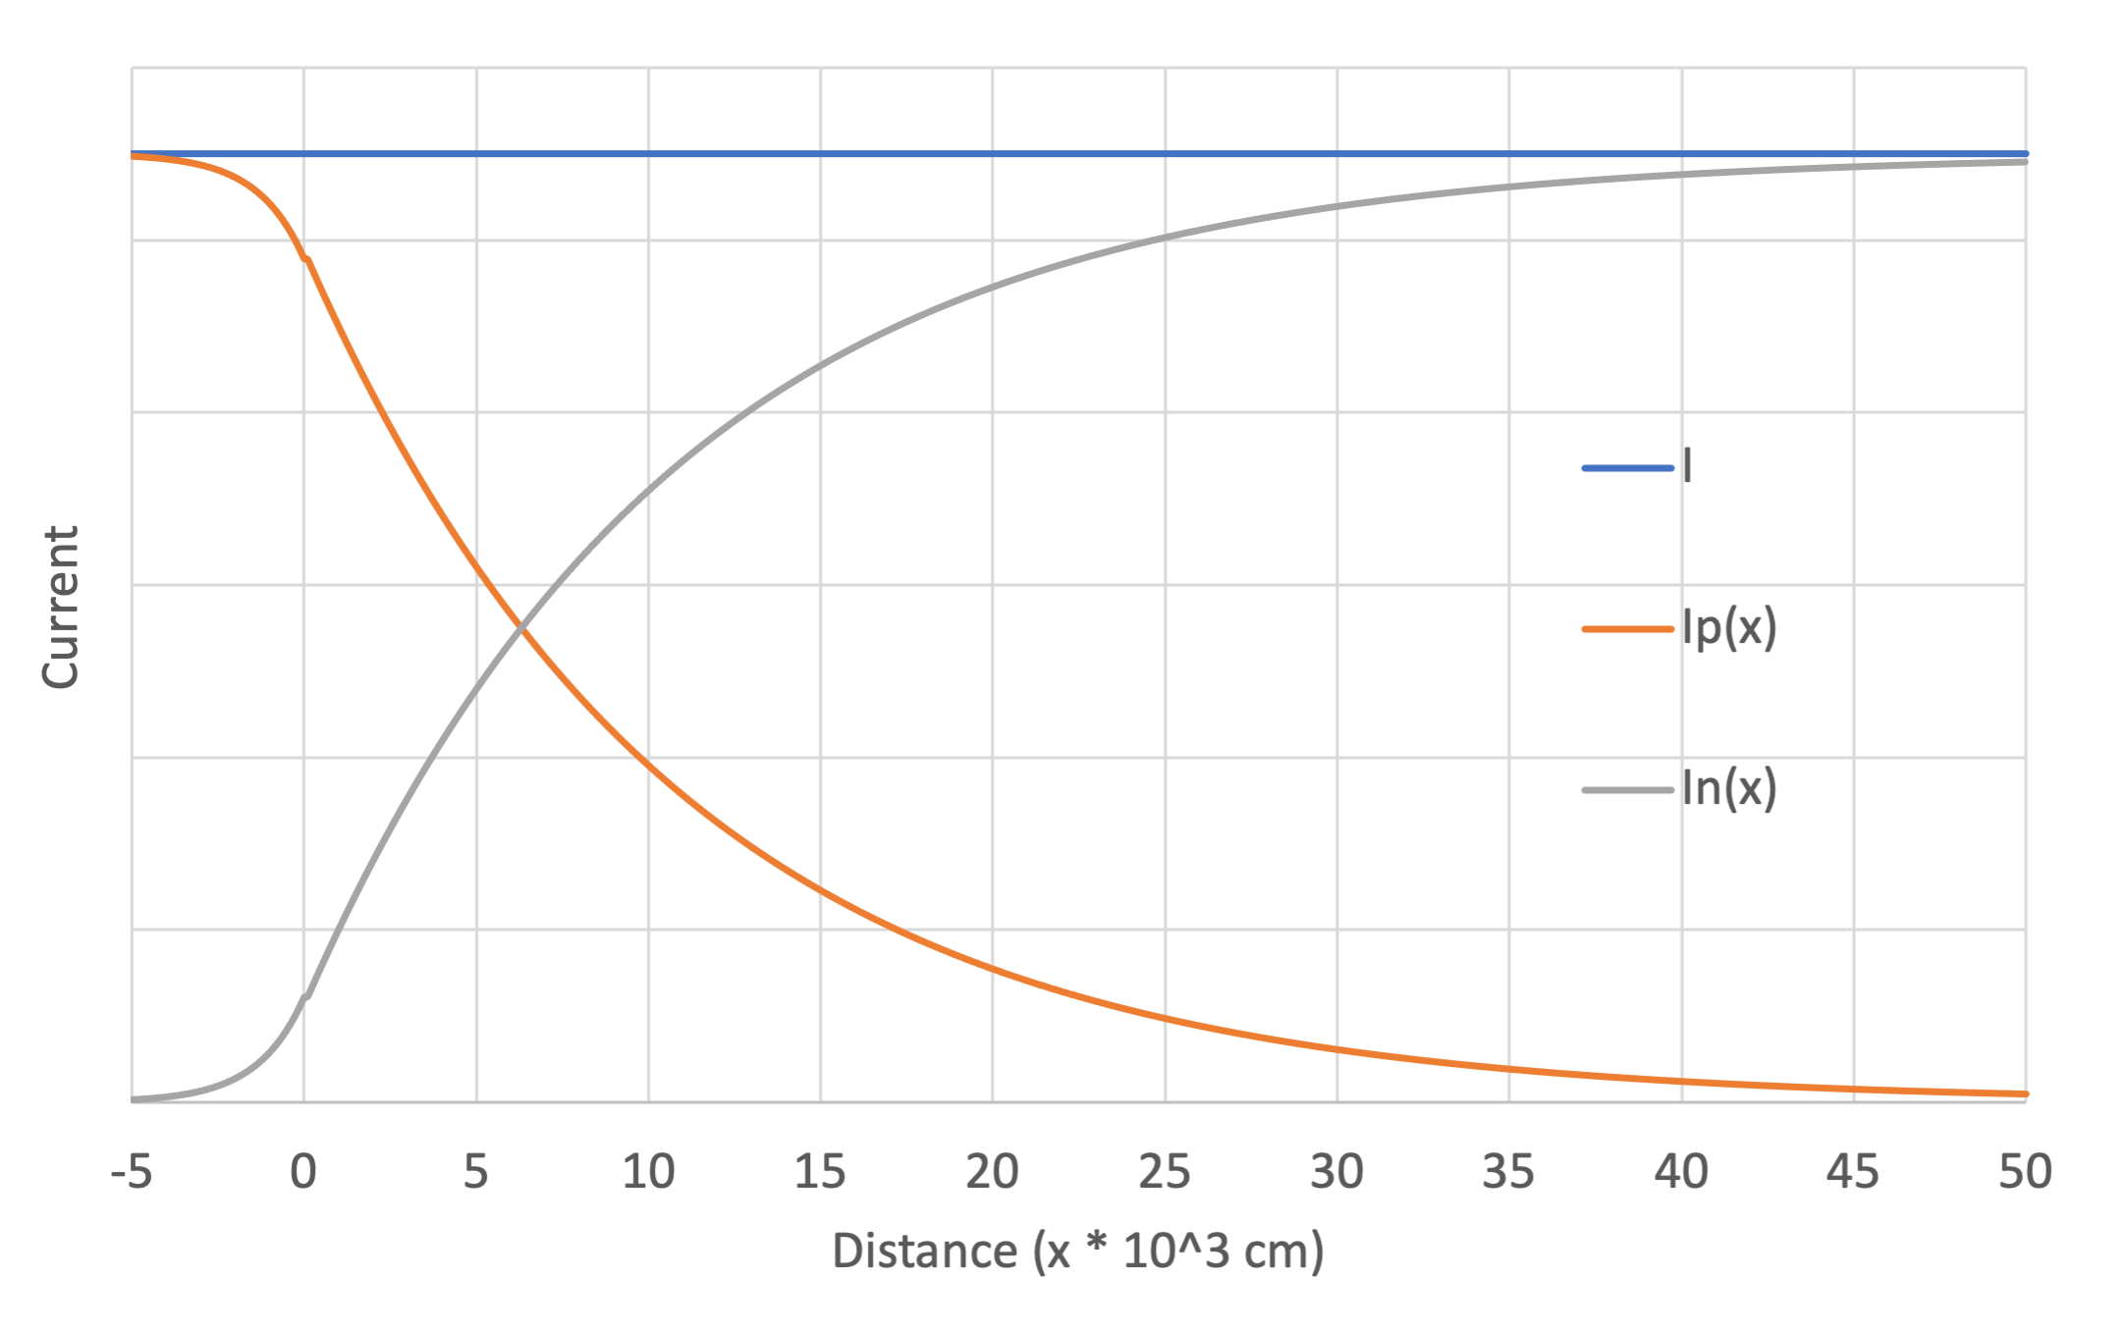
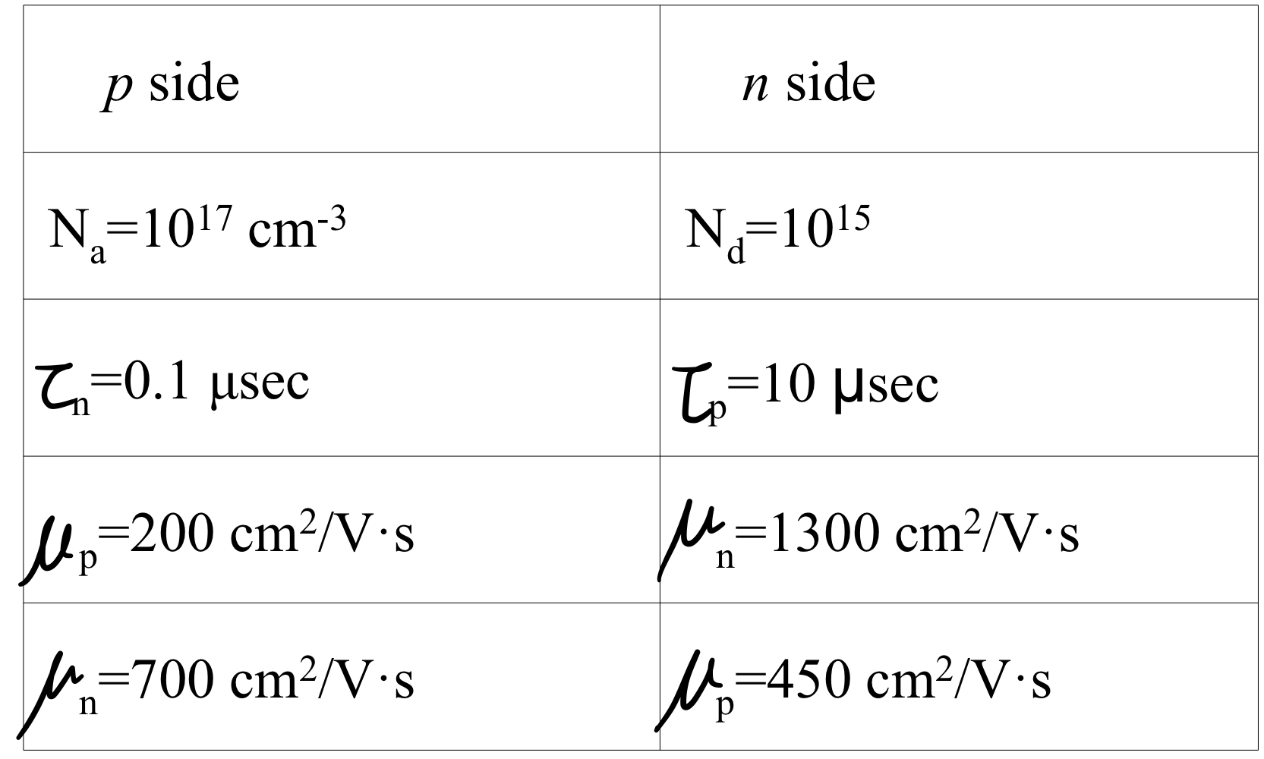
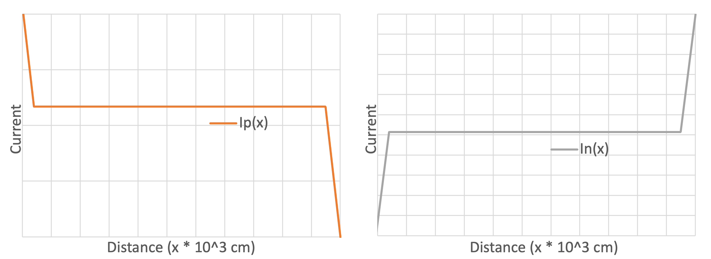
02_Result
Steady-state carrier injection
An abrupt Si p-n junction (Area :${10}^{−4}{cm}^{2}$)
Temperature : 300K
The junction is forward biased by 1V.

Slide 13
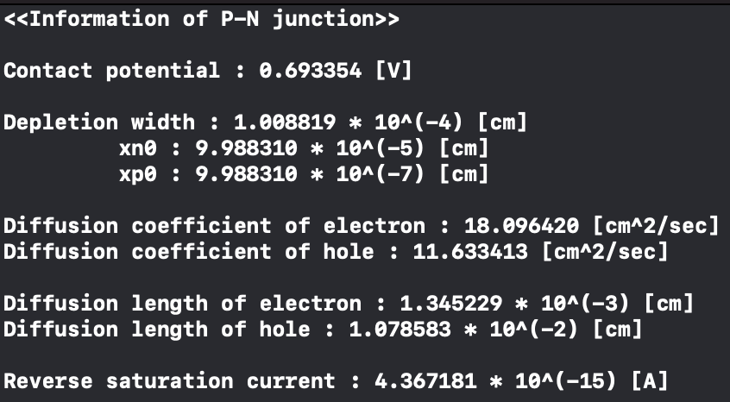
02_Result
Steady-state carrier injection
An abrupt Si p-n junction (Area :${10}^{−4}{cm}^{2}$)
Temperature : 300K
The junction is forward biased by 1V.

Slide 14
Thank you

