Slide 1
소재수치해석 HW8
20140850
신소재공학과 김민정

Slide 2
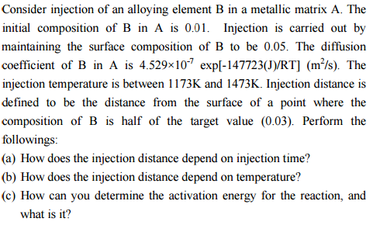
Problem

Slide 3
Code-Explicit method
program hw8_a
implicit none
doubleprecision,dimension(:,:),allocatable::W,A
doubleprecision::dt,dx,t,x,D,lambda,R,dummy
integer::i,j,k,l,temp,n
dt=1
dx=0.000003
temp = 1173
n=100
R=8.314
D=4.529*exp(-147723/R/temp)/10/10/10/10/10/10/10
lambda = D*dt/dx/dx
allocate(W(n,n))
allocate(A(n,n))
open(unit=1,file='result.txt')
print*,"lambda value:",lambda
do i=1,n
do k=1,n
A(i,k)=0
end do
end do
A(1,1)=1-2*lambda
A(1,2)=lambda
do i=2,n-1
A(i,i-1)=lambda
A(i,i)=1-2*lambda
A(i,i+1)=lambda
end do
A(n,n-1)=lambda
A(n,n)=1-lambda
do j=1,n
W(1,j)=0.05 !Surface는 시간이 흘러도 항상 0.05
end do
do i=2,n
W(i,1)=0.01 !surface 제외한 곳의 initial condition은 전부 0.01
end do
do j=1,n-1
do i=2,n
dummy=0
do k=1,n
dummy= dummy+A(i,k)*W(k,j)
end do
W(i,j+1)=dummy
end do
end do
do i=1,n
print*,"x:",dx*(i-1),"Composition at 2s:",W(i,3)
write(1,*) dx*(i-1),W(i,3)
end do
close(1)
end program

Slide 4
A. Injection distance & time

Slide 5
A. Injection distance & time
dx=0.000003m=3μm

Slide 6
B. Injection distance & temperature

Slide 7
C. Determine Activation Energy

