Slide 1
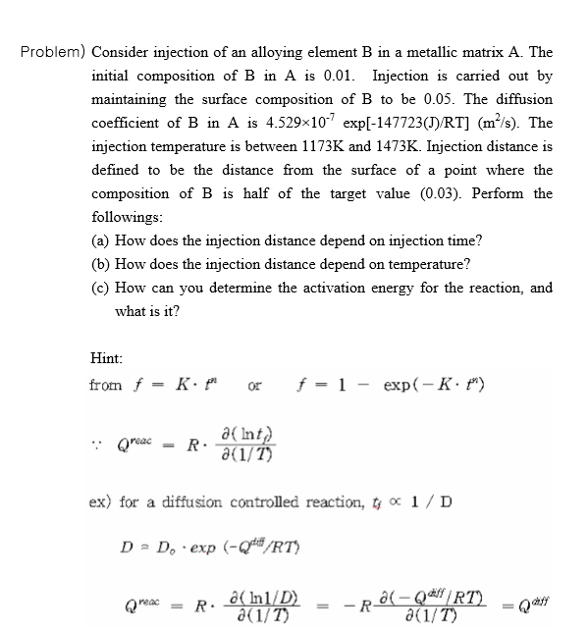
AMSE318 HW8 with python
49004547 Seokjee SHIN

Slide 2
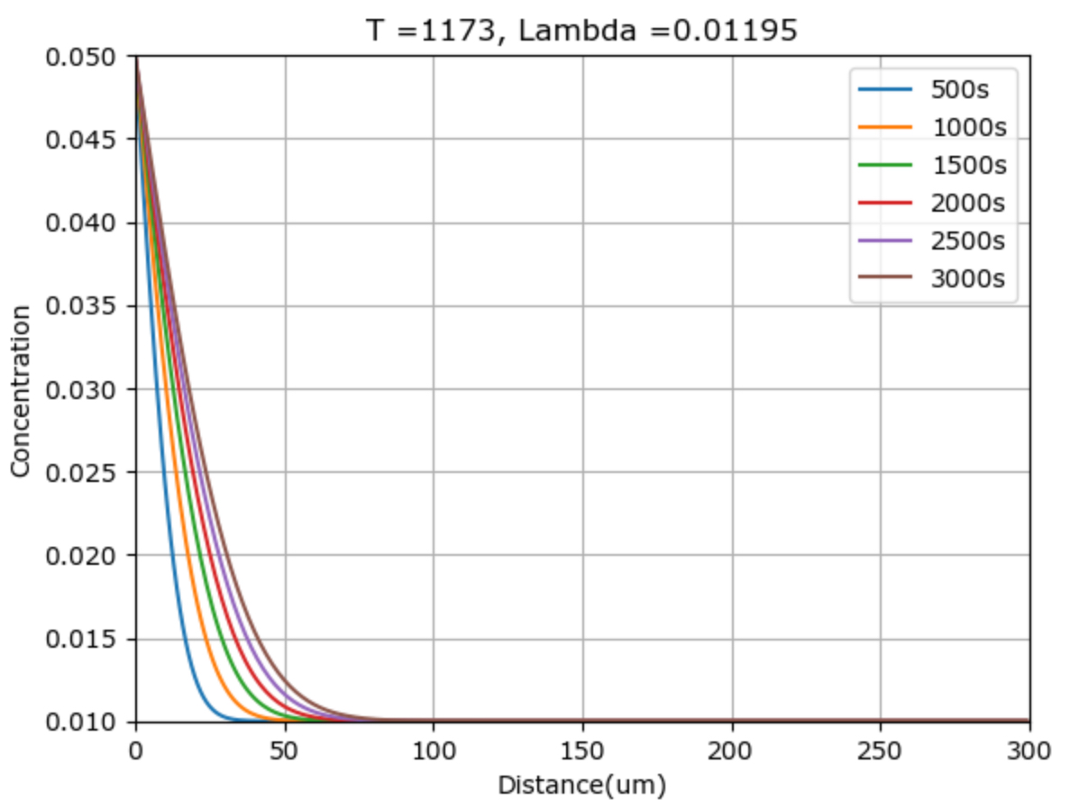
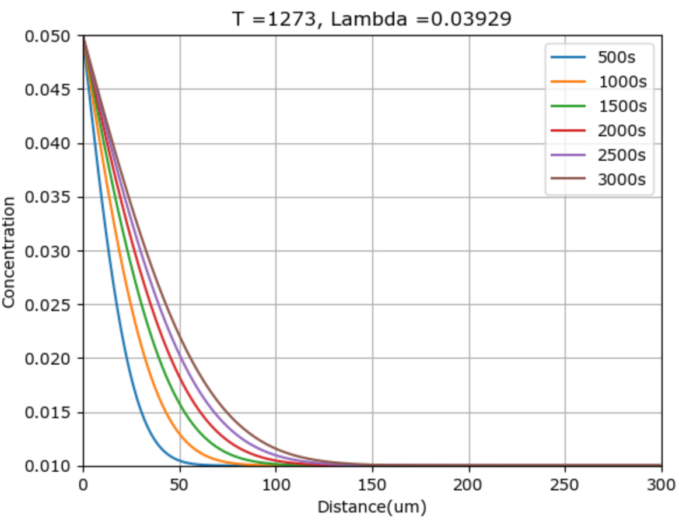
Result

Slide 3
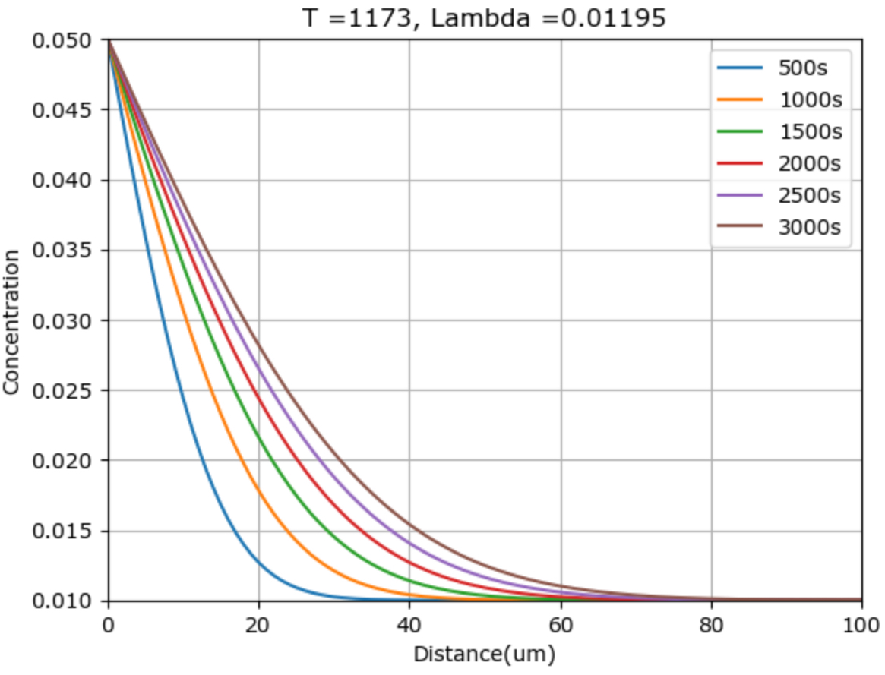
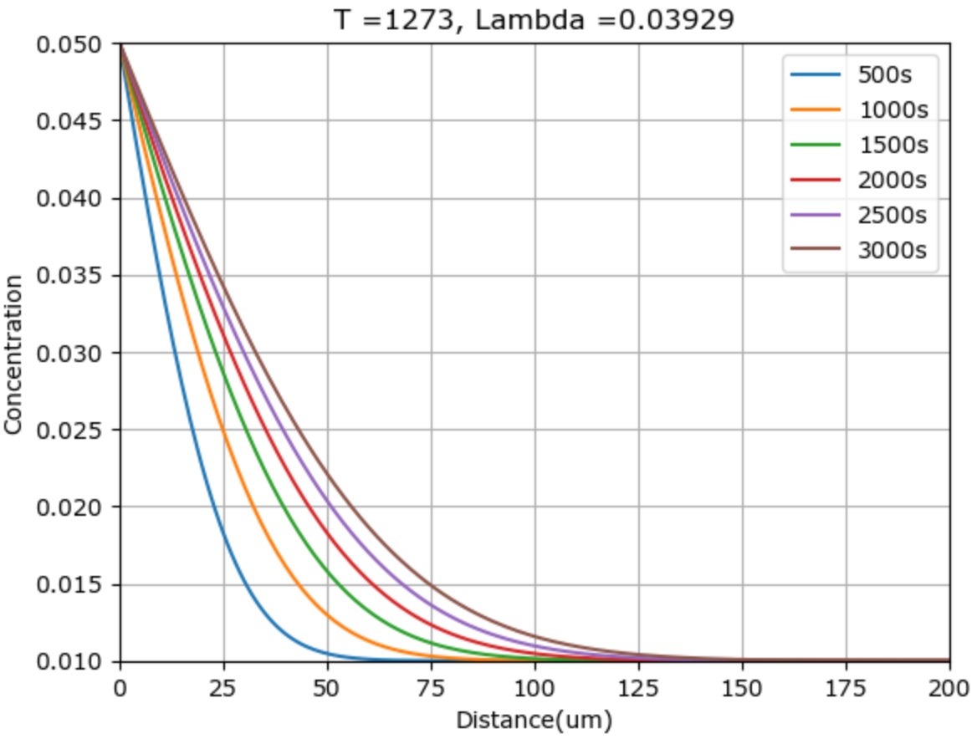
Result

Slide 4
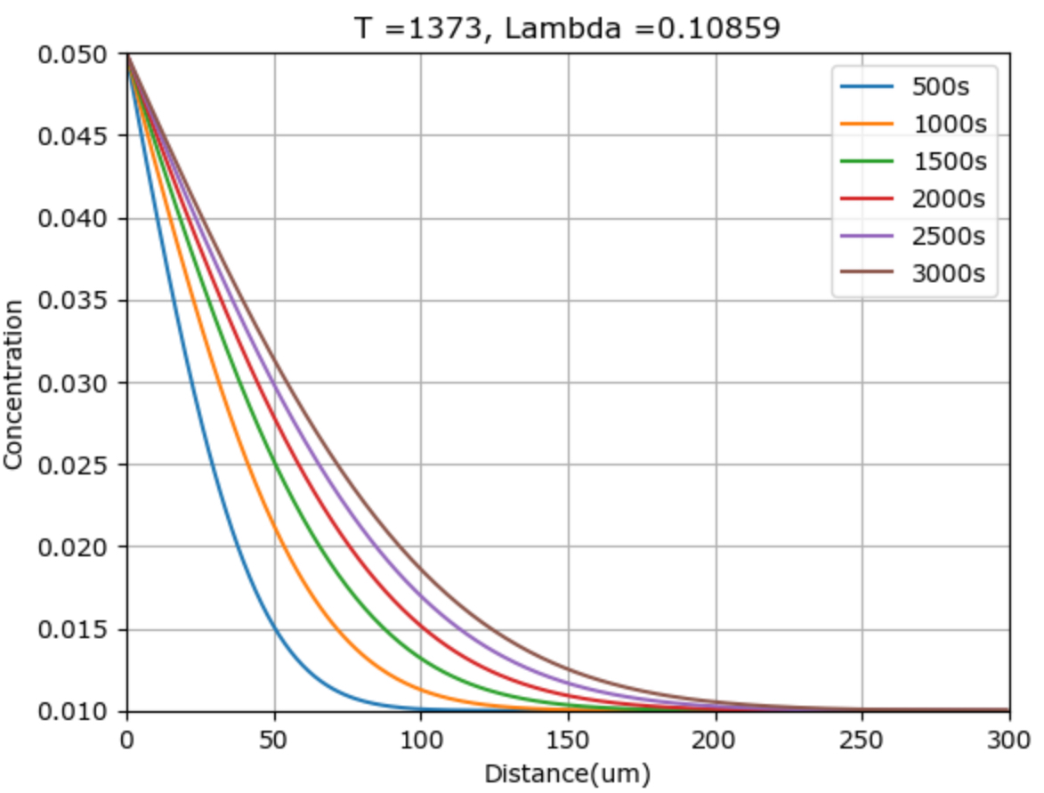
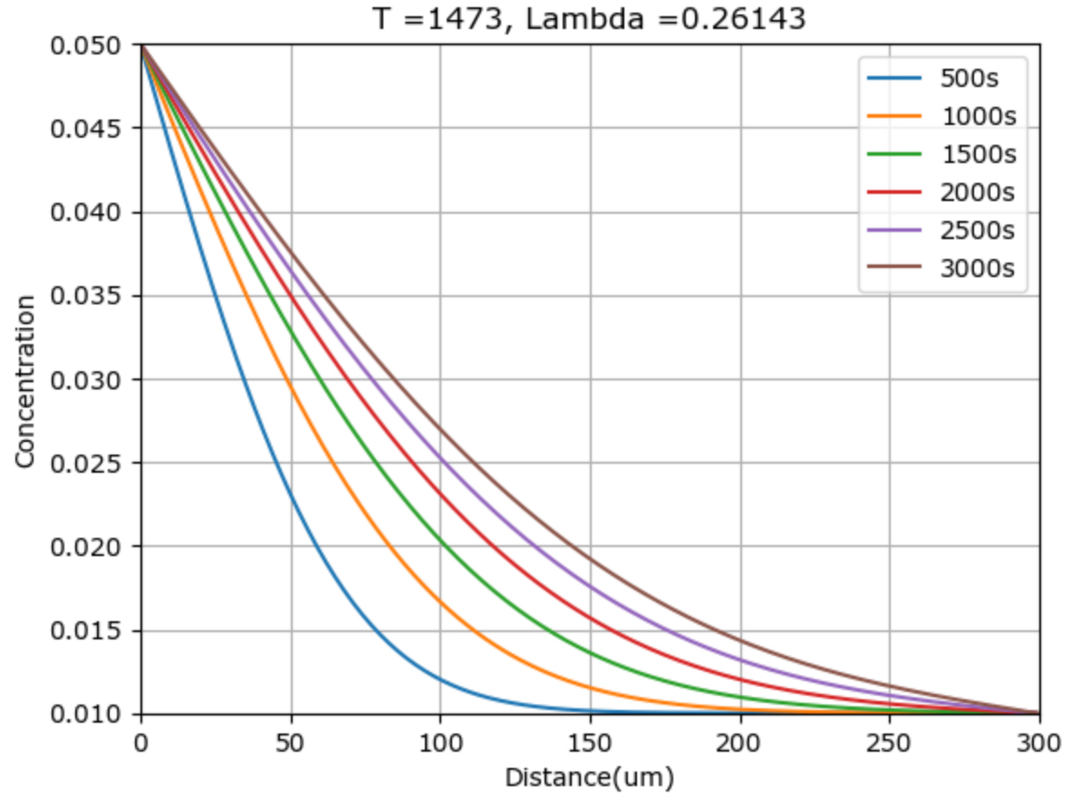
Result

Slide 5
Result - a
$x=\sqrt{Dt} →x ∝\sqrt{t}$
As injection time increases, the injection distance also increases exponentially, thus having linear relationship between injection distance and t^1/2

Slide 6
Result - B
$x=\sqrt{Dt} →D= D_{0}\exp\left(−\frac{Q}{RT}\right)→x=\sqrt{D_{0}\exp\left(−\frac{Q}{RT}\right)t} →x^{2}∝\exp\left(−\frac{Q}{2RT}\right)→ ∴\ln\left(x^{2}\right)∝\frac{1}{T}$
As temperature increases, the injection distance increases with constant temperature.

Slide 7
Result - C
$$x=\sqrt{Dt} \& D= D_{0}\exp\left(−\frac{Q}{RT}\right)→x=\sqrt{D_{0}\exp\left(−\frac{Q}{RT}\right)t}$$
$$x^{2}=D_{0}\exp\left(−\frac{Q}{RT}\right)t$$
$$\ln\left(\frac{x^{2}}{D_{0}}\right)=−\frac{Q}{RT}$$
$$T=−\frac{Q}{R}{\ln\left(\frac{x^{2}}{D_{0}}\right)}^{−1}→−\frac{Q}{R}is a slope!$$
$$Q=−ln\left(\frac{x^{2}}{D_{0}}\right)∗RT or Q≈17202.2∗R=−143027 J$$
$$Error\%=\frac{\left|Q_{numerical}−Q_{reference}\right|}{Q_{reference}}∗100=3.18 \%$$
time | m
3000s | -17413
2500s | -17594
2000s | -16908
1500s | -16926
1000s | -17342
500s | -17030
Average | -17202.2
Was able to find the value of Q with slope of 1/T vs. ln(injection distance). The error % is bigger than expectation, but it may be due to numerical errors such as rounding values or lack of data/accuracy. If we change the parameters, the Q value/Error% may change.

