Slide 1
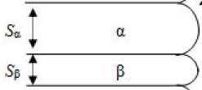
1
(a) Why the tip of each layer has a curvature?
Force balance from three different interface energy at three phase boundary & Capillary effect
$\vec{γ_{αβ}}+\vec{γ_{βγ}}$ + $\vec{γ_{γα}}$ = 0
Capillary effect
$$\vec{γ_{γα}}$$
$$\vec{γ_{αβ}}$$
$$θ_{1}$$
$$θ_{2}$$
$$\vec{γ_{βγ}}$$
(b) Estimate the radius of curvature for each layer as a function of layer thickness.
$$2r_{α}\sin\left(\frac{π}{2}−θ_{1}\right)=S_{α}=2r_{α}cosθ_{1}$$
$$γ_{γα}cosθ_{1}+γ_{βγ}cosθ_{2}= γ_{αβ}$$
$$+$$
$$2r_{β}\sin\left(\frac{π}{2}−θ_{2}\right)=S_{β}=2r_{β}cosθ_{2}$$
$$γ_{γα}sinθ_{1}=γ_{βγ}sinθ_{2}$$
$r_{α}=S_{α}γ_{αβ}γ_{γα}/({γ_{αβ}}^{2}+{γ_{γα}}^{2}−{γ_{βγ}}^{2}$)
$r_{β}=S_{α}γ_{αβ}γ_{βγ}/({γ_{αβ}}^{2}+{γ_{βγ}}^{2}−{γ_{γα}}^{2}$)
(c) Free energy increase calculated from capillary effects and interfacial energy
$$∆G_{IF}=\frac{2γ_{αβ}V_{m}}{S}$$
$$∆G_{cap}=\frac{γ_{γα}V_{α}}{r_{a}}+\frac{γ_{βγ}V_{β}}{r_{β}}=\frac{V_{α}({γ_{αβ}}^{2}+{γ_{γα}}^{2}−{γ_{βγ}}^{2})}{S_{a}γ_{αβ}}+\frac{V_{β}{{(γ}_{αβ}}^{2}+{γ_{γα}}^{2}−{γ_{βγ}}^{2})}{S_{β}γ_{αβ}}$$
$$= \frac{2γ_{αβ}V_{m}}{S}$$
Assume $\frac{V_{α}}{S_{a}}=\frac{V_{β}}{S_{β}}=\frac{V_{m}}{S}$

Slide 2
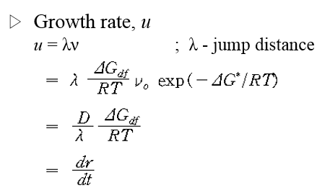
2
(a) Find the time dependence of the average grain size
Initial condition : 512000 grain
Temperature level : 10
400 ~ 1000 MCS
<R> = k$t^{n}$ → n = 0.2998
(b) Find the temperature dependence of grain growth and the activation energy
Q/R = 15.021
주의할 점
$$Assume ∆G_{df} is constant$$
$$→ln\left(\frac{n\left\langle R\right\rangle T}{MCS}\right)=lnC−\frac{Q}{RT }$$
(1 - exp(-ΔG_{df}/RT))
* At 1000 MCS
T | 5 | 10 | 15 | 20
n | 0.1996 | 0.2998 | 0.3756 | 0.4105
<R> | 12.94122 | 14.31108 | 15.48246 | 16.33895
ΔG_{df} / RT

