Slide 1
AMSE318 HW3 with python
49004547 Seokjee SHIN

Slide 3
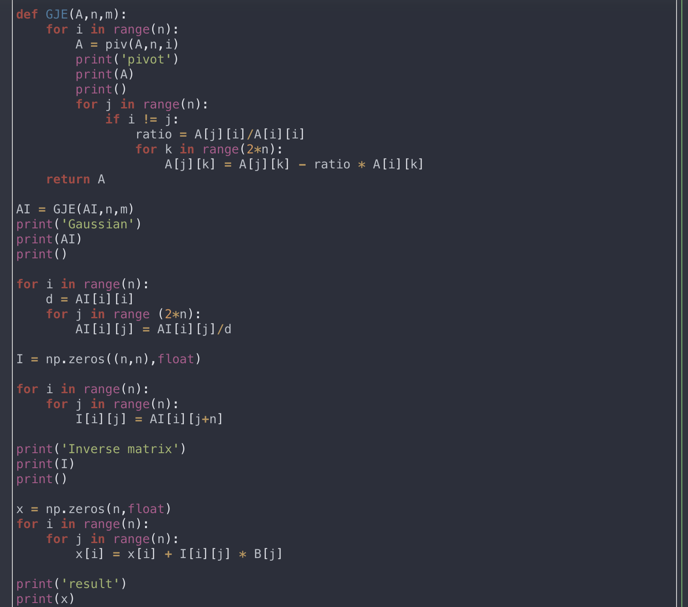

Slide 4
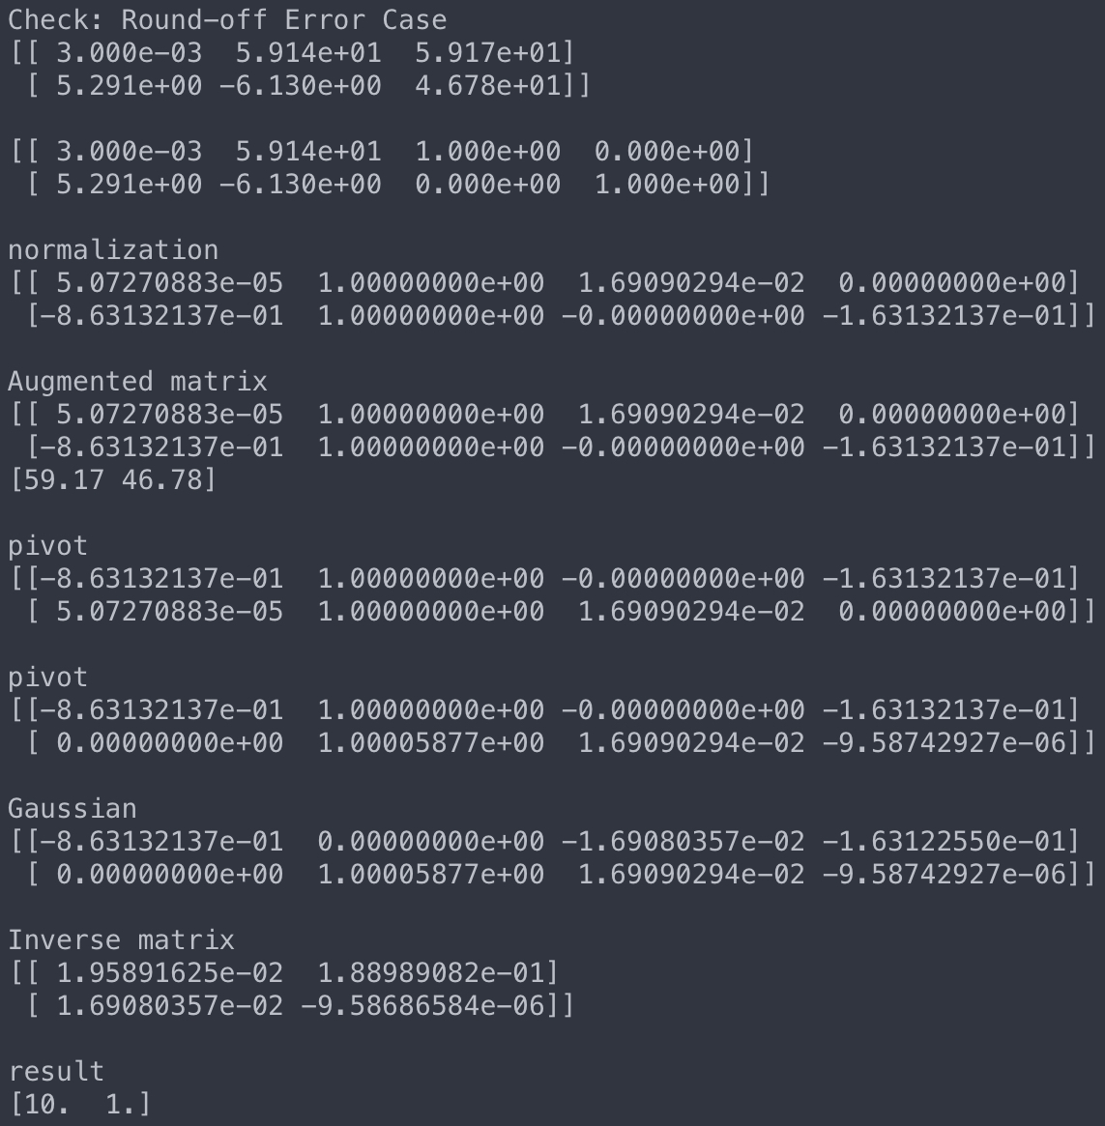
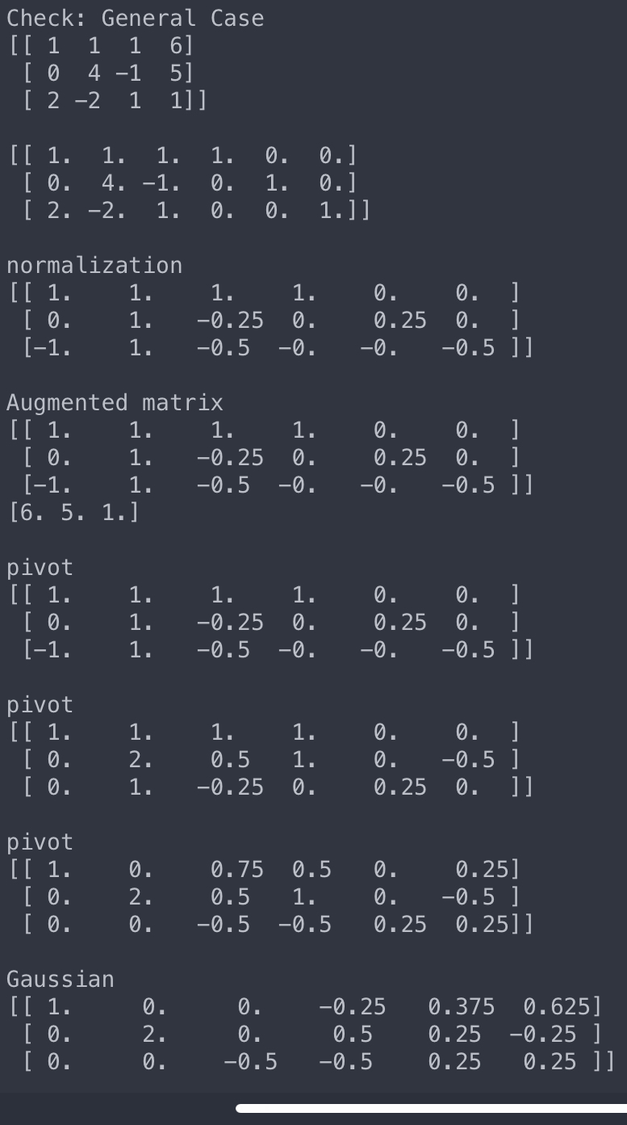
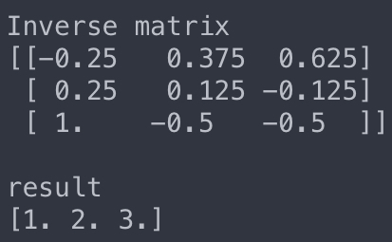

Slide 5
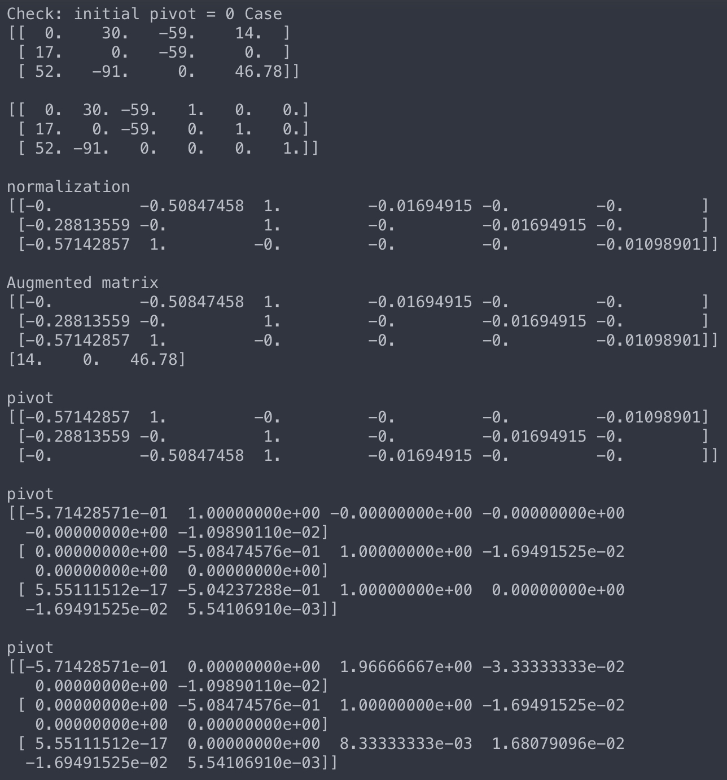
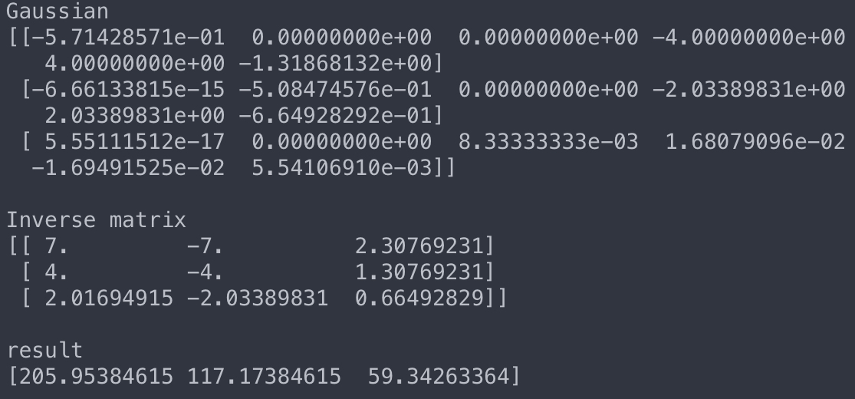

Slide 6
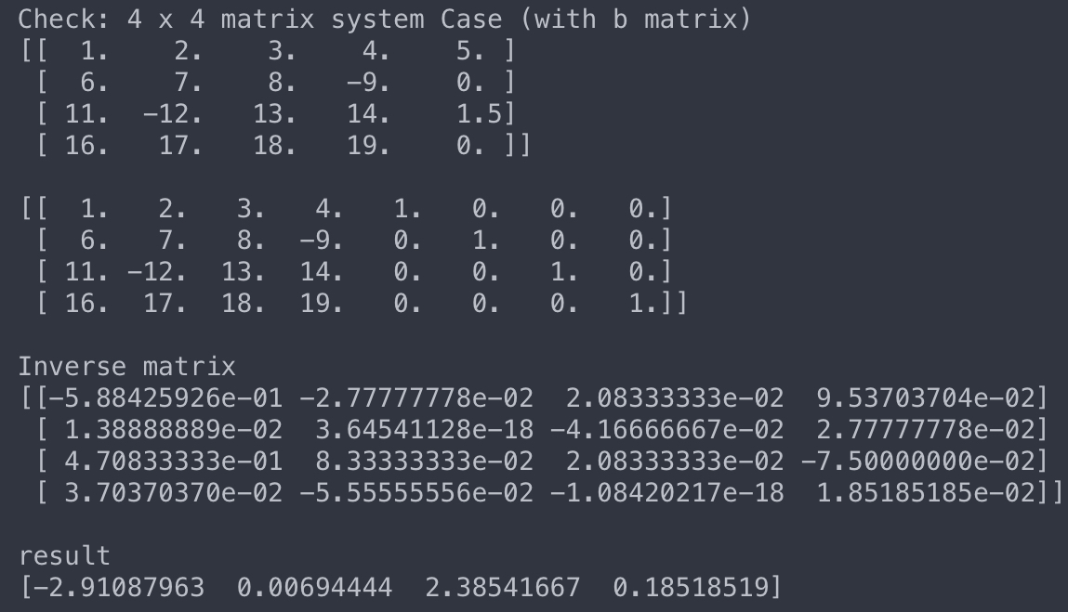
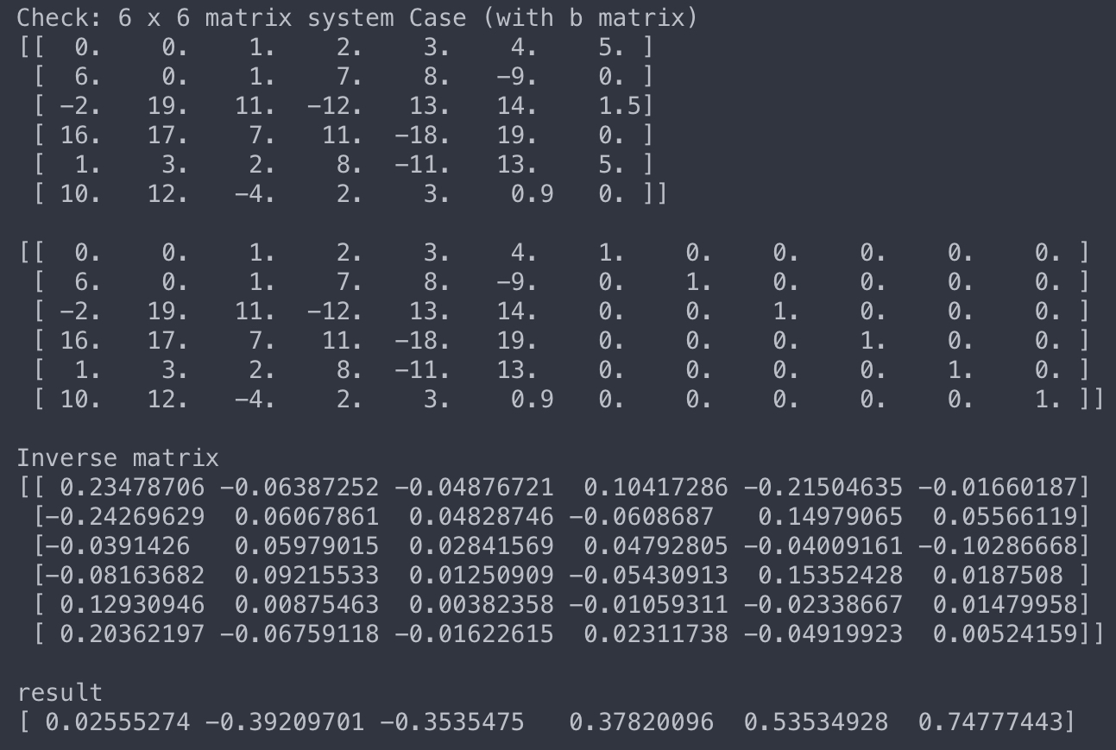

Slide 7
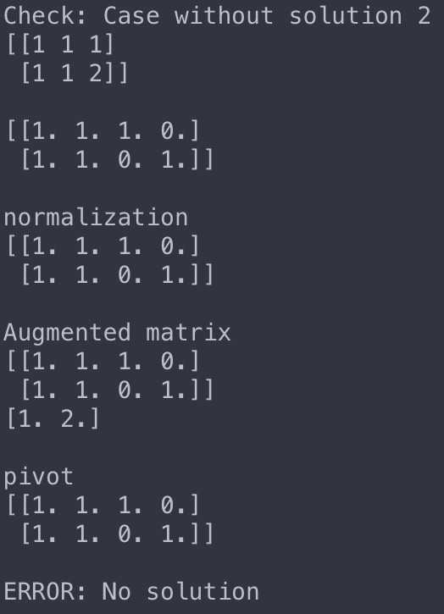

Slide 8
Conclusion of HW3
By using a Gauss-Jordan method, was able to develop a code that gives an inverse matrix of an arbitrarily given matrix (a. k. a linear equation system) and solve them.
Through various examples, was able to emphasize the performance of the Scaled Partial Pivoting successfully
For convenience, matrix was generated in the code. However, with “.loadtxt” function, can also read file and import matrix from outside

