Slide 1
Midterm Project
20100366 이원태

Slide 2
Previous HW6 – Liquid, FCC, BCC
Enthalpy of Mixing – Liquid phase
L1 = 0 이면 Regular solution
L1 ≠ 0 이면 Sub regular solution
Activity – Liquid phase
Linear Regression을 하기 위해 y = ax+b꼴로 만들어 줘야 함

Slide 3
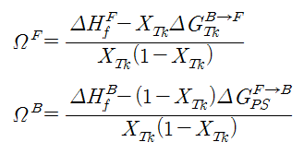
Previous HW6 – Liquid, FCC, BCC
Enthalpy of Mixing and Formation – Liquid & FCC & BCC phase
$$∆{G_{l}}^{}=RT\left(X_{Ps}lnX_{Ps}+X_{Tk}lnX_{Tk}\right)+[X_{Ps}{G^{0}}_{Ps}+X_{Tk}{{ΔG}^{0}}_{Tk}+Ω^{L}X_{Ps}X_{Tk}]$$
$$∆H_{}^{M}$$
$$∆{G_{F}}^{}=RT\left(X_{Ps}lnX_{Ps}+X_{Tk}lnX_{Tk}\right)+[X_{Ps}G_{Ps}^{F→F}+X_{Tk}{ΔG}_{Tk}^{B→F}{+Ω}^{F}X_{Ps}X_{Tk}]$$
$$∆H_{f}^{F}$$
$$∆{G_{B}}^{}=RT\left(X_{Ps}lnX_{Ps}+X_{Tk}lnX_{Tk}\right)+[X_{Tk}G_{Tk}^{B→B}+X_{Ps}G_{Ps}^{F→B}+Ω^{B}X_{Ps}X_{Tk}]$$
$$∆H_{f}^{B}$$

Slide 4
Previous HW6 – Liquid, FCC, BCC
Chemical potential of Liquid & FCC & BCC
$$μ_{Ps}^{L}=RTlna_{Ps}^{L}=ΔG_{Ps}^{F→L}+RTln(1−X_{Tk}^{F})+[(L_{0}+L_{1}(2X_{Tk}^{F}−1)]{(X_{Tk}^{F})}^{2}$$
$$μ_{Tk}^{L}=RTlna_{Tk}^{L}=ΔG_{Tk}^{B→L}+RTln(X_{Tk}^{F})+[L_{0}+L_{1}∗2X_{Tk}^{F}]{(1−X_{Tk}^{F})}^{2}$$
$$μ_{Ps}^{F}=RTlna_{Ps}^{F}=ΔG_{Ps}^{F→F}+RTln(1−X_{Tk}^{F})+[(L_{0}+L_{1}(2X_{Tk}^{F}−1)]{(X_{Tk}^{F})}^{2}$$
$$μ_{Tk}^{F}=RTlna_{Tk}^{F} =ΔG_{Tk}^{B→F}+RTln(X_{Tk}^{F})+[L_{0}+L_{1}∗2X_{Tk}^{F}]{(1−X_{Tk}^{F})}^{2}$$
$$μ_{Ps}^{B}=RTlna_{Ps}^{B}=ΔG_{Ps}^{F→B}+RTln(1−X_{Tk}^{B})+[(L_{0}+L_{1}(2X_{Tk}^{B}−1)]{(X_{Tk}^{B})}^{2}$$
$$μ_{Tk}^{B}=RTlna_{Tk}^{B}=ΔG_{Tk}^{B→B}+RTln(X_{Tk}^{B})+[(L_{0}+L_{1}(2X_{Tk}^{B})]{(1−X_{Tk}^{B})}^{2}$$

Slide 5
Result
$$Ω^{L}=14894.230619 −7.991374T+\left(−4794.925467 −0.011238T\right)X_{Tk}$$
$Ω^{F}=12597.609462 −5.000808T+(−7199.977924+0.004399T)$ $X_{Tk}$
$$Ω^{B}=6999.023386 −3.998341T$$

Slide 6
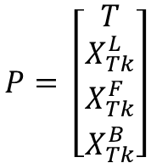

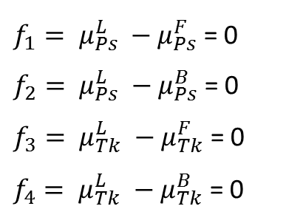
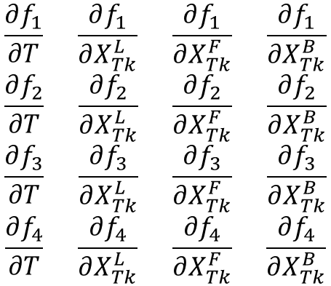
Midterm – Binary Phase diagram
$$μ_{Ps}^{L}=μ_{Ps}^{F}=μ_{Ps}^{B}$$
Find Athermal reaction point
$$μ_{Tk}^{L}=μ_{Tk}^{F}=μ_{Tk}^{B}$$
HW4 : Newton method
$$\frac{∂f_{1}}{∂T} \frac{∂f_{1}}{∂X_{Tk}^{L}} \frac{∂f_{1}}{∂X_{Tk}^{F}} \frac{∂f_{1}}{∂X_{Tk}^{B}}$$
$$\frac{∂f_{2}}{∂T} \frac{∂f_{2}}{∂X_{Tk}^{L}} \frac{∂f_{2}}{∂X_{Tk}^{F}} \frac{∂f_{2}}{∂X_{Tk}^{B}}$$
$$\frac{∂f_{3}}{∂T} \frac{∂f_{3}}{∂X_{Tk}^{L}} \frac{∂f_{3}}{∂X_{Tk}^{F}} \frac{∂f_{3}}{∂X_{Tk}^{B}}$$
$$\frac{∂f_{4}}{∂T} \frac{∂f_{4}}{∂X_{Tk}^{L}} \frac{∂f_{4}}{∂X_{Tk}^{F}} \frac{∂f_{4}}{∂X_{Tk}^{B}}$$
$f_{1}= μ_{Ps}^{L} −μ_{Ps}^{F}$ = 0
$f_{2}= μ_{Ps}^{L} −μ_{Ps}^{B}$ = 0
$f_{3}= μ_{Tk}^{L} −μ_{Tk}^{F}$ = 0
$f_{4}= μ_{Tk}^{L} −μ_{Tk}^{B}$ = 0
$$F= \left[\begin{aligned}f_{1} \\ f_{2} \\ f_{3} \\ f_{4}\end{aligned}\right]$$
$$P= \left[\begin{aligned}T \\ X_{Tk}^{L} \\ X_{Tk}^{F} \\ X_{Tk}^{B}\end{aligned}\right]$$
J =

Slide 7
Midterm – Key code
Athermal reaction temperature = 715.144956K
Temperature range
Liquid – FCC : 715K<T<1300K(Ps melting temp : 1250K)
Liquid – BCC : 600K<T<715K(Tk melting temp : 600K)
FCC – BCC : T<715K

Slide 8
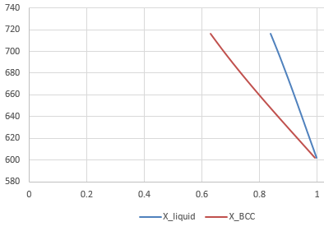
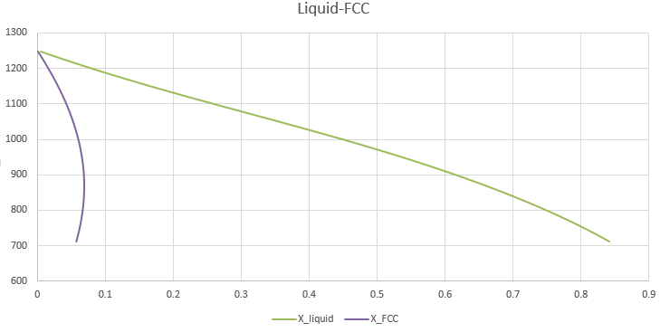
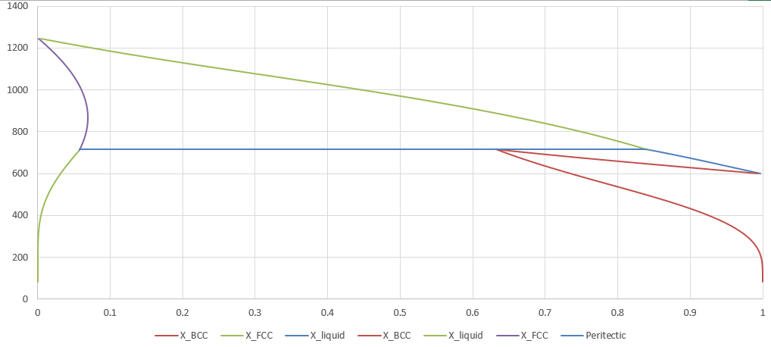
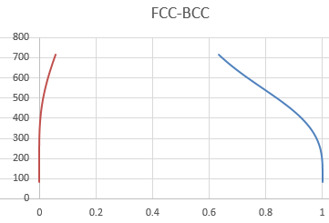
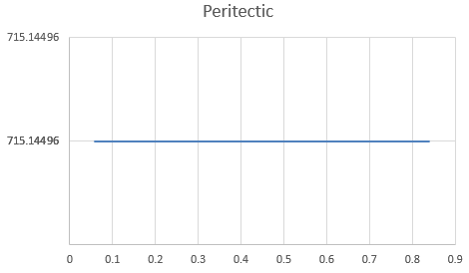
Liquid - BCC

Slide 9
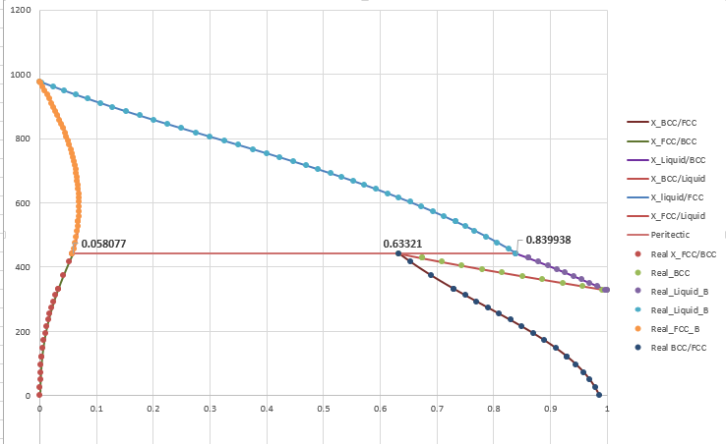

Slide 10
Conclusion
Liquid FCC BCC의 L parameter와 주어진 Data(Enthalpy, Activity, Gibbs energy)를 이용하여 Ps-Tk phase diagram을 그릴 수 있다.
특정 phase의 Gibbs Energy, Enthalpy, Activity의 정보를 알고 있다면 이를 이용하여 특정 syste의 phase diagram을 그릴 수 있다!!
Thank you!!

