Slide 1
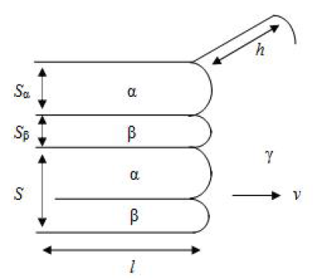
Problem 4-1
20152027 조민국
Why the tip of each layer has a curvature?
Estimate the radius of curvature for each layer as a function of layer thickness
Show that the free energy of the capillarity effect is same as the interfacial energy
The curvature is balance between surface tension and surface energy in local equilibrium.
$$γ_{α}\cos{θ_{α}}+γ_{β}\cos{θ_{β}}=γ_{αβ}$$
$$γ_{α}\sin{θ_{α}}=γ_{β}\sin{θ_{β}}$$
If the tip has a constant curvature,
$$r_{α}cosθ_{α}=\frac{S_{α}}{2}$$
$$r_{β}cosθ_{β}=\frac{S_{β}}{2}$$
γ_{α}
$$∴$$
$$r_{α}=\frac{S_{α}γ_{α}γ_{αβ}}{{γ_{αβ}}^{2}+{γ_{α}}^{2}−{γ_{β}}^{2}}$$
$$r_{β}=\frac{S_{β}γ_{β}γ_{αβ}}{{γ_{αβ}}^{2}+{γ_{β}}^{2}−{γ_{α}}^{2}}$$
γ_{αβ}
θ_{α}
θ_{β}
γ_{β}
Length of tip growth = $δ$
$∆G_{capillarity}\left(S\right)=\frac{γ_{α}}{r_{α}}S_{α}hδ+\frac{γ_{β}}{r_{β}}S_{β}hδ =hδ\left(\frac{{γ_{αβ}}^{2}+{γ_{α}}^{2}−{γ_{β}}^{2}}{γ_{αβ}}+\frac{{γ_{αβ}}^{2}+{γ_{β}}^{2}−{γ_{α}}^{2}}{γ_{αβ}}\right)$ $=hδ\left(2γ_{αβ}\right)$
$$∆G_{intereface}\left(S\right) =hδ\left(2γ_{αβ}\right)$$
$${∴ ∆G}_{capillarity}\left(S\right)=∆G_{intereface}\left(S\right)$$

Slide 2
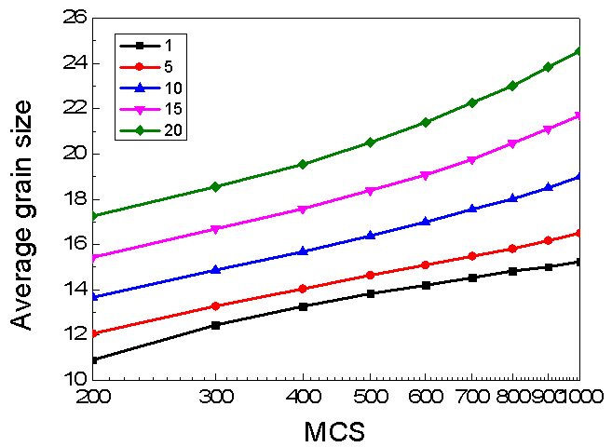
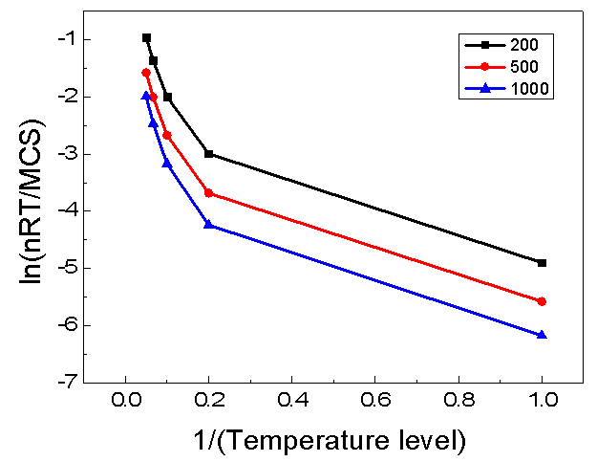
Problem 4-2
20152027 조민국
Initial # of grains : 512000
T_level | 1 | 5 | 10 | 15 | 20
n | 0.138 | 0.200 | 0.278 | 0.360 | 0.414
$$\frac{d\overline{R}}{dt}=λν_{0}e^{−\frac{ΔG^{∗}}{RT}}\left(1−e^{−\frac{ΔG_{df}}{RT}}\right)=nkt^{n−1}=\frac{n\overline{R}}{t}$$
$$\ln\left(\frac{n\overline{R}T}{t}\right)=\ln{C}−\frac{ΔG^{∗}}{RT}$$
MCS | 200 | 400 | 600 | 800 | 1000
$ΔG^{∗}$/R | 20.5 | 21.2 | 22.1 | 22.7 | 23.2
The activation energy is increased
as high temperature level and time duration.

