Slide 1
AMSE318 HW6 with python
49004547 Seokjee SHIN

Slide 2
HW6-1 Midpoint, trapezoidal, Simpson methods
$$f\left(x\right)=0.2+25x −200x^{2}+675x^{3}−900x^{4}+400x^{5}$$
$x=\left[0,0.8\right]$ & Answer = 1.64053334
 | Midpoint |  | Trapezoidal |  | Simpson
n | Result | error | Result | error | Result | error
3 | 1.770956 | 7.950035e-2 | 1.369574 | 1.651656e-1 | 5.478311e-1 | 6.660762e-1
25 | 1.642579 | 1.246842e-3 | 1.636440 | 2.495085e-3 | 1.613411 | 1.653256e-2
50 | 1.641045 | 3.119598e-4 | 1.639510 | 6.241213e-4 | 1.640533 | 4.667490e-7
100 | 1.640661 | 7.797694e-5 | 1.640277 | 1.560808e-4 | 1.640533 | 6.726918e-8
From given methods, all of them had decrease in error with increase of n value which indicate the size of sub-intervals. Overall, the Simpson method is the most accurate method.

Slide 3
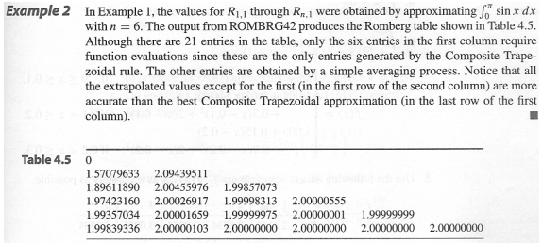
HW6-2 Romberg method

Slide 4
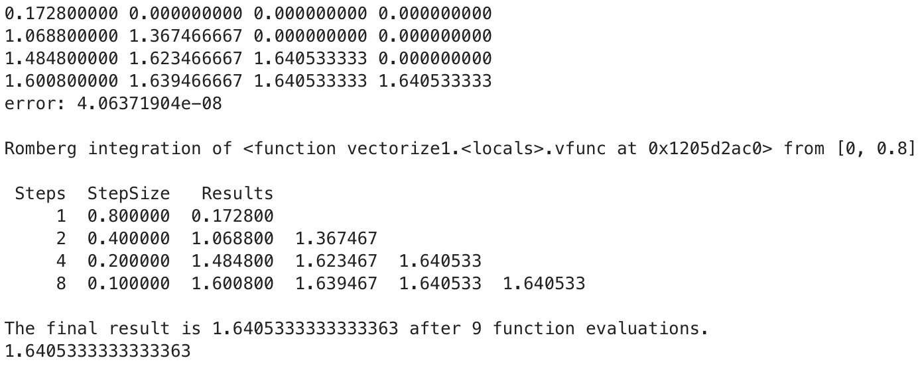
HW6-2 Romberg method
$$f\left(x\right)=0.2+25x −200x^{2}+675x^{3}−900x^{4}+400x^{5}$$
$x=\left[0,0.8\right]$ & Answer = 1.64053334
Result of the code
Built-in function for Romberg integration

Slide 5
Conclusion of HW6
Among Midpoint; Trapezoidal; and Simpson methods, the Simpson method had exponential decrease with decrease of sub-interval differences. Overall, decrease of sub-interval difference increased the accuracy of the result.
Still, the Romberg method is the most accurate and efficient method for integration as it needs the least amount of iteration with smallest error value.

