Slide 1
재료수치해석 midterm-revised
20100098 최원미

Slide 2
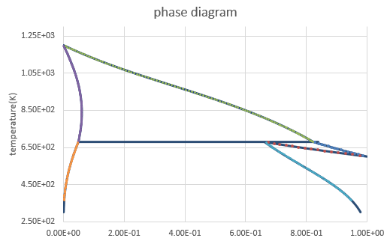
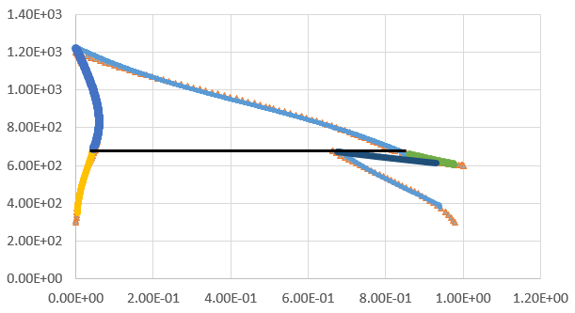
result,
Tk-Ps phase diagram
liquid
liquid
FCC
FCC+liquid
FCC
FCC+liquid
Liquid+BCC
Liquid+BCC
BCC+FCC
BCC
BCC
BCC+FCC

