Slide 1
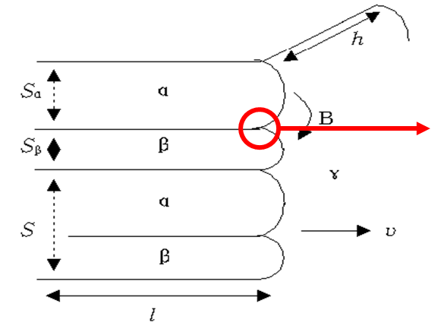
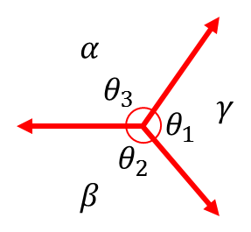
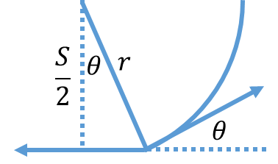

(a)
(b)
(c)
There is interface between $α$ and $β$ → $γ_{αβ}≠0$
$θ_{1}=0 only if γ_{αβ}=0$ → $θ_{1}≠0$
Always curvature must be exist for force balance
$$r_{α}cosθ_{α}=\frac{S_{α}}{2}$$
$$r_{β}cosθ_{β}=\frac{S_{β}}{2}$$
$γ_{αβ}={cosθ_{α}γ}_{α}$+$cosθ_{β}γ_{β}$
${sinθ_{α}γ}_{α}$=${sinθ_{β}γ}_{β}$
$$γ_{α}$$
$$γ_{αβ}$$
$$r_{α}=\frac{S_{α}γ_{α}γ_{αβ}}{{γ_{αβ}}^{2}+{γ_{α}}^{2}−{γ_{β}}^{2}}$$
$$r_{β}=\frac{S_{β}γ_{β}γ_{αβ}}{{γ_{αβ}}^{2}+{γ_{β}}^{2}−{γ_{α}}^{2}}$$
$$∆G=∆\left(PV\right)=γ\left(\frac{1}{r_{1}}+\frac{1}{r_{2}}\right)V_{m}=\frac{γV_{m}}{r}$$
$$∆G=∆G_{α}+∆G_{β}=\frac{γ_{α}V_{m}^{α}}{r_{α}}\frac{S_{α}}{S}+\frac{γ_{β}V_{m}^{β}}{r_{β}}\frac{S_{β}}{S}$$
$$=\frac{V_{m}^{α}({γ_{αβ}}^{2}+{γ_{α}}^{2}−{γ_{β}}^{2})}{Sγ_{αβ}}+\frac{V_{m}^{β}{{(γ}_{αβ}}^{2}−{γ_{α}}^{2}+{γ_{β}}^{2})}{Sγ_{αβ}}=\frac{2γ_{αβ}V_{m}^{L}}{S}$$
If there is no molar volume change, then, $V_{m}^{α}=V_{m}^{β}=V_{m}^{L}$

Slide 2
Grain growth simulation
Initial # of grains = 512000, GB energy anisotropy level = 0
(a) Time-dependence of $\overline{R}$
(b) Temperature-dependence of $\overline{R}$
(Cumulative offset of $\overline{R}=2$ for clearance)
$$\frac{d\overline{R}}{dt}=λν_{0}e^{−\frac{ΔG^{∗}}{RT}}\left(1−e^{−\frac{ΔG_{df}}{RT}}\right)=nkt^{n−1}=\frac{n\overline{R}}{t}$$
$$\ln\left(\frac{n\overline{R}T}{t}\right)=\ln{C}−\frac{ΔG^{∗}}{RT}$$
$\overline{R}$ = k$t^{n}$ → $\log{\overline{R}}=n log{t}+\log{k}$
k = constant
T_level | 1 | 5 | 10 | 15 | 20
n | 0.137 | 0.199 | 0.279 | 0.361 | 0.413
MCS | 200 | 400 | 600 | 800 | 1000
$ΔG^{∗}$/R | 20.6 | 21.2 | 22 | 22.8 | 23.3
(for temperature level = 20, 15 10)

