Slide 1
Regression
Enthalpy of Mixing and Activity
Seungpyo Hong
Flow Physics and Engineering Lab.
Department of Mechanical Engineering
POSTECH

Slide 2
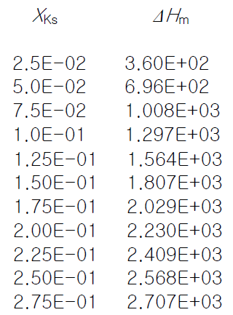
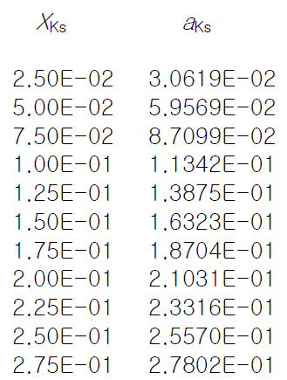
Problem
Minimizing sum of squares of deviation of given data.
Two sets of data points are given.
(i.e. Enthalpy of mixing and activity )

Slide 3
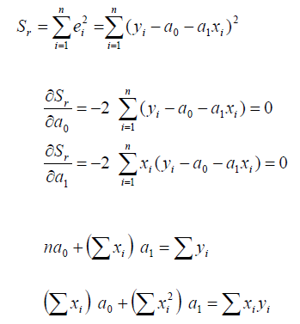
Formulation
Correlation coefficient

Slide 4
Structure of the program
PROGRAM Regression
END PROGRAM Rigression
Read the Enthalpy of Mixing, Activity data, and reference temp
Allocate arrays
2
1
Solve linear equation
4
3
Solve linear equation
5
Obtain correlation coefficient
Write output file and deallocate arrays

Slide 5
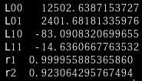
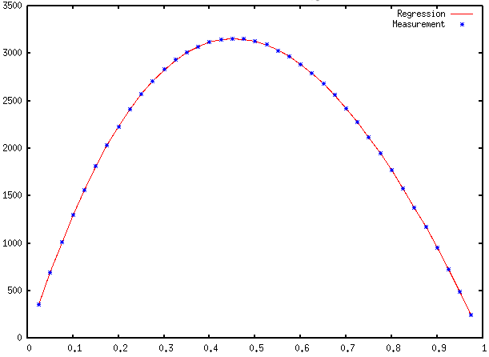
Results

Slide 6
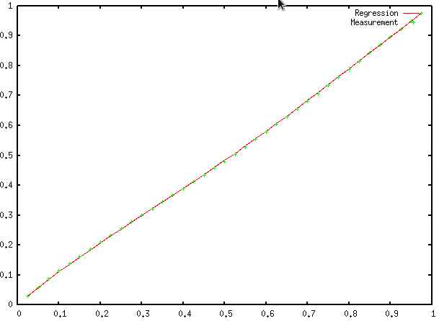
Results

