Slide 1
소재수치해석 HW#8
대학원 20162548 신소재공학과
김진수

Slide 2
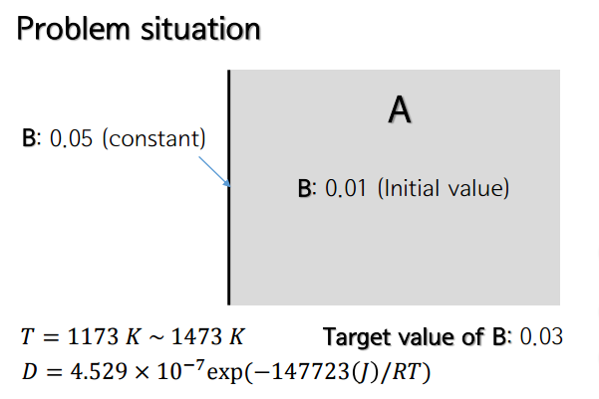
Problem

Slide 3
Code
do j=1, timestep
w(1,j) = 0.05 ! boundary condition
w(n,j) = 0.01 ! boundary condition
end do
do i=1, n
w(i,1) = 0.01 ! initial condition
end do
R=8.314
D=4.529*10e-7*exp(-147723/(R*T))
!length=n*dx
dx=dx*1e-6
lamda = D*dt/((dx)*(dx))
print*, "lamda= ", lamda
allocate(A(n,n))
allocate(w(n,timestep))
do j=1, timestep-1
do i=2, n-1
dummy = 0
do k=1,n
dummy = dummy + A(i,k)*w(k,j)
end do
w(i,j+1) = dummy
end do
if(w(i,j+1) < 0.01) then
w(i,j+1) = 0.01
exit
end if
end do
! set matrix A
A=0
do i=1,n
do j=1, n
if(i==j) then
A(i,j) = 1-2*lamda
else if (j==i+1 .OR. j==i-1) then
A(i,j) = lamda
end if
end do
end do
! set matrix A
Notes:
program FDM
implicit none
double precision, allocatable, dimension(:,:) :: A,w
double precision :: T,lam,dt,dx,D,length,R,Total_time,lamda,dummy
integer :: i,j,k,timestep,n
print*, "Input temperature (K): "
read*, T
print*, "Input time steps: "
read*, timestep
print*, "Input delta_t (s): "
read*, dt
print*, "Input the dx (um): "
read*, dx
print*, "Input the number of grid: "
read*, n
length=n*dx
Total_time=timestep*dt
print*, "FDM simulation begins: "
print*, "Total time = ", Total_time, "(s)"
print*, "Length = ", length, "(um)"
open(unit=10, file="concentration.txt", status='replace')
R=8.314
D=4.529*10e-7*exp(-147723/(R*T))
!length=n*dx
dx=dx*1e-6
lamda = D*dt/((dx)*(dx))
print*, "lamda= ", lamda
allocate(A(n,n))
allocate(w(n,timestep))
! set matrix A
A=0
do i=1,n
do j=1, n
if(i==j) then
A(i,j) = 1-2*lamda
else if (j==i+1 .OR. j==i-1) then
A(i,j) = lamda
end if
end do
end do
! set matrix A
do j=1, timestep
w(1,j) = 0.05 ! boundary condition
w(n,j) = 0.01 ! boundary condition
end do
do i=1, n
w(i,1) = 0.01 ! initial condition
end do
do j=1, timestep-1
do i=2, n-1
dummy = 0
do k=1,n
dummy = dummy + A(i,k)*w(k,j)
end do
w(i,j+1) = dummy
end do
if(w(i,j+1) < 0.01) then
w(i,j+1) = 0.01
exit
end if
end do
dx=dx*1e+6
write(10,*) "t= ", Total_time
write(10,*) "x (um) ", "Concentraton:"
do i=1,n
write(10,*) dx*i, w(i,timestep)
end do
end program FDM

Slide 4
(a) How does the injection distance (x) depend on injection time?
dt=0.01s, dx=2um
$$x ∝ \sqrt{t}$$

Slide 5
(b) How does the injection distance (x) depend on temperature?
dt=0.01s, dx=2um
$$x=\sqrt{Dt}=\sqrt{D_{0}\exp\left(−\frac{Q}{RT}\right)t} →x^{2}=D_{0}\exp\left(−\frac{Q}{RT}\right)t →\ln{x^{2}=\ln{D_{0}t}−\frac{Q}{RT}}$$

Slide 6
(c) How can you determine the activation energy for the reaction, and what is it?
Activation energy for reaction = Activation energy for diffusion $∵$ Diffusion controlled reaction
$$\ln{x^{2}=\ln{D_{0}t}−\frac{Q}{RT}}$$
t (s) | Q (J/mol)
50 | 140016
100 | 145121
500 | 136566
1000 | 144830
 | Average: 141633
문제에서 주어진 Q 값: 147723 J/mol. 상대오차: 4.12%. 오차의 원인은 x 값을 정확히 측정하지 못했기 때문.

