Slide 1
AMSE 318 Numerical Methods
Homework #5
non-linear equation system
2013/10/08
Jongwon, Lee

Slide 2
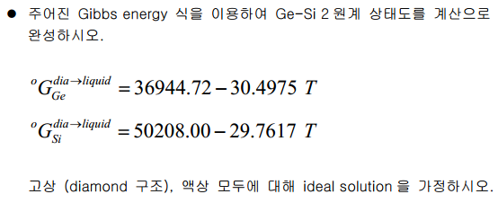
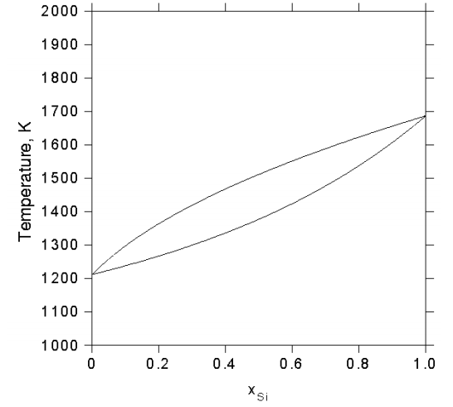
Assignment
Notes:
The first article is from applied physics letters and it published 21 June
The title is 282nm AlGaN-based DUV LEDs with improved performance on nano-patterned sapphire substrate.

Slide 3
Basic Thermo-dynamics
→ Using this equation to get chemical potential difference between liquid phase and solid phase on Si and Ge
Diamond is used as a reference phase

Slide 4
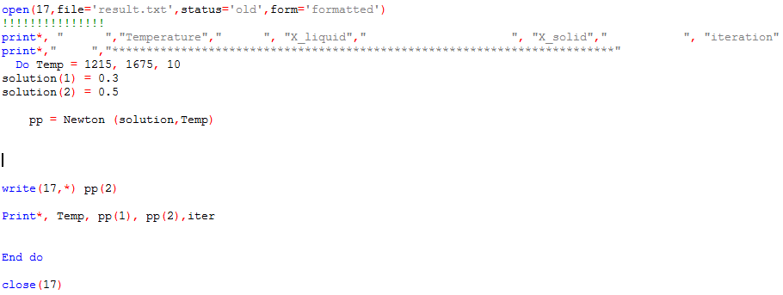
Fortran Code
→ Open Text file ‘result.txt’
→ Set temperature 1215K to 1675K, Step: 10K
→ Set initial value of p1 (Controllable)
pp is final value (x_liquid, x_solid) at some temperature
Write the results on text file

Slide 5
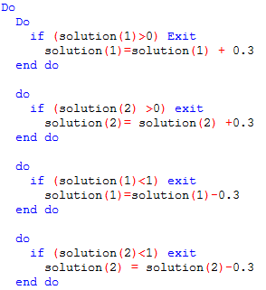
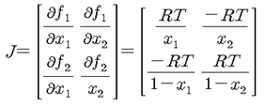
Fortran Code
Function part
Check
Check, Make components to be 0<x1,x2<1

Slide 6
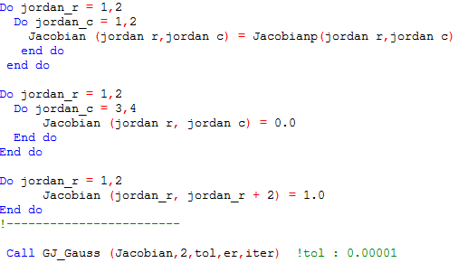
Fortran Code
Make augmented matrix and Call gauss-jordan method (get inverted matrix)

Slide 7
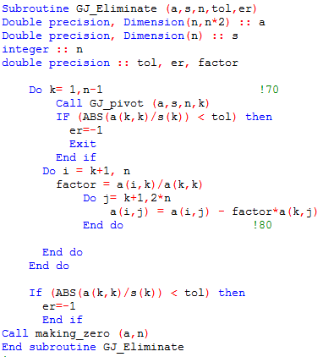
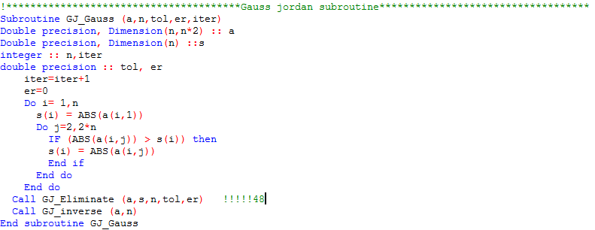
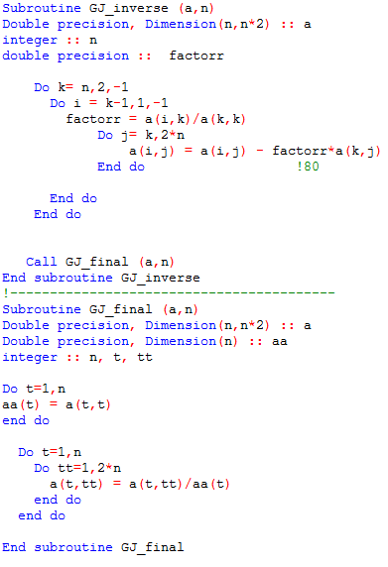
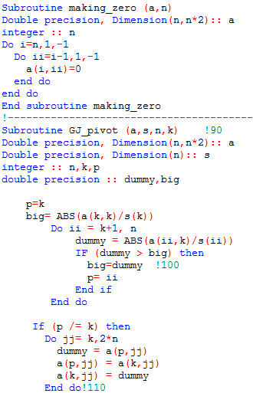
Fortran Code
Gauss jordan Subroutine

Slide 8
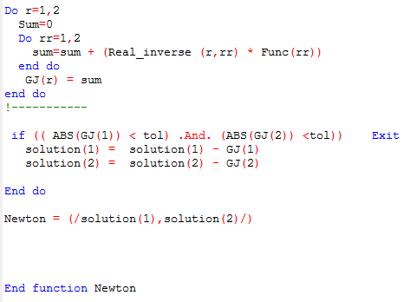
Fortran Code
Calculate
GJ
If GJ < tol (0.00001) then → END newton function

Slide 9
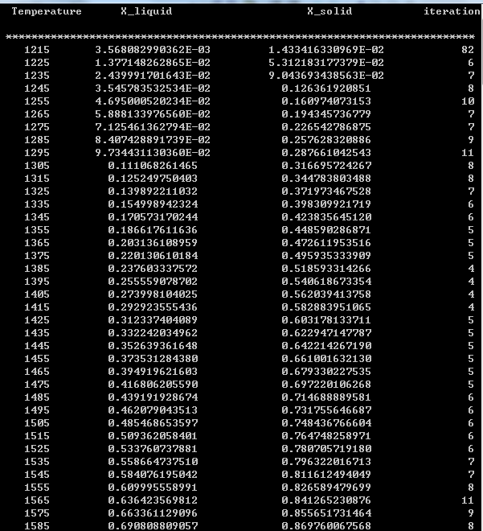
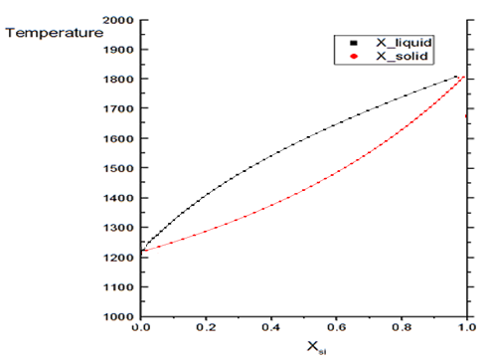
Results

Slide 10
Discussion (tolerance)
Tol=0.00001
10^-5
Tol=0.000001
10^-6
Tol=0.0000001
10^-7
Tol=0.00000000001
10^-11
Iteration depends on the tolerance

Slide 11
Discussion (initial value)
X1=0.3
X2=0.5
X1=0.01
X2=0.99
X1=0.0001
X2=0.0002
X1=0.000001
X2=0.999999
→Worst
X1=0.2
X2=0.8
→ Best
Iteration depends on the Initial value

