Slide 1
소재수치해석 과제 # 4: 비선형 연립 방정식
Kyungmi Noh (*Email :{nkyungmi}@postech.ac.kr)
Department of Materials Science and Engineering, POSTECH
AI & NEUROMORPHIC DEVICE LAB

Slide 2
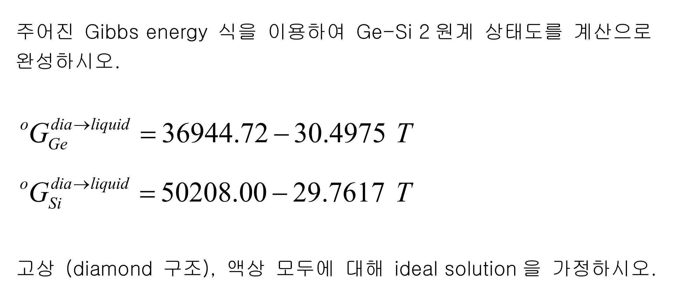
1. Problem given
$$L^{p}=0$$
AI & NEUROMORPHIC DEVICE LAB

Slide 3
2. Equations
[given]
$$x_{Ge}=1 −x_{Si}$$
[formulation]
$${f_{1}\left(x_{liq},x_{dia}\right)= μ}_{Si}^{liq}−μ_{Si}^{dia}=\dot{Δ}G_{Si}^{dia→liquid}+RTln\left(\frac{x_{liq}}{x_{dia}}\right)=0$$
$${f_{2}\left(x_{liq},x_{dia}\right)= μ}_{Ge}^{liq}−μ_{Ge}^{dia}=\dot{Δ}G_{Ge}^{dia→liquid}+RTln\left(\frac{1−x_{liq}}{{ 1−x}_{dia}}\right)$$
$$μ_{Si}^{liq}−μ_{Si}^{dia}=0$$
$$μ_{Ge}^{liq}−μ_{Ge}^{dia}=0$$
AI & NEUROMORPHIC DEVICE LAB

Slide 4
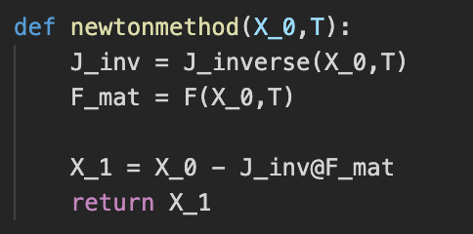
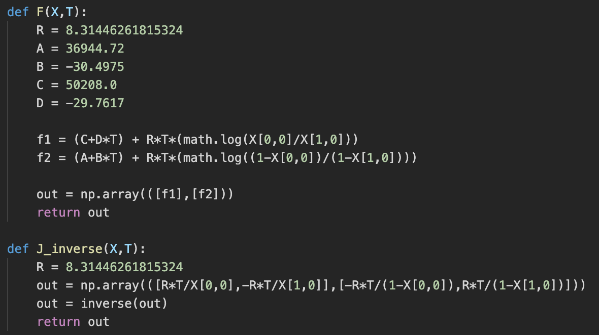
3. Method
Newton Method
,where
$$P_{k}= \left[\begin{matrix}x_{liq_{k}} \\ x_{dia_{k}}\end{matrix}\right]$$
$J\left(P_{k}\right)=\left[\begin{matrix}\frac{∂f_{1}}{∂x_{liq}} & \frac{∂f_{1}}{∂x_{dia}} \\ \frac{∂f_{2}}{∂x_{liq}} & \frac{∂f_{2}}{∂x_{dia}}\end{matrix}\right]$ = $\left[\begin{matrix}\frac{RT}{x_{liq}} & \frac{−RT}{x_{dia}} \\ \frac{−RT}{1−x_{liq}} & \frac{RT}{1−x_{dia}}\end{matrix}\right]$
$$F\left(P_{k}\right)= \left[\begin{matrix}{f_{1}(x}_{liq_{k}},x_{dia_{k}}) \\ {f_{2}(x}_{liq_{k}},x_{dia_{k}})\end{matrix}\right]$$
AI & NEUROMORPHIC DEVICE LAB

Slide 5
3. Method
Newton Method
[Iteration]
for given T (1212~1687, 600 points),
for given iteration time,
P_k = newton method(P_(k-1))
if any item of P_k is larger than 1 or smaller than 0,
reset P_k with random number
if Euclidean distance of P_k & P_(k-1) < threshold,
break
else
P_(k-1) = P_k
,where
$$P_{k}= \left[\begin{matrix}x_{liq_{k}} \\ x_{dia_{k}}\end{matrix}\right]$$
$J\left(P_{k}\right)=\left[\begin{matrix}\frac{∂f_{1}}{∂x_{liq}} & \frac{∂f_{1}}{∂x_{dia}} \\ \frac{∂f_{2}}{∂x_{liq}} & \frac{∂f_{2}}{∂x_{dia}}\end{matrix}\right]$ = $\left[\begin{matrix}\frac{RT}{x_{liq}} & \frac{−RT}{x_{dia}} \\ \frac{−RT}{1−x_{liq}} & \frac{RT}{1−x_{dia}}\end{matrix}\right]$
$$F\left(P_{k}\right)= \left[\begin{matrix}{f_{1}(x}_{liq_{k}},x_{dia_{k}}) \\ {f_{2}(x}_{liq_{k}},x_{dia_{k}})\end{matrix}\right]$$
**Iteration time = 1000
Threshold = 1e-9
AI & NEUROMORPHIC DEVICE LAB

Slide 6
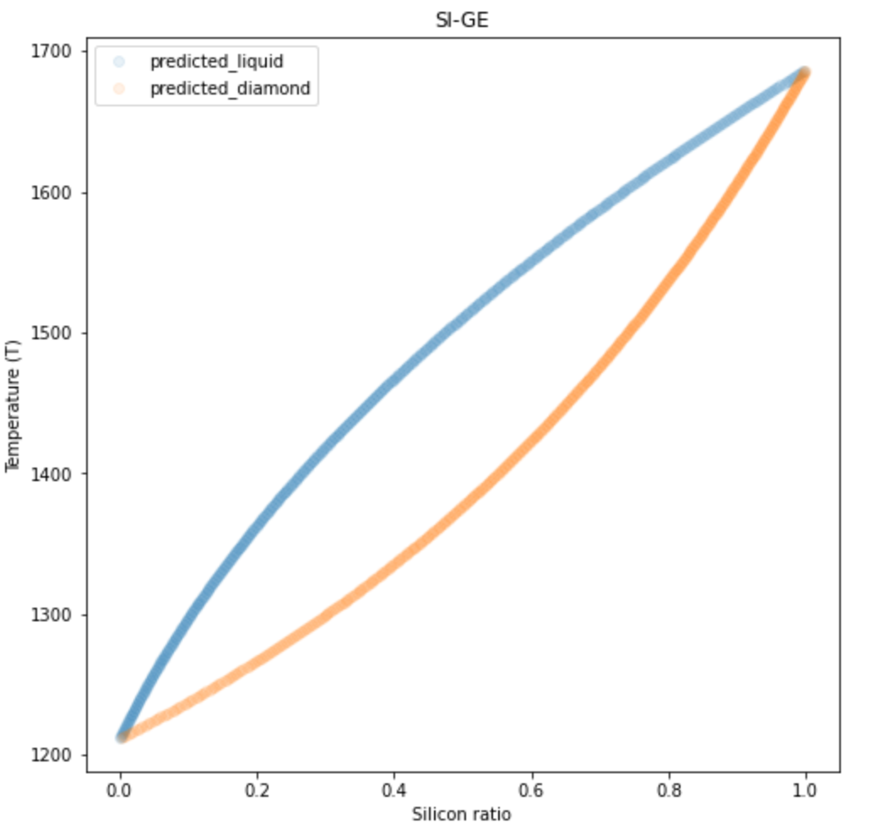
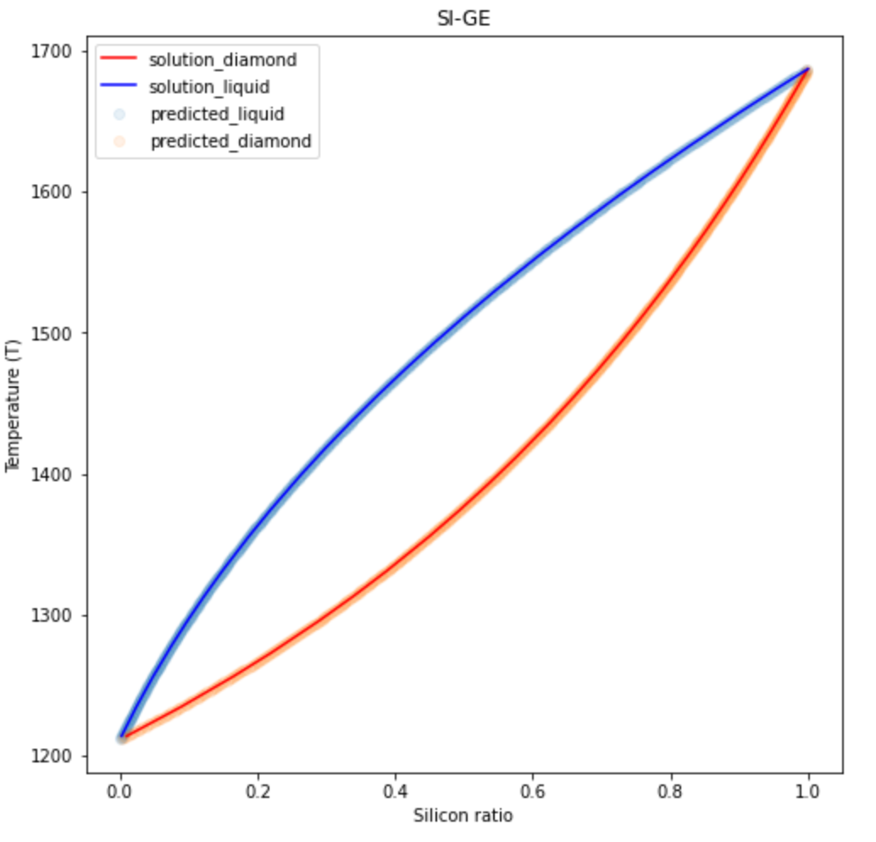
4. Result
AI & NEUROMORPHIC DEVICE LAB

