Slide 1
소재수치해석 Midterm
Kyungmi Noh (*Email :{nkyungmi}@postech.ac.kr)
Department of Materials Science and Engineering, POSTECH
AI & NEUROMORPHIC DEVICE LAB

Slide 2
1. Method
2개의 상을 비교하여
Chemical potential 등식 설립
Liquid – FCC / FCC – BCC / Liquid – BCC
상태도 그리기
Newton Method
L term 포함한 chemical potential 구하기
Ps-Ks 이원계 상태도
그리기
Eutectic point 찾기 위해 모든 Chemical potential 등식 설립
Eutectic point 찾기
Newton Method
AI & NEUROMORPHIC DEVICE LAB

Slide 3
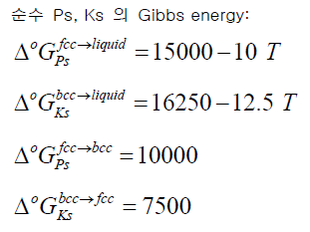
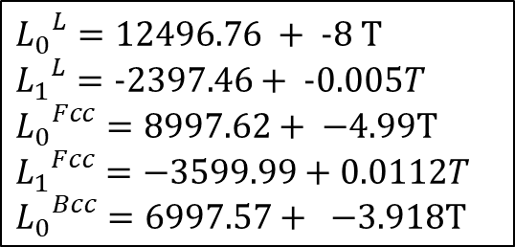
1. Equations
Chemical potentials
$${μ_{Ks}}^{L}=∆{G_{Ks}}^{Bcc→L}+RTlnx_{Ks}+{(1−x_{Ks})}^{2} \{{L_{0}}^{L}+ \left(4x_{Ks}−1\right)∗{L_{1}}^{L}\}$$
$${μ_{Ks}}^{Fcc}=∆{G_{Ks}}^{Bcc→Fcc}+RTlnx_{Ks}+{(1−x_{Ks})}^{2} \{{L_{0}}^{Fcc}+\left(4x_{Ks}−1\right)∗{L_{1}}^{Fcc}\}$$
$${μ_{Ks}}^{Bcc}=RTlnx_{Ks}+{(1−x_{Ks})}^{2} \{{L_{0}}^{Bcc}+\left(4x_{Ks}−1\right)∗{L_{1}}^{Bcc}\}$$
$${μ_{Ps}}^{L}=∆{G_{Ps}}^{Fcc→L}+RTln(1−x_{Ks})+{\left(x_{Ks}\right)}^{2} \{{L_{0}}^{L}+ \left(4x_{Ks}−3\right)∗{L_{1}}^{L}\}$$
$${L_{0}}^{L}=12496.76 + -8 T$$
$${L_{1}}^{L}=-2397.46+ -0.005T$$
$${L_{0}}^{Fcc}=8997.62+ −4.99T$$
$${L_{1}}^{Fcc}=−3599.99+0.0112T$$
$${L_{0}}^{Bcc}=6997.57+ −3.918T$$
$${μ_{Ps}}^{Fcc}=RTln(1−x_{Ks})+{\left(x_{Ks}\right)}^{2} \{{L_{0}}^{Fcc}+\left(4x_{Ks}−3\right)∗{L_{1}}^{Fcc}\}$$
$${μ_{Ps}}^{Bcc}=∆{G_{Ps}}^{Fcc→Bcc}+RTln(1−x_{Ks})+{\left(x_{Ks}\right)}^{2} \{{L_{0}}^{Bcc}+\left(4x_{Ks}−3\right)∗{L_{1}}^{Bcc}\}$$
AI & NEUROMORPHIC DEVICE LAB

Slide 4
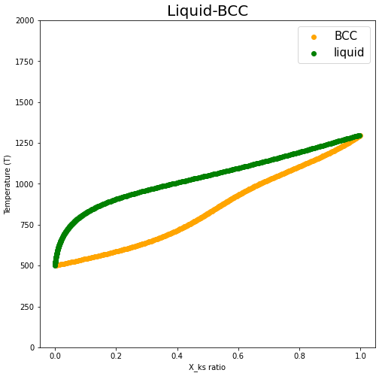
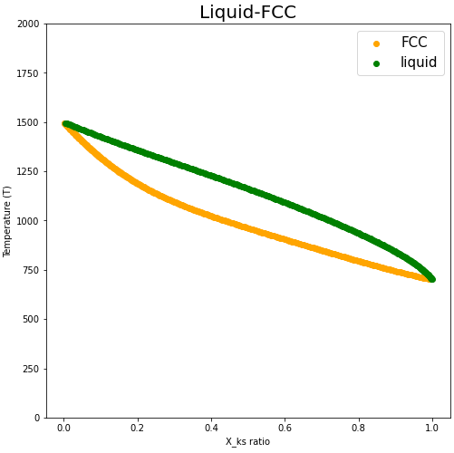
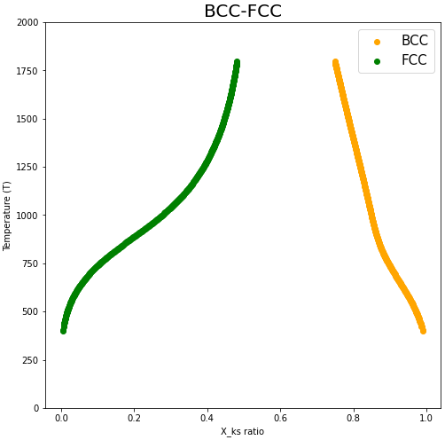
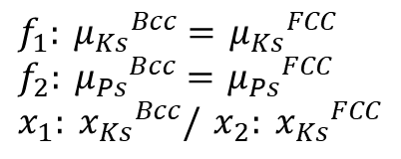
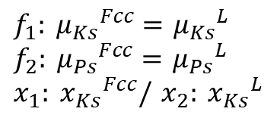

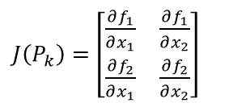
2. Equilibrium
$J\left(P_{k}\right)=\left[\begin{matrix}\frac{∂f_{1}}{∂x_{1}} & \frac{∂f_{1}}{∂x_{2}} \\ \frac{∂f_{2}}{∂x_{1}} & \frac{∂f_{2}}{∂x_{2}}\end{matrix}\right]$
$$F\left(P_{k}\right)= \left[\begin{matrix}{f_{1}(x}_{1},x_{2}) \\ {f_{2}(x}_{1},x_{2})\end{matrix}\right]$$
$f_{1}: {μ_{Ks}}^{Bcc}=$ ${μ_{Ks}}^{L}$
$f_{2}: {μ_{Ps}}^{Bcc}=$ ${μ_{Ps}}^{L}$
$x_{1}: {x_{Ks}}^{Bcc}/$ $x_{2}: {x_{Ks}}^{L}$
$f_{1}: {μ_{Ks}}^{Fcc}=$ ${μ_{Ks}}^{L}$
$f_{2}: {μ_{Ps}}^{Fcc}=$ ${μ_{Ps}}^{L}$
$x_{1}: {x_{Ks}}^{Fcc}/$ $x_{2}: {x_{Ks}}^{L}$
$f_{1}: {μ_{Ks}}^{Bcc}=$ ${μ_{Ks}}^{FCC}$
$f_{2}: {μ_{Ps}}^{Bcc}=$ ${μ_{Ps}}^{FCC}$
$x_{1}: {x_{Ks}}^{Bcc}/$ $x_{2}: {x_{Ks}}^{FCC}$
Liquid - BCC
Liquid - FCC
BCC - FCC
AI & NEUROMORPHIC DEVICE LAB

Slide 5
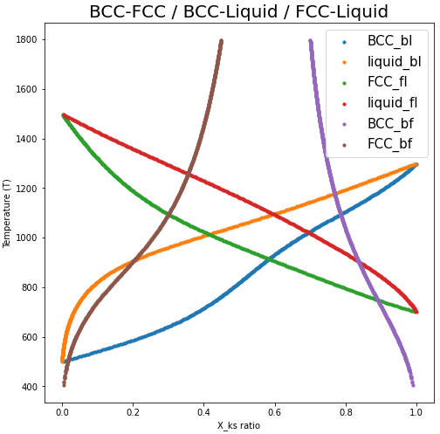
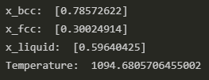
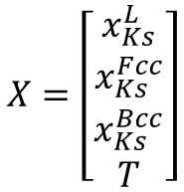
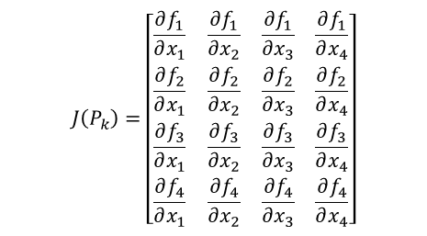
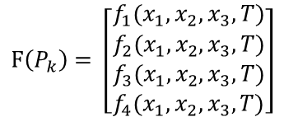
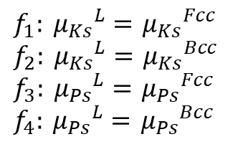
3. Eutectic Point
Equilibrium
$$J\left(P_{k}\right)=\left[\begin{matrix}\frac{∂f_{1}}{∂x_{1}} & \frac{∂f_{1}}{∂x_{2}} & \frac{∂f_{1}}{∂x_{3}} & \frac{∂f_{1}}{∂x_{4}} \\ \frac{∂f_{2}}{∂x_{1}} & \frac{∂f_{2}}{∂x_{2}} & \frac{∂f_{2}}{∂x_{3}} & \frac{∂f_{2}}{∂x_{4}} \\ \frac{∂f_{3}}{∂x_{1}} & \frac{∂f_{3}}{∂x_{2}} & \frac{∂f_{3}}{∂x_{3}} & \frac{∂f_{3}}{∂x_{4}} \\ \frac{∂f_{4}}{∂x_{1}} & \frac{∂f_{4}}{∂x_{2}} & \frac{∂f_{4}}{∂x_{3}} & \frac{∂f_{4}}{∂x_{4}}\end{matrix}\right]$$
$$F\left(P_{k}\right)= \left[\begin{matrix}{f_{1}(x}_{1},x_{2},x_{3},T) \\ \begin{aligned}{f_{2}(x}_{1},x_{2},x_{3},T) \\ {f_{3}(x}_{1},x_{2},x_{3},T) \\ {f_{4}(x}_{1},x_{2},x_{3},T)\end{aligned}\end{matrix}\right]$$
$f_{1}: {μ_{Ks}}^{L}=$ ${μ_{Ks}}^{Fcc}$
$f_{2}: {μ_{Ks}}^{L}=$ ${μ_{Ks}}^{Bcc}$
$f_{3}: {μ_{Ps}}^{L}=$ ${μ_{Ps}}^{Fcc}$
$f_{4}: {μ_{Ps}}^{L}=$ ${μ_{Ps}}^{Bcc}$
$$X=\left[\begin{matrix}x_{Ks}^{L} \\ x_{Ks}^{Fcc} \\ \begin{aligned}x_{Ks}^{Bcc} \\ T\end{aligned}\end{matrix}\right]$$
AI & NEUROMORPHIC DEVICE LAB

Slide 6
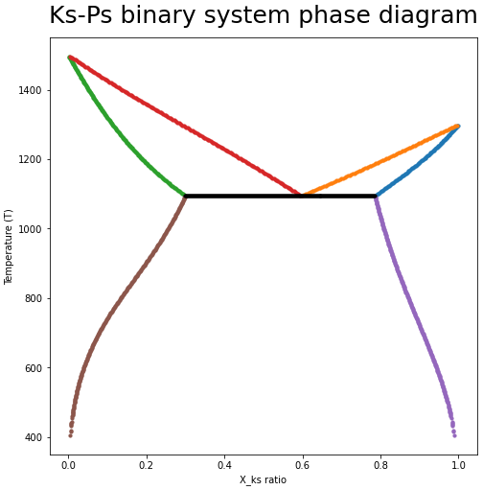
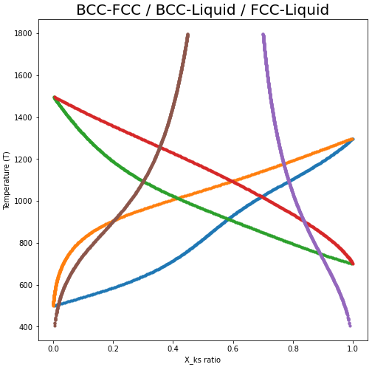
4. Phase Diagram
${x_{Ks}}^{fcc}$=0.30
${x_{Ks}}^{liq}$=0.59
${x_{Ks}}^{bcc}$=0.78
liquid
FCC + liquid
BCC + liquid
FCC
BCC
T=1094.68
BCC + FCC
AI & NEUROMORPHIC DEVICE LAB

