Slide 1
Midterm project
| 소재수치해석
Jaemin Wang
Computational Materials Science and Engineering Laboratory
POSTECH

Slide 2
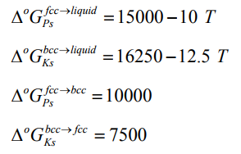
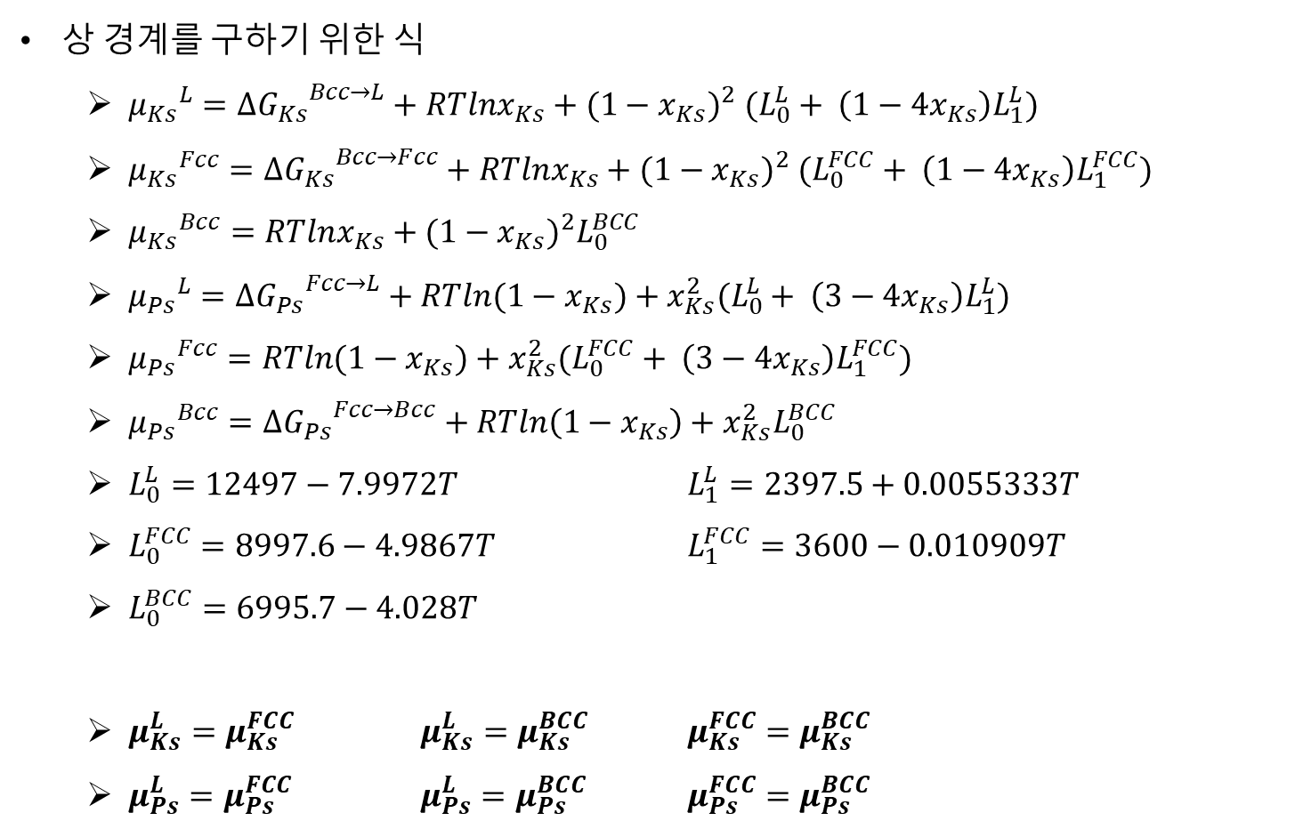
수식 요약
상 경계를 구하기 위한 식
${μ_{Ks}}^{L}=∆{G_{Ks}}^{Bcc→L}+RTlnx_{Ks}+{(1−x_{Ks})}^{2} (L_{0}^{L}+ \left(1−4x_{Ks}\right)L_{1}^{L})$
${μ_{Ks}}^{Fcc}=∆{G_{Ks}}^{Bcc→Fcc}+RTlnx_{Ks}+{(1−x_{Ks})}^{2} (L_{0}^{FCC}+ \left(1−4x_{Ks}\right)L_{1}^{FCC})$
${μ_{Ks}}^{Bcc}=RTlnx_{Ks}+{(1−x_{Ks})}^{2}L_{0}^{BCC}$
${μ_{Ps}}^{L}=∆{G_{Ps}}^{Fcc→L}+RTln(1−x_{Ks})+x_{Ks}^{2}(L_{0}^{L}+ \left(3−4x_{Ks}\right)L_{1}^{L})$
${μ_{Ps}}^{Fcc}=RTln(1−x_{Ks})+x_{Ks}^{2}(L_{0}^{FCC}+ \left(3−4x_{Ks}\right)L_{1}^{FCC})$
${μ_{Ps}}^{Bcc}=∆{G_{Ps}}^{Fcc→Bcc}+RTln\left(1−x_{Ks}\right)+x_{Ks}^{2}L_{0}^{BCC}$
$L_{0}^{L}=12497−7.9972T$ $L_{1}^{L}=2397.5+0.0055333T$
$L_{0}^{FCC}=8997.6−4.9867T$ $L_{1}^{FCC}=3600−0.010909T$
$L_{0}^{BCC}=6995.7−4.028T$
$μ_{Ks}^{L}=μ_{Ks}^{FCC}$ $μ_{Ks}^{L}=μ_{Ks}^{BCC}$ $μ_{Ks}^{FCC}=μ_{Ks}^{BCC}$
$μ_{Ps}^{L}=μ_{Ps}^{FCC}$ $μ_{Ps}^{L}=μ_{Ps}^{BCC}$ $μ_{Ps}^{FCC}=μ_{Ps}^{BCC}$

Slide 3
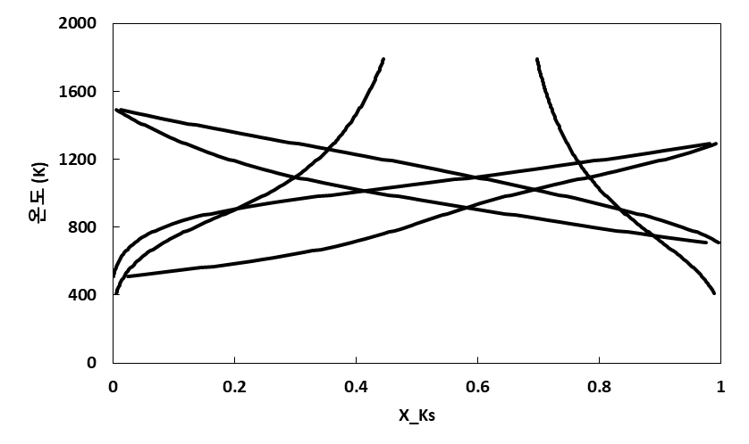
상 경계 계산 결과
$μ_{Ks}^{L}=μ_{Ks}^{FCC}$ $μ_{Ks}^{L}=μ_{Ks}^{BCC}$ $μ_{Ks}^{FCC}=μ_{Ks}^{BCC}$
$μ_{Ps}^{L}=μ_{Ps}^{FCC}$ $μ_{Ps}^{L}=μ_{Ps}^{BCC}$ $μ_{Ps}^{FCC}=μ_{Ps}^{BCC}$

Slide 4
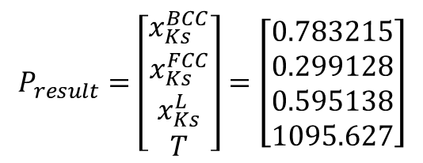
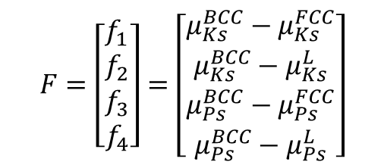
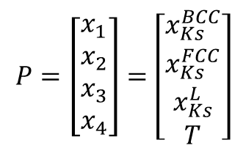
Eutectic temperature 계산
$$P=\left[\begin{aligned}x_{1} \\ x_{2} \\ x_{3} \\ x_{4}\end{aligned}\right]=\left[\begin{aligned}x_{Ks}^{BCC} \\ x_{Ks}^{FCC} \\ x_{Ks}^{L} \\ T\end{aligned}\right]$$
$$F=\left[\begin{aligned}f_{1} \\ f_{2} \\ f_{3} \\ f_{4}\end{aligned}\right]=\left[\begin{aligned}μ_{Ks}^{BCC}−μ_{Ks}^{FCC} \\ μ_{Ks}^{BCC}−μ_{Ks}^{L} \\ μ_{Ps}^{BCC}−μ_{Ps}^{FCC} \\ μ_{Ps}^{BCC}−μ_{Ps}^{L}\end{aligned}\right]$$
$$P_{result}=\left[\begin{aligned}x_{Ks}^{BCC} \\ x_{Ks}^{FCC} \\ x_{Ks}^{L} \\ T\end{aligned}\right]=\left[\begin{aligned}0.783215 \\ 0.299128 \\ 0.595138 \\ 1095.627\end{aligned}\right]$$

Slide 5
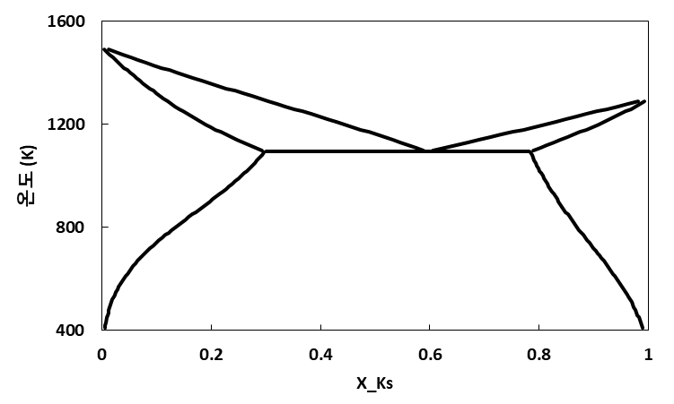
Ks-Ps Phase Diagram
Liquid
BCC+Liquid
FCC+Liquid
FCC
BCC
FCC+BCC

