Slide 1
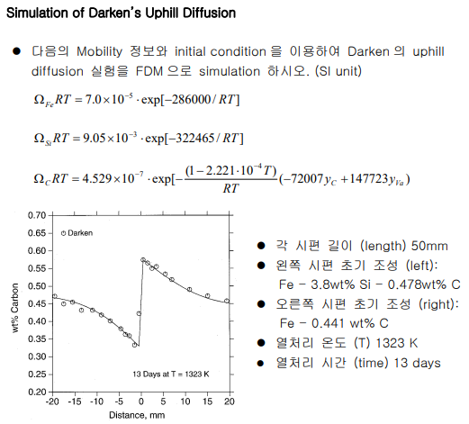
AMSE318 Term report with python
Si is not equal to 0 -> 0.0001wt%
49004547 Seokjee SHIN

Slide 2
$${°G}_{FeVa}={°G}_{Fe}^{fcc}=0$$
$${°G}_{SiVa}={°G}_{Si}^{Diamond}+51000−21.8T=51000−21.8T$$
$${°G}_{FeC}={°G}_{Fe}^{fcc}+{°G}_{C}^{graphite}+77207−15.877T=77207−15.877T$$
$${°G}_{SiC}={°G}_{Si}^{Diamond}+{°G}_{C}^{graphite}−20510+38.7T=−20510+38.7T$$
$$L_{FeSiVa}=−125248+41.116T−142708\left(y_{Fe}−y_{Si}\right)+89907{\left(y_{Fe}−y_{Si}\right)}^{2}$$
$$=−125248+41.116T−142708\left(1−{2y}_{Si}\right)+89907{\left(1−{2y}_{Si}\right)}^{2}$$
$L_{FeSiC}=143219.9+39.31T−216320.5\left(y_{Fe}−y_{Si}\right)$ $=143219.9+39.31T−216320.5\left(1−{2y}_{Si}\right)$
$$L_{FeCVa}=−34671$$
$$μ_{M}=G_{m}+\left(1−y_{M}\right)\left(\frac{∂G_{m}}{∂y_{M}}−\frac{∂G_{m}}{∂y_{Fe}}\right)=G_{m}+\left(1−y_{M}\right)\frac{dG_{m}}{dy_{M}}$$
$$μ_{C}=\left(\frac{∂G_{m}}{∂y_{C}}−\frac{∂G_{m}}{∂y_{Va}}\right)=\frac{dG_{m}}{dy_{C}}$$

Slide 3
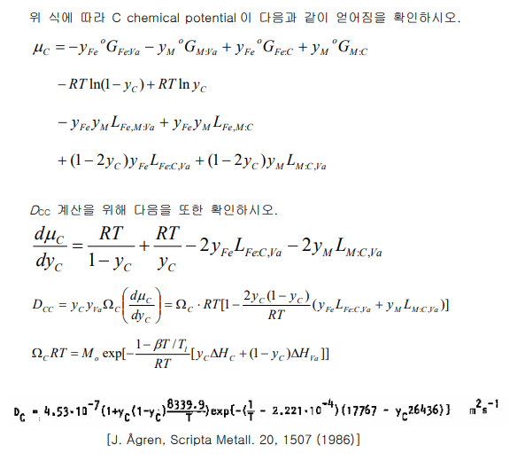
$$μ_{C}=\left(\frac{∂G_{m}}{∂y_{C}}−\frac{∂G_{m}}{∂y_{Va}}\right)=\frac{dG_{m}}{dy_{C}}$$
= $y_{Fe}(1−y_{C}){°G}_{FeVa}+y_{M}(1−y_{C}){°G}_{MVa}$+ $y_{Fe}y_{C}$ ${°G}_{FeC}$+ $y_{M}y_{C}$ ${°G}_{MC}+RT\left(y_{Fe} lny_{Fe}+y_{M} lny_{M}\right)+RT\left((1−y_{C})ln(1−y_{C})+y_{C} lny_{C}\right)+y_{Fe}y_{M}(1−y_{C})L_{FeMVa}+y_{Fe}y_{M}y_{C}L_{FeMC}$ $+y_{Fe}y_{C}(1−y_{C})L_{FeCVa}$ $+y_{M}y_{C}\left(1−y_{C}\right)L_{MCVa}$
= ${−y}_{Fe}{°G}_{FeVa}−y_{M}{°G}_{MVa}$+ $y_{Fe}$ ${°G}_{FeC}$+ $y_{M}$ ${°G}_{MC}−RT\left(ln\left(1−y_{C}\right)\right)+RT( lny_{C})−y_{Fe}y_{M}L_{FeMVa}+y_{Fe}y_{M}L_{FeMC}$ $+y_{Fe} (1−{2y}_{C})L_{FeCVa}$ $+y_{M} (1−{2y}_{C})L_{MCVa}$

Slide 4
$$\frac{dμ_{C}}{dy_{C}}=\frac{d^{2}G_{m}}{dy_{C}^{2}}$$
= ${−y}_{Fe}{°G}_{FeVa}−y_{M}{°G}_{MVa}$+ $y_{Fe}$ ${°G}_{FeC}$+ $y_{M}$ ${°G}_{MC}−RT\left(ln\left(1−y_{C}\right)\right)+RT( lny_{C})−y_{Fe}y_{M}L_{FeMVa}+y_{Fe}y_{M}L_{FeMC}$ $+y_{Fe} (1−{2y}_{C})L_{FeCVa}$ $+y_{M} (1−{2y}_{C})L_{MCVa}$
= $\frac{RT}{1−y_{C}}+\frac{RT}{y_{C}} −{2y}_{Fe} L_{FeCVa}$ $−2y_{M}L_{MCVa}$

Slide 5
$${Let y}_{Va}=1−y_{C} \&{ y}_{Fe}=1−y_{Si}$$
$G_{m}$ = $y_{Fe}y_{Va}$ ${°G}_{FeVa}+y_{M}y_{Va} {°G}_{MVa}$+ $y_{Fe}y_{C}$ ${°G}_{FeC}$+ $y_{M}y_{C}$ ${°G}_{MC}+RT\left(y_{Fe} lny_{Fe}+y_{M} lny_{M}\right)+RT\left(y_{Va} lny_{Va}+y_{C} lny_{C}\right)+y_{Fe}y_{M}y_{Va}L_{FeMVa}+y_{Fe}y_{M}y_{C}L_{FeMC}$ $+y_{Fe}y_{C}y_{Va}L_{FeCVa}$ $+y_{M}y_{C}y_{Va}L_{MCVa}$
= ${(1−y}_{Si})(1−y_{C})$ ${°G}_{FeVa}+y_{Si}(1−y_{C}){°G}_{SiVa}$+$(1−y_{Si})y_{C}$ ${°G}_{FeC}$+ $y_{Si}y_{C}$ ${°G}_{SiC}+RT\left((1−y_{Si})ln(1−y_{Si})+y_{Si} lny_{Si})\right)+RT\left((1−y_{C})ln(1−y_{C})+y_{C} lny_{C}\right))+(1−y_{Si})y_{Si}(1−y_{C})L_{FeSiVa}+(1−y_{Si})y_{Si}y_{C}L_{FeSiC}$ $+(1−y_{Si})y_{C}(1−y_{C})L_{FeCVa}$ $+y_{Si}y_{C}(1−y_{C})L_{SiCVa}$
$$\frac{d^{2}G_{m}}{dy_{Si}dy_{C}}={°G}_{FeVa}−{°G}_{SiVa}− {°G}_{FeC}\text{+ }{°G}_{SiC}+\left(2y_{Si}−1\right)L_{FeSiVa}−\left(1−y_{Si}\right)y_{Si}\left[142708−2∗89907\left(1−2y_{Si}\right)\right]+\left(1−2y_{Si}\right)L_{FeSiC}+y_{Si}\left(1−y_{Si}\right)\left(2∗216320.5\right)−\left(1−2y_{C}\right)L_{FeCVa}+(1−{2y}_{C})L_{SiCVa}$$

Slide 6
$${Let y}_{Va}=1−y_{C} \&{ y}_{Fe}=1−y_{Si}$$
$G_{m}$ = $y_{Fe}y_{Va}$ ${°G}_{FeVa}+y_{M}y_{Va} {°G}_{MVa}$+ $y_{Fe}y_{C}$ ${°G}_{FeC}$+ $y_{M}y_{C}$ ${°G}_{MC}+RT\left(y_{Fe} lny_{Fe}+y_{M} lny_{M}\right)+RT\left(y_{Va} lny_{Va}+y_{C} lny_{C}\right)+y_{Fe}y_{M}y_{Va}L_{FeMVa}+y_{Fe}y_{M}y_{C}L_{FeMC}$ $+y_{Fe}y_{C}y_{Va}L_{FeCVa}$ $+y_{M}y_{C}y_{Va}L_{MCVa}$
= ${(1−y}_{Si})(1−y_{C})$ ${°G}_{FeVa}+y_{Si}(1−y_{C}){°G}_{SiVa}$+$(1−y_{Si})y_{C}$ ${°G}_{FeC}$+ $y_{Si}y_{C}$ ${°G}_{SiC}+RT\left((1−y_{Si})ln(1−y_{Si})+y_{Si} lny_{Si})\right)+RT\left((1−y_{C})ln(1−y_{C})+y_{C} lny_{C}\right))+(1−y_{Si})y_{Si}(1−y_{C})L_{FeSiVa}+(1−y_{Si})y_{Si}y_{C}L_{FeSiC}$ $+(1−y_{Si})y_{C}(1−y_{C})L_{FeCVa}$ $+y_{Si}y_{C}(1−y_{C})L_{SiCVa}$
$$\frac{d^{2}G_{m}}{dy_{Si}^{2}}=RT\left(\frac{1}{1−y_{Si}}+\frac{1}{y_{Si}}\right)−2\left(1−y_{C}\right)L_{FeSiVa}+2\left(1−2y_{Si}\right)\left(1−y_{C}\right)\left[142708−2∗89907\left(1−2y_{Si}\right)\right]+\left(y_{Si}−y_{Si}^{2}\right)\left(1−y_{C}\right)\left(4∗89907\right)−2y_{C}L_{FeSiC}+2\left(1−2y_{Si}\right)y_{C}\left(2∗216320.5\right)−2\left(1−y_{C}\right)L_{FeCVa}$$

Slide 7
$$D_{CC}=y_{C}y_{Va}Ω_{C}\frac{{dμ}_{C}}{{dy}_{C}}=y_C\left(1−y_{C}\right)Ω_{C}\frac{{dμ}_{C}}{{dy}_{C}}\text{=} y_{C}(1−y_{C})Ω_{C}(\frac{RT}{1−y_{C}}+\frac{RT}{y_{C}} −{2y}_{Fe} L_{FeCVa} −2y_{M}L_{MCVa})$$
$$D_{CM}=y_{C}y_{Va}Ω_{C}\frac{{dμ}_{C}}{{dy}_{Si}}=y_C\left(1−y_{C}\right)Ω_{C}\frac{{dμ}_{C}}{{dy}_{Si}}\text{=}y_{C}(1−y_{C})Ω_{C}({°G}_{FeVa}−{°G}_{SiVa}− {°G}_{FeC}\text{+ }{°G}_{SiC}+\left(2y_{Si}−1\right)L_{FeSiVa}−\left(1−y_{Si}\right)y_{Si}\left[142708−2∗89907\left(1−2y_{Si}\right)\right]+\left(1−2y_{Si}\right)L_{FeSiC}+y_{Si}\left(1−y_{Si}\right)\left(2∗216320.5\right)−\left(1−2y_{C}\right)L_{FeCVa}+(1−{2y}_{C})L_{SiCVa})$$
$D_{MM}=y_{Si}\left(1−y_{Si}\right)Ω_{Si}\left(1−y_{Si}\right)\frac{{d^{2}G}_{m}}{{dy}_{Si}^{2}}−y_{Si}\left(1−y_{Si}\right)Ω_{Fe}(−y_{Si}\frac{{d^{2}G}_{m}}{{dy}_{Si}^{2}})$
$$=y_{Si}\left(1−y_{Si}\right)\frac{{d^{2}G}_{m}}{{dy}_{Si}^{2}}\left[\left(1−y_{Si}\right)Ω_{Si}−y_{Si}Ω_{Fe}\right]$$
$$D_{MC}=y_{Si}y_{Fe}\left[\left(Ω_{Si}−Ω_{Fe}\right)\frac{dG_{m}}{dy_{C}}+\left(Ω_{Si}−Ω_{Si}y_{Si}+Ω_{Fe}y_{Si}\right)\left(\frac{{d^{2}G}_{m}}{dy_{C}dy_{Si}}\right)\right]$$

Slide 8
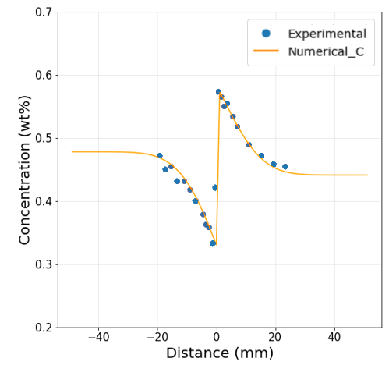
conclusion
Conclusion
Through derivations of the equations, was able to draw a Numerical curve that fits Experimental data.
The cause of an error last time was mainly due to typo in the code and wrong constant usage.

