Slide 1
Round-off Error
Seungpyo Hong
Flow Physics and Engineering Lab.
Department of Mechanical Engineering
POSTECH

Slide 2
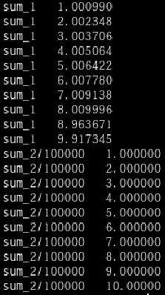
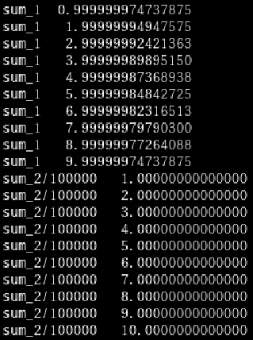
Round-off Error
Single Precision
Double Precision
Cannot express 0.00001 exactly.
Can express
1.00000 exactly.
i=1
i=2
i=3
i=4

Slide 3
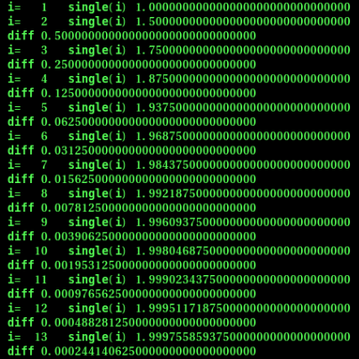
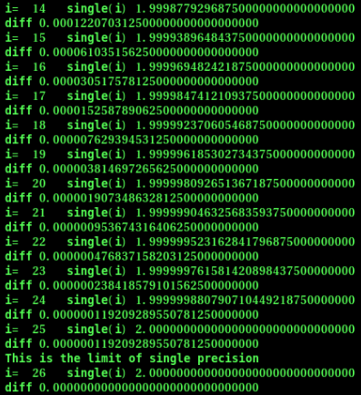
Single Precision
$$\frac{1}{2^{24}} ?$$

Slide 4
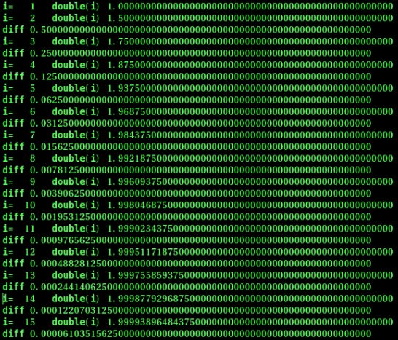
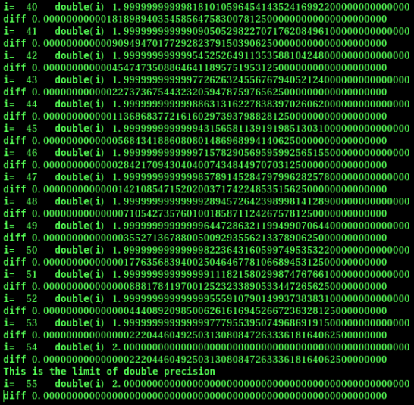
Double Precision
$$\frac{1}{2^{53}} ?$$

