Slide 1
재료수치해석 final
20100098 최원미

Slide 2
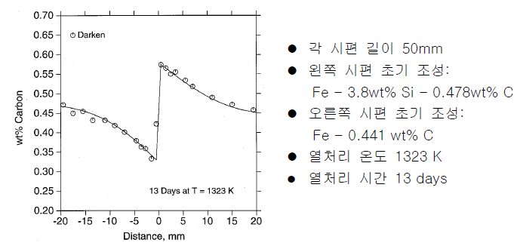
question,
Darken’s uphill theorem

Slide 3
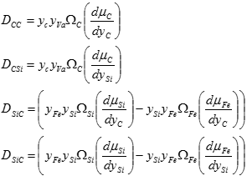
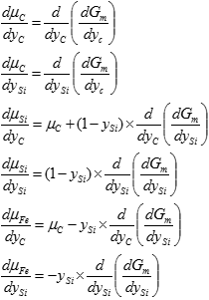
solve,
Fe-Si-C 3원계에서 Si와 C의 확산속도

Slide 4
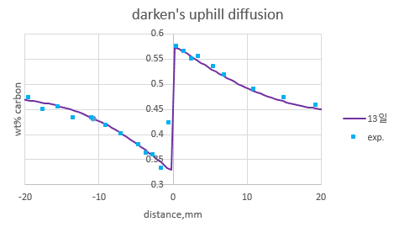
result,

Slide 5
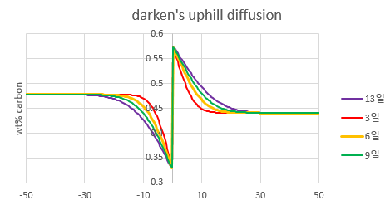
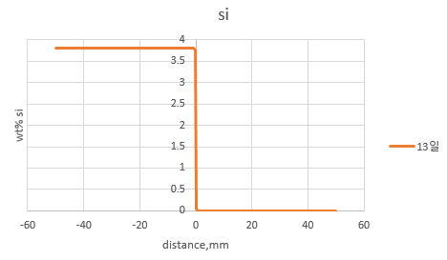
result,

Slide 6
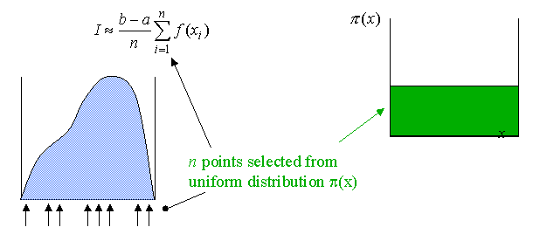
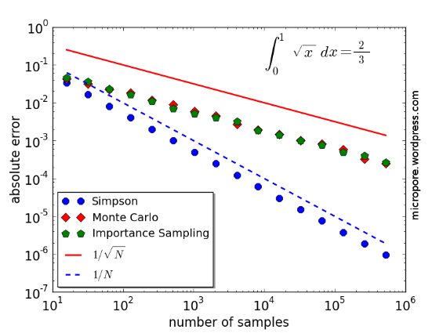
Free problem, Monte Carlo integration
Concept,
In Monte Carlo : Error $∝\frac{1}{\sqrt{N}}$

Slide 7
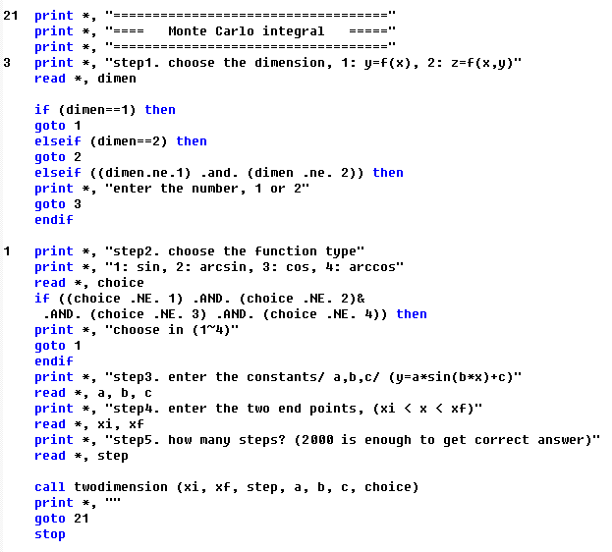
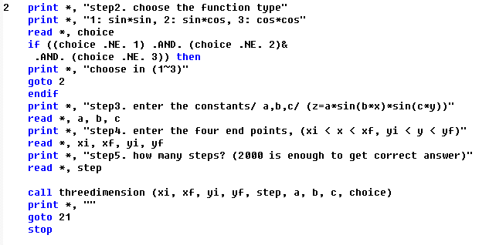
1. 조건 입력
Free problem, code

Slide 8
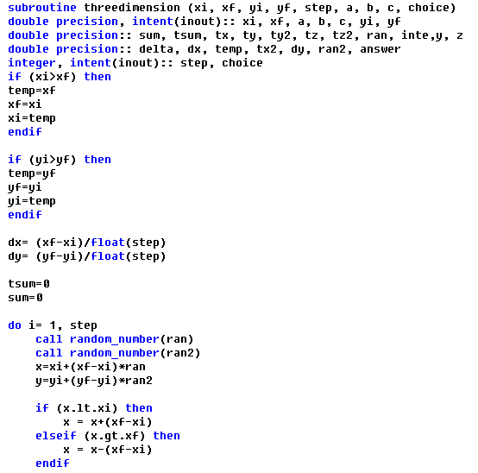
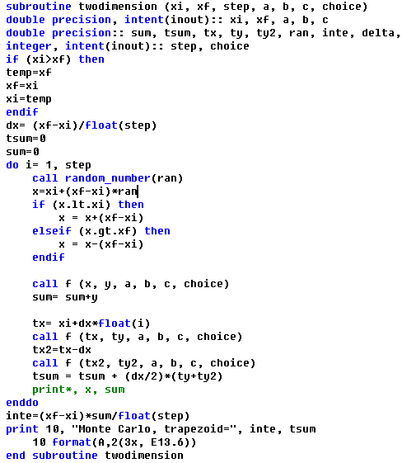
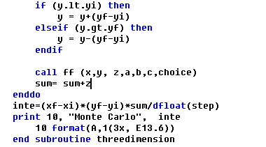
2. main code
Free problem, code
Trapezoid integration

Slide 9
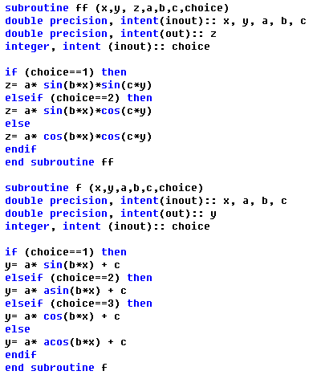
3. function
Free problem, code

Slide 10
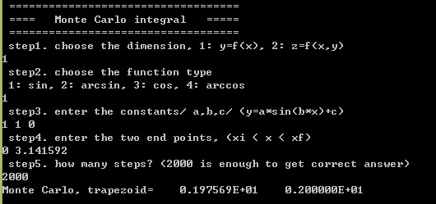
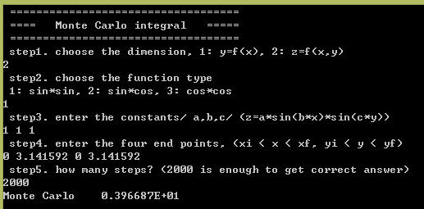
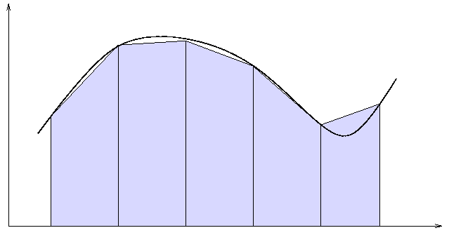
Free problem, Monte Carlo integration
실행모습,
1. y=f(x)
2. z=f(x,y)
Monte Carlo integration
Trapezoid integration

Slide 11
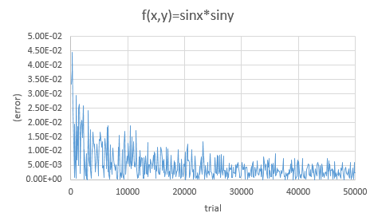
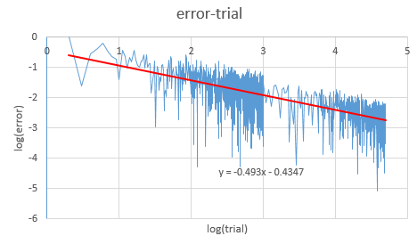
Free problem, Monte Carlo integration
In Monte Carlo : Error $∝\frac{1}{\sqrt{N}}$

