Slide 1
Numerical Method Homework 6
20190272 장환중

Slide 2
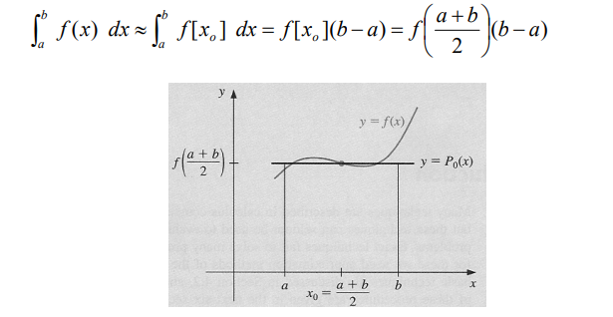
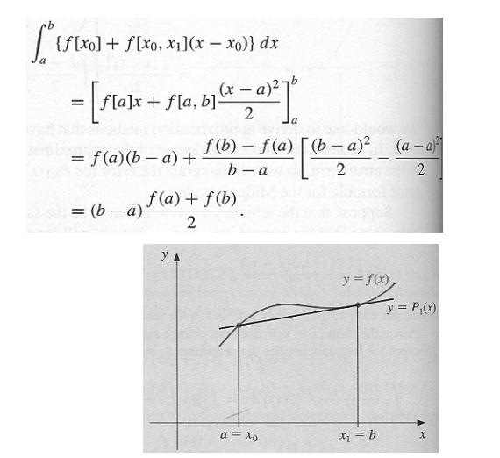
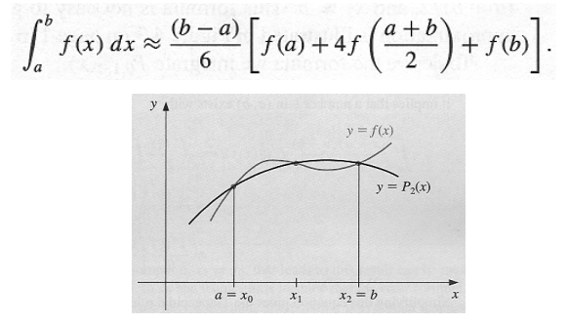
Background Information: Numerical integration
Midpoint method
Trapezoidal method
Simpson method

Slide 3
Program Outline
Main function: do midpoint/trapezoidal/Simpson rule according to n from 3 to 100
function: calculate the function value f(a)
midpoint: do midpoint rule
trapezoidal: do trapezoidal rule
simpson: do Simpson rule

Slide 4
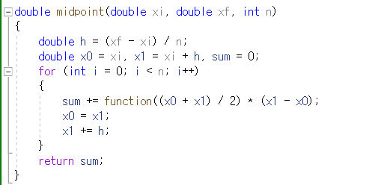
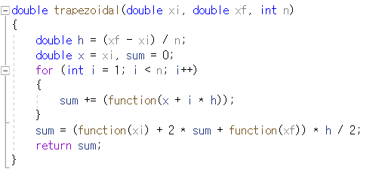
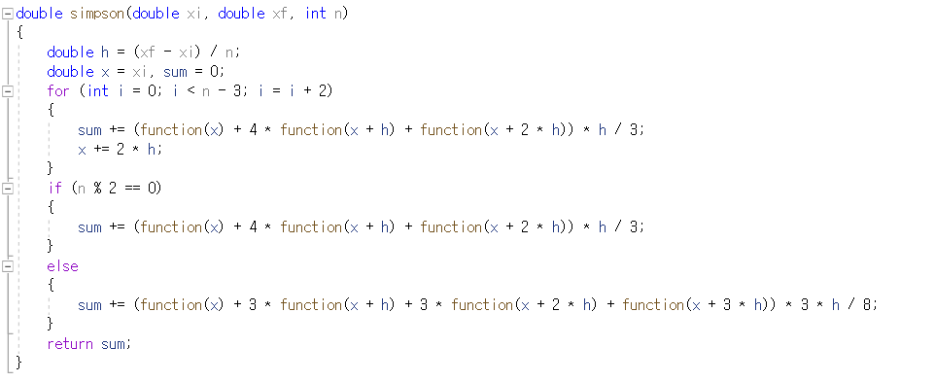
How to make code for each rule

Slide 5
Result
Accuracy: Simpson rule>midpoint rule>trapezoidal rule for every increasing n

