Slide 1
재료수치해석 HW#6
MSE 20061279
최 지 원

Slide 2
HW#6
액상에 대한 실험 정보(혼합열, 활동도)로부터 액상의 Gibbs energy of mixing 표현을 완성하시오.

Slide 3
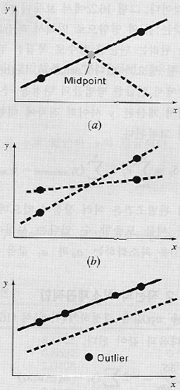
회귀분석
Minimizing sum of squares of deviation

Slide 4
Solution model

Slide 5
Solution model

Slide 6
bcc, fcc

Slide 7
알고리즘
From Enthalpy
user input n
read file -> X, Y(X = [ 1 x x² x³ … x^{n} ])
X^{T}X, X^{T}Y, inverse X^{T}X
A = [X^{T}X]⁻¹[X^{T}Y]
determination coefficient
print
From Activity

Slide 8
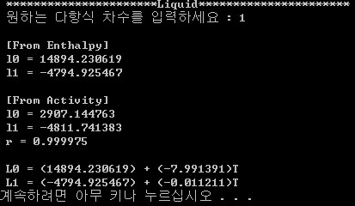
결과

Slide 9
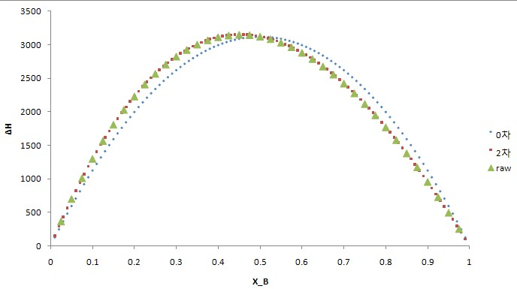
Enthalpy

Slide 10
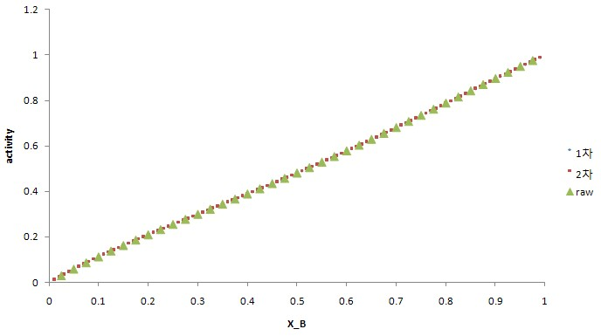
Activity

Slide 11
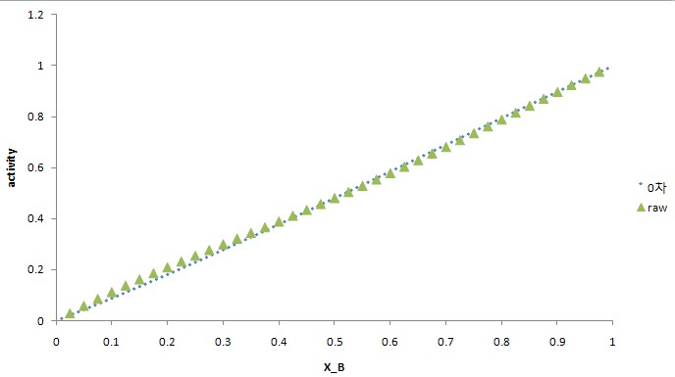

Slide 12
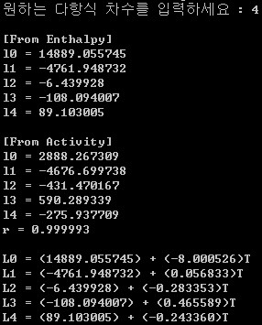
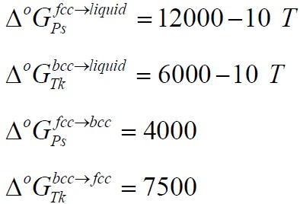
결론
Po-Tk liquid solution : Subregular solution
(St >> Sr, r ~ 1)
where

