Slide 1
Midterm Project
Ps-Tk phase diagram
20071050 오승재

Slide 2
Problem

Slide 3
Thermodynamic equations
Liquid

Slide 4
Thermodynamic equations
FCC

Slide 5
Thermodynamic equations
BCC

Slide 6
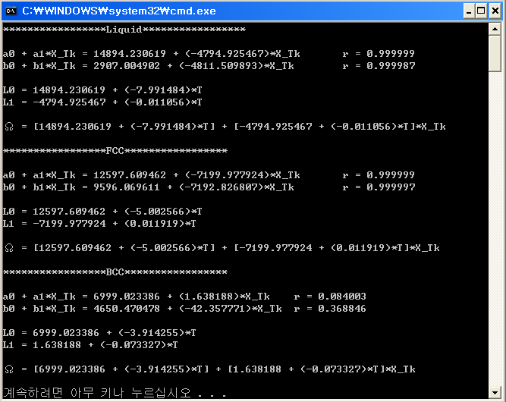
Calculate Excess Free energy
By regression.
L0 ≫ L1 → Regular solution

Slide 7
Phase Diagram(Thermodynamic equations)

Slide 8
Phase Diagram
By Newton’s method.

Slide 9
Eutectic Temperature
X^{L} difference < 0.0015
X^{F} difference < 0.0015
X^{B} difference < 0.0015

Slide 10
Result - Phase Diagram

Slide 11
Conclusion
BCC에서 회귀분석시 r값.
Missing points → Code의 취약성

