Slide 1
Numerical Analysis for Materials (AMSE318-01)
HOmework #1
Doan Minh Quan - 49004023

Slide 2
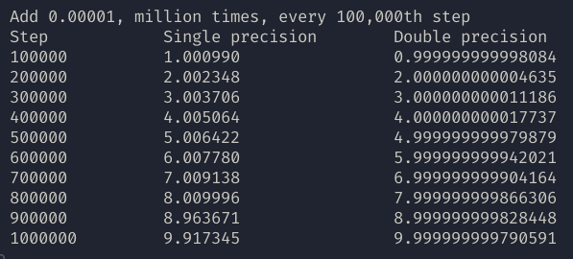
1.1: Add 0.00001, million times, showing the result every 100,000th step
float x = 0;
double y = 0;
for (int i = 1; i <= 1000000; i++) {
x += (float)0.00001;
y += (double)0.00001;
if (!(i % 100000)) {
printf("%d\t\t", i);
printf("%.*f\t\t", FLT_DIG, x);
printf("%.*lf\n", DBL_DIG, y);
}
}
Remark:
There are inaccuracy in calculation, because of 0.00001 can only be represent approximately in the computer. The error add up to the inaccuracy of the final result.
Single precision error > double precision because the approximation of 0.00001 is greater

Slide 3
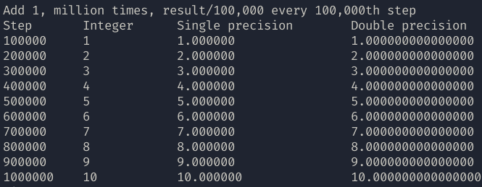
1.2: Add 1, million times, showing the result/100,000 every 100,000th step
float x = 0;
double y = 0;
int z = 0, d = 1000000;
for (int i = 1; i <= 1000000; i++) {
x += (float)(1);
y += (double)(1);
z += 1;
if (!(i % 100000)) {
printf("%d\t", i);
printf(" %d\t\t", z / d);
printf("%.*f\t\t", FLT_DIG, x / d);
printf("%.*lf\n", DBL_DIG, y / d);
}
}
Remark:
There are inaccuracy in calculation, because of 0.00001 can only be represent approximately in the computer. The error add up to the inaccuracy of the final result.
Single precision error > double precision because the approximation of 0.00001 is greater

Slide 4
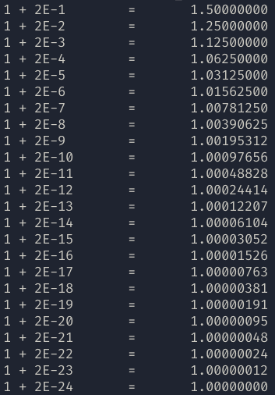
2: Determine how many bits express a mantissa (single precision)
Method:
Let m: number of mantissa
1 and 1 + 2^(m+1) should be indistinguishable for the computer
Number 1 is chosen because it is the default bit 1 that is not stored in the mantissa
float a, b, c;
int mantissa = 1;
a = 1;
b = 0.5;
do {
c = a + b;
printf("1 + 2E-%d\t=\t%.8f\n", mantissa, a + b);
b /= 2;
mantissa++;
} while (a != c);
=> In single precision number, there are 23 mantissa bits

Slide 5
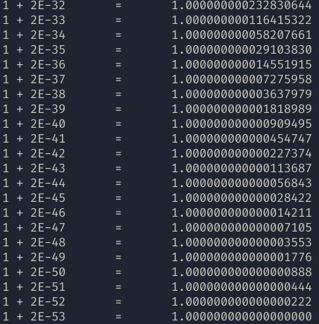
2: Determine how many bits express a mantissa (double precision)
Method: Similar to single precision
double a, b, c;
int mantissa = 1;
a = 1;
b = 0.5;
do {
c = a + b;
printf("1 + 2E-%d\t=\t%.8f\n", mantissa, a + b);
b /= 2;
mantissa++;
} while (a != c);
=> In double precision number, there are 52 mantissa bits

