Slide 1
AMSE318 HW5 with python
49004547 Seokjee SHIN

Slide 2
$\text{Enthalpy} \text{of} \text{mixing}\text{,}$
$∆H_{m}=x_{A}x_{B}L_{A,B}=x\left(1−x\right)\left(L^{00}+L^{10}\left(1−2x\right)\right)$
$\frac{∆H_{m}}{x\left(1−x\right)}=L^{00}+L^{10}\left(1−2x\right)=L^{00}+L^{10}−2L^{10}x⇒y=a_{0}+a_{1}x$
$L^{10}=−\frac{a_{1}}{2}$ & $L^{00}=a_{0}+\frac{a_{1}}{2}$
$\text{E}\text{nthalpy} \text{of} \text{formation}\text{,}$
$∆H_{f}= (1−x)∆°H_{A}^{ref→β}+{x ∆°{H_{B}}^{ref→β}}_{}+x\left(1−x\right)\left(L^{00}+L^{10}\left(1−2x\right)\right)$
$(∆H_{f}− \left(1−x\right)∆°H_{A}^{ref→β}−{x ∆°{H_{B}}^{ref→β}}_{})/x\left(1−x\right)=L^{00}+L^{10}\left(1−2x\right)$
$L^{10}=−\frac{a_{1}}{2}$ & $L^{00}=a_{0}+\frac{a_{1}}{2}$
For activity of liquid
$RTlna_{A}=RTlnx_{A}+{\left(1−x_{A}\right)}^{2}\left(L^{0}+\left(4x_{A}−1\right)L^{1}\right)$
$RTln(\frac{a_{A}}{x_{A}})/{\left(1−x_{A}\right)}^{2}=L^{0}+\left(4x_{A}−1\right)L^{1}$ = $L^{0}−L^{1}+4x_{A}L^{1}⇒y=a_{0}+a_{1}x$
$L^{1}=\frac{a_{1}}{4}$ & $L^{0}=a_{0}−L^{1}$
For activity of Ks for FCC
$RTlna_{A}=∆°G_{A}^{bcc→fcc}+RTlnx_{A}+{\left(1−x_{A}\right)}^{2}\left(L^{0}+\left(1−4x_{A}\right)L^{1}\right)$
$(RTln(\frac{a_{A}}{x_{A}})−∆°G_{A}^{bcc→fcc})/{\left(1−x_{A}\right)}^{2}=L^{0}+\left(1−4x_{A}\right)L^{1}$= $L^{0}+L^{1}−4x_{A}L^{1}⇒y=a_{0}+a_{1}x$
$L^{1}=−\frac{a_{1}}{4}$ & $L^{0}=a_{0}−L^{1}$
For activity of Ps for BCC
$RTlna_{A}=∆°G_{A}^{fcc→bcc}+RTln{(1−x}_{A})+x_{A}^{2}\left(L^{0}+\left(1−4(1−x_{A}) \right)L^{1}\right)$
$(RTln(\frac{a_{A}}{{1−x}_{A}})−∆°G_{A}^{fcc→bcc})/x_{A}^{2}=L^{0}+\left(4x_{A}−3\right)L^{1}$ = $L^{0}−{3L}^{1}+4x_{A}L^{1}⇒y=a_{0}+a_{1}x$
$L^{1}=\frac{a_{1}}{4}$ & $L^{0}=a_{0}+3L^{1}$
$$x=X_{Ks}$$
Sub-regular solution model,
$L_{A,B}=L^{0}+L^{1}\left(x_{A}−x_{B}\right)$
$$=L^{0}+L^{1}\left(1−2x\right)$$
$L^{0}=L^{00}+L^{01}T$, $L^{1}=L^{10}+L^{11}T$
$$∆°G_{Ps}^{fcc→liquid}=15000 −10T$$
$$∆°G_{Ks}^{bcc→liquid}=16250 −12.5T$$
$$∆°G_{Ps}^{fcc→bcc}=10000$$
$$∆°G_{Ks}^{bcc→fcc}=7500$$

Slide 3
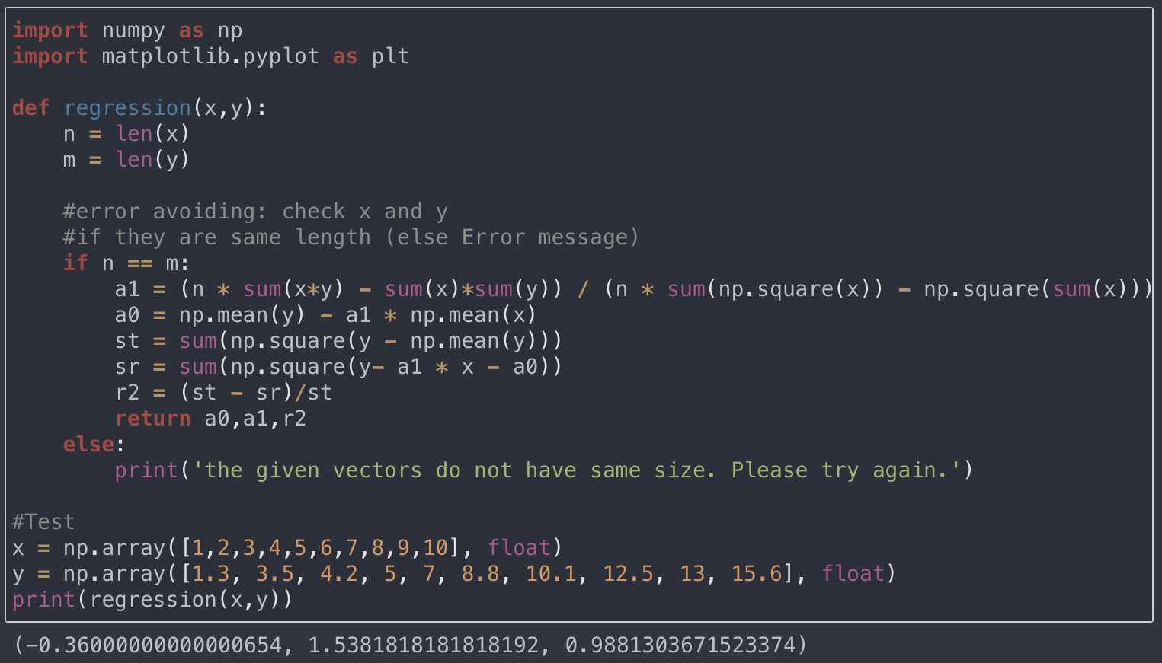
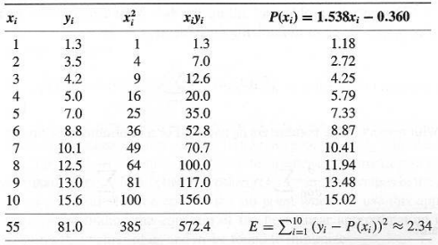
Linear regression

Slide 4
Liquid State of Ks sub-regular solution

Slide 5
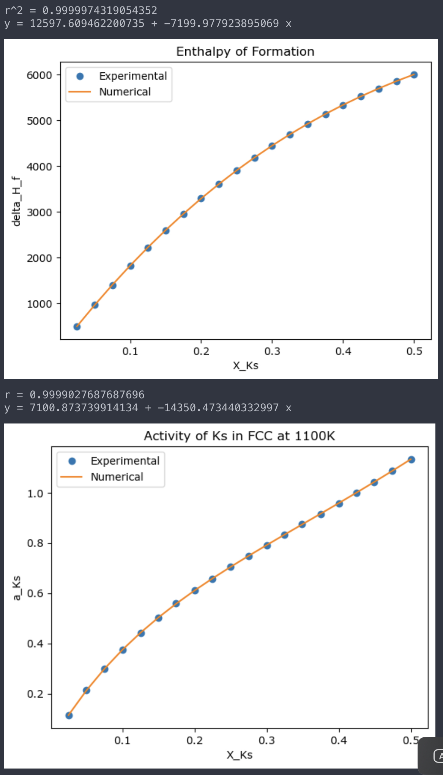
FCC of Ks sub-regular solution

Slide 6
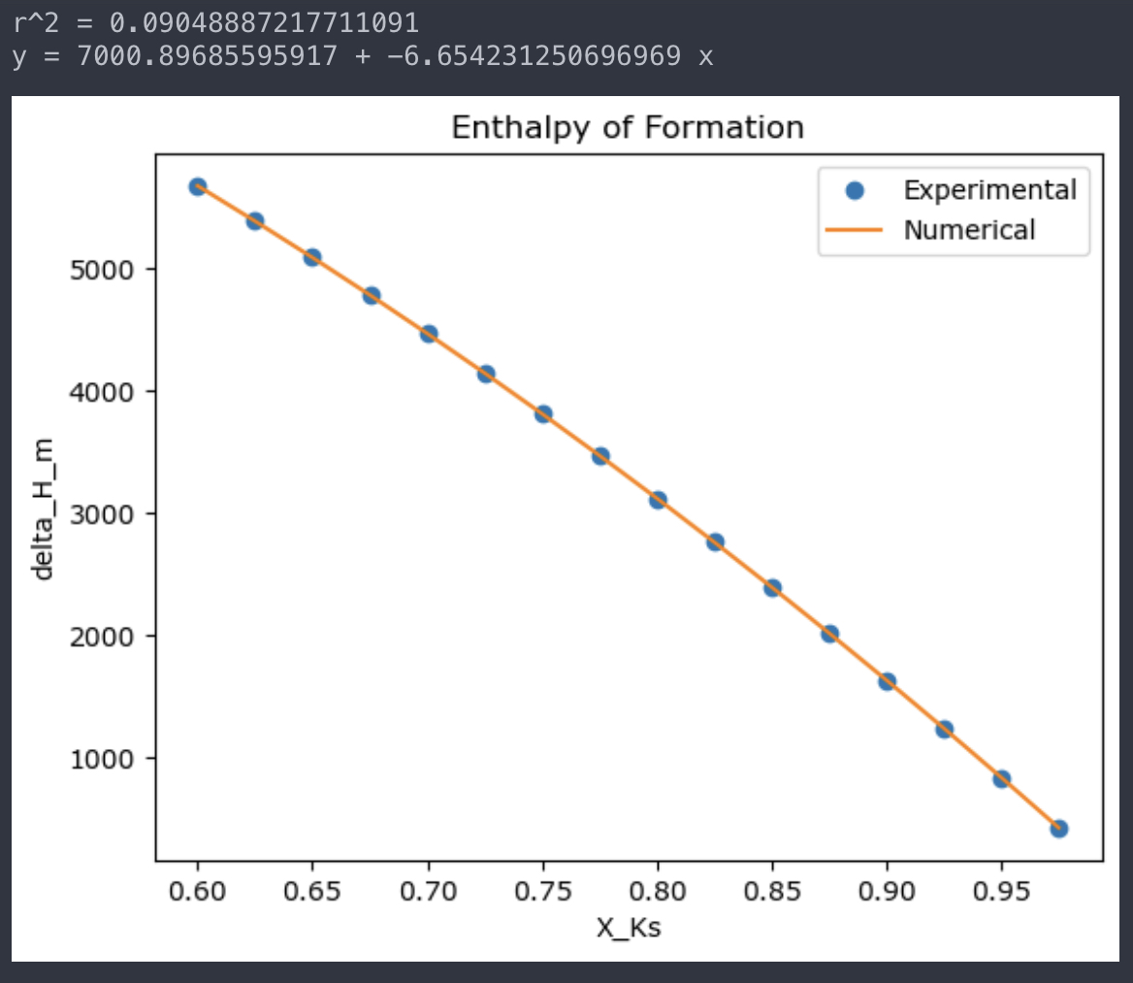
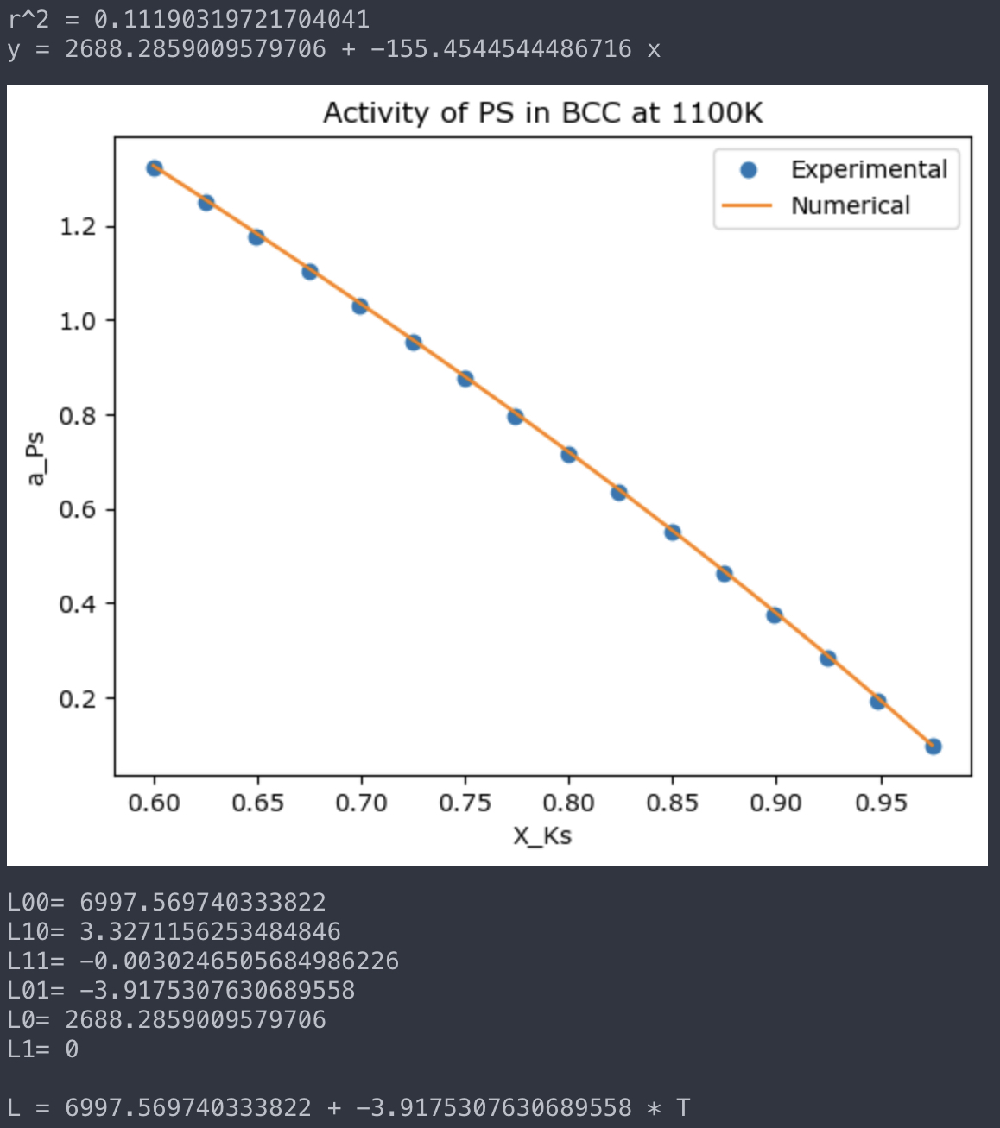
BCC of Ps regular solution (L1 = 0)

