Slide 1
Assn 6
화학공학과 신민철

Slide 2
Midterm Supplementary

Slide 3
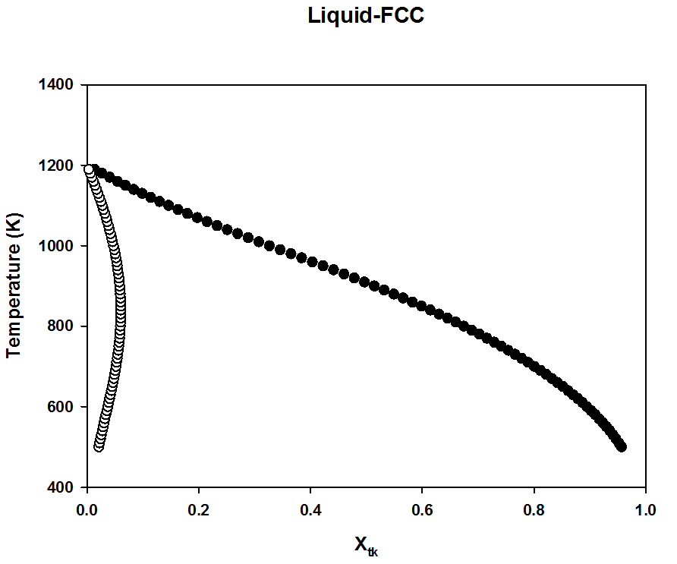
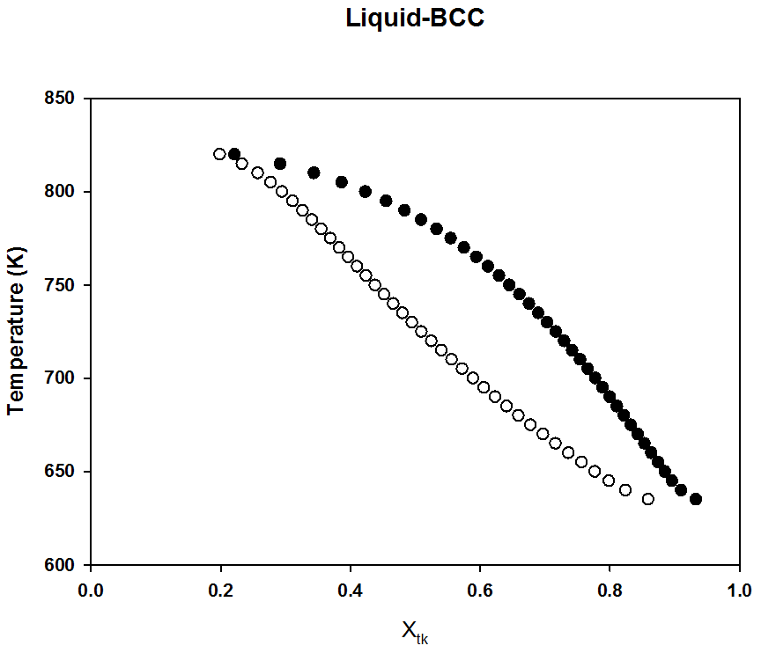
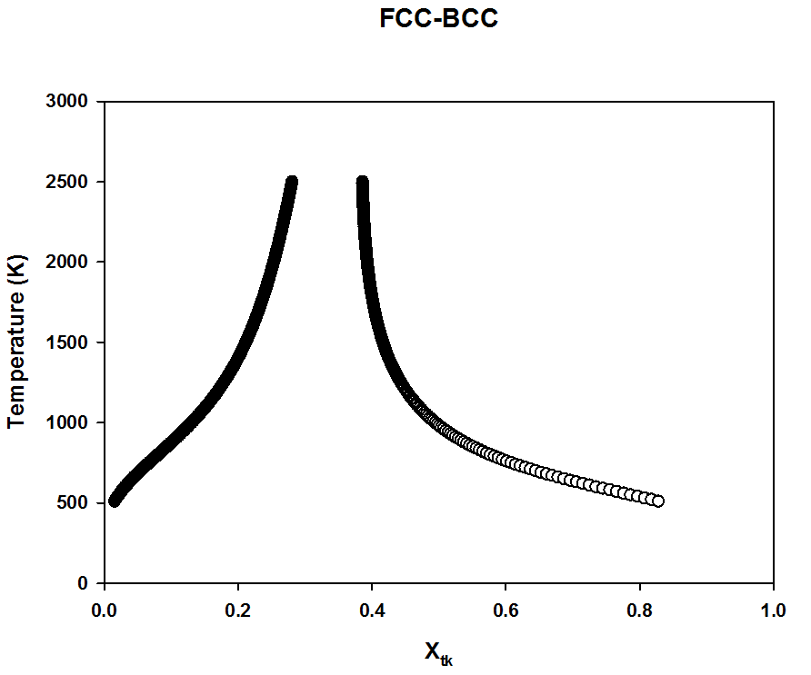
Midterm Supplementary
$$f_{1}=μ_{Ps}^{L}−μ_{Ps}^{FCC}=0$$
$$f_{2}=μ_{Tk}^{L}−μ_{Tk}^{FCC}=0$$
$$f_{1}=μ_{Ps}^{L}−μ_{Ps}^{BCC}=0$$
$$f_{2}=μ_{Tk}^{L}−μ_{Tk}^{BCC}=0$$
$$f_{1}=μ_{Ps}^{FCC}−μ_{Ps}^{BCC}=0$$
$$f_{2}=μ_{Tk}^{FCC}−μ_{Tk}^{BCC}=0$$

Slide 4
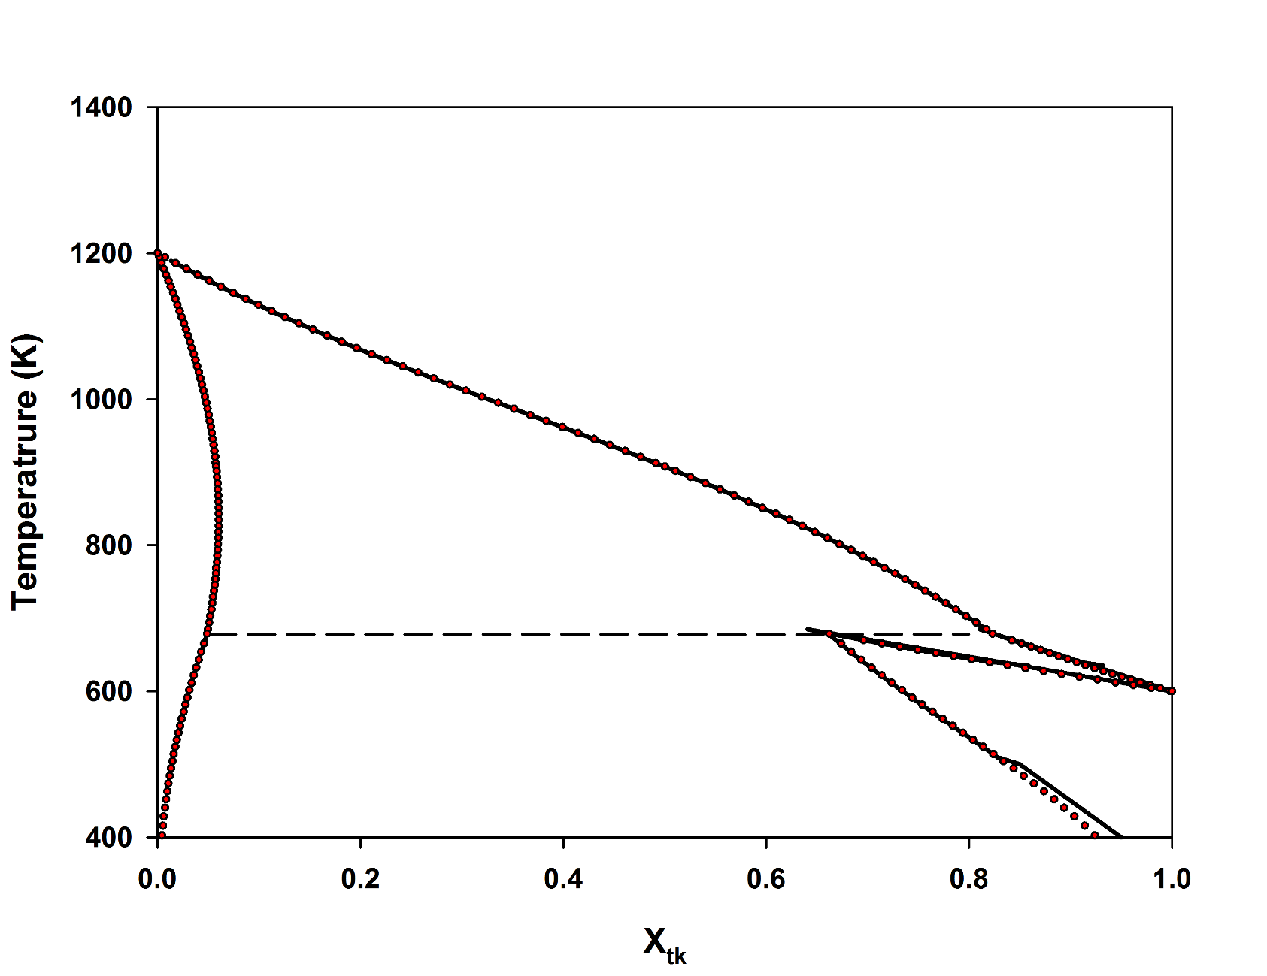
$$f_{1}=μ_{Ps}^{L}−μ_{Ps}^{FCC}=0$$
$$f_{2}=μ_{PS}^{L}−μ_{Ps}^{BCC}=0$$
$$f_{3}=μ_{Tk}^{L}−μ_{Tk}^{FCC}=0$$
$$f_{4}=μ_{Tk}^{L}−μ_{Tk}^{BCC}=0$$
Overall
4.8932533711E-02 6.7871173096E+02
8.2303357124E-01 6.7871173096E+02
6.6220688820E-01 6.7871173096E+02
구하지 못해 그냥 연결

Slide 5
$$Integral: 0.2+25x−200x^{2}+675x^{3}−900x^{4}+400x^{5}, from 0 to 0.8$$
Simpson’s rule
-$\frac{(b−a)}{6}\left[f\left(a\right)+4f\left(\frac{\left(a+b\right)}{2}\right)+f\left(b\right)\right]$이용
2. Gaussian Quadrature
-3 points 이용

Slide 6
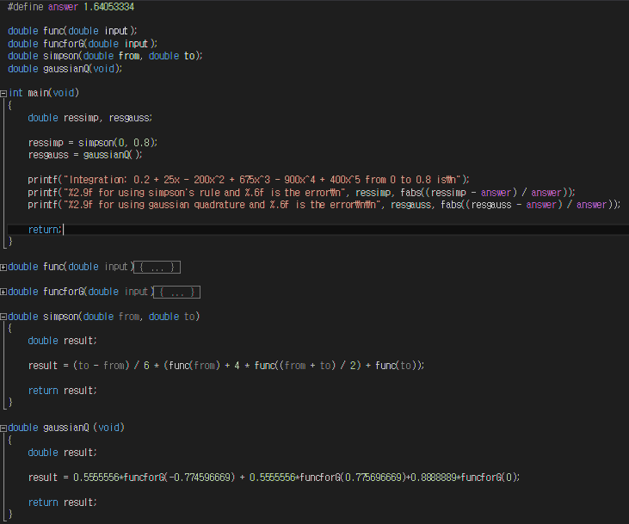

Slide 7
Results

Slide 8
3 point Gaussian Quadrature 방법이 더 정확하다.

