Slide 1
소재수치해석 #9
MSE 20100099 장민지.

Slide 2
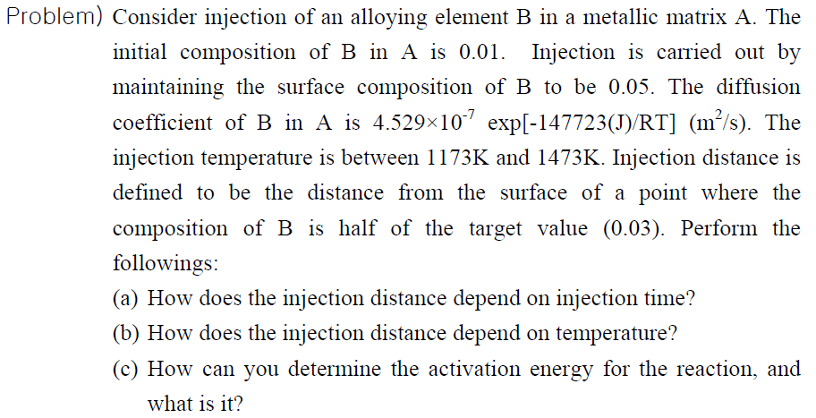
Problem

Slide 3
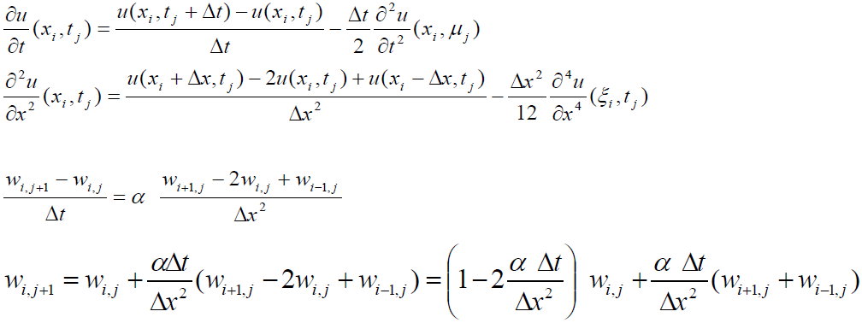
Introduction

Slide 4
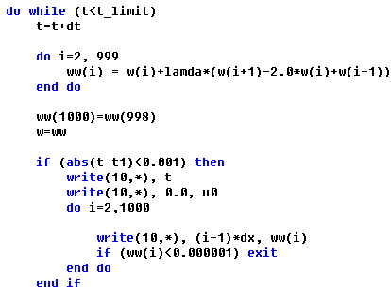
Algorithm & Coding

Slide 5
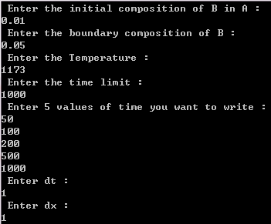
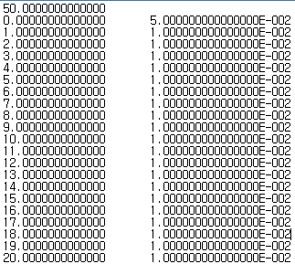
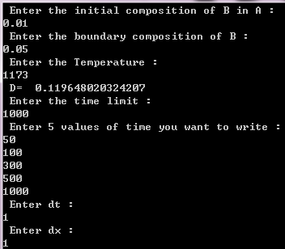
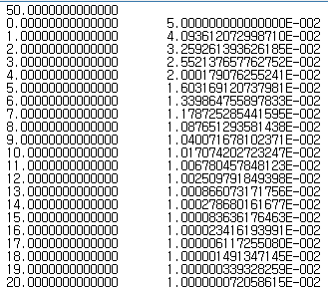
Results

Slide 6
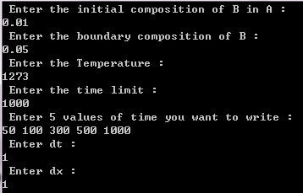
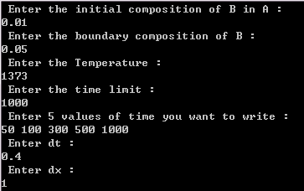
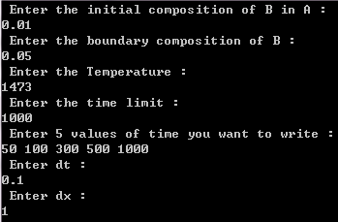
Results

Slide 7
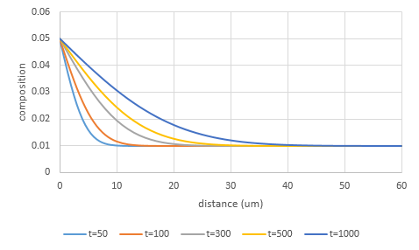
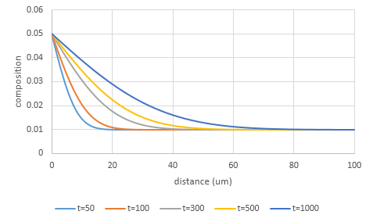
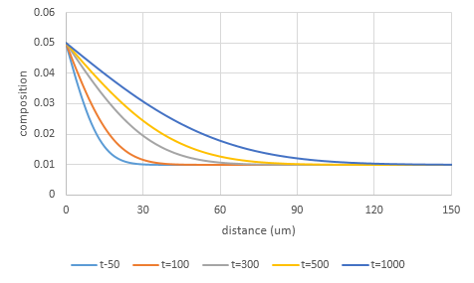
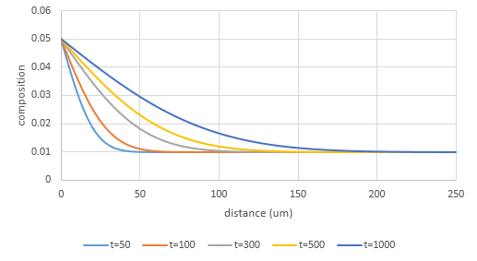
Results
T=1173K
T=1273K
T=1373K
T=1473K

Slide 8
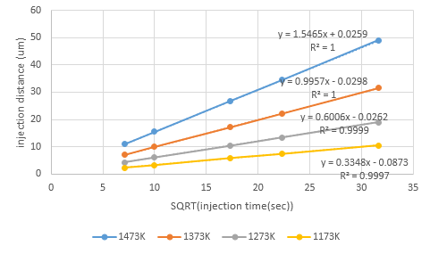
Results
Variable : T, t, x
T : fixed
How does the injection distance depend on injection time?

Slide 9
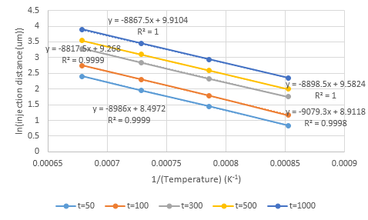
Results
Variable : T, t, x
t : fixed
How does the injection distance depend on temperature?

Slide 10
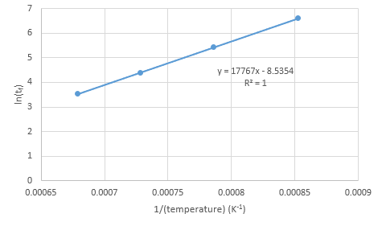
Results
Variable : T, t, x
x : fixed ( 10um )
How does the injection distance depend on temperature?
= 8.3144621*17767
=147723.0481

Slide 11
Conclusion
dt와 dx를 어떻게 설정하느냐에 따라 각 조건에서 얻을 수 있는 정확도가 달라짐
마지막 숙제! 뿌듯하다^^
기말과제 걱정된다 T.T

