Slide 1
HW8
20190312 신소재공학과 김서현

Slide 2
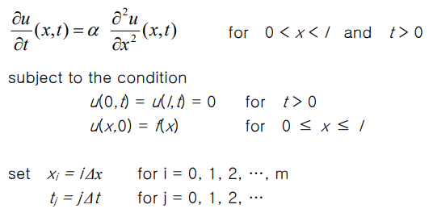
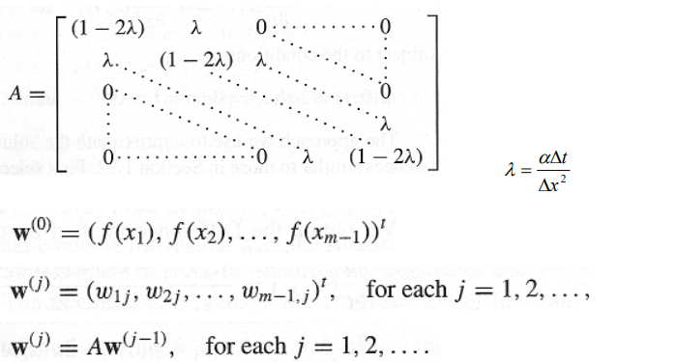
Formulas
Finite difference method
u(0,t) = 0.05
u(l,t) = 0.01
u(x,0) = 0.01
dx = 1㎛
dt = 0.1s
l = 300 ㎛
α = D =

Slide 3
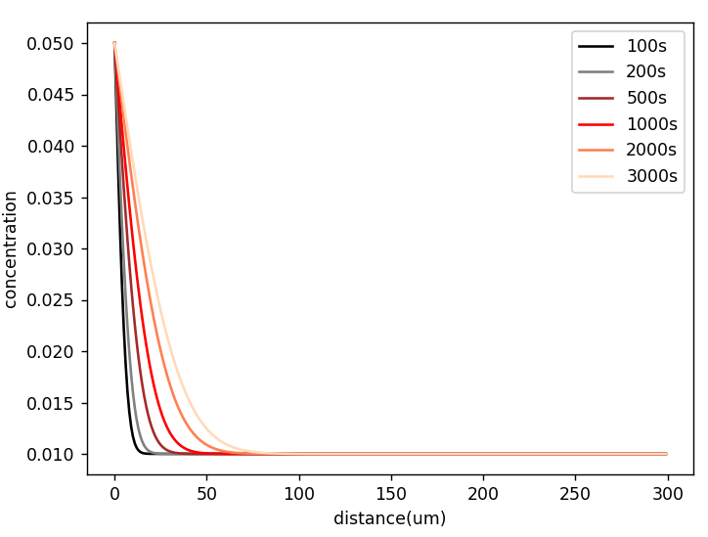
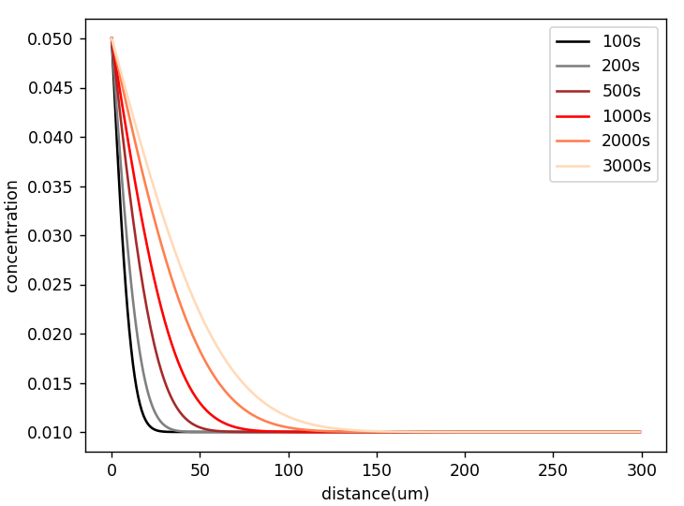
Graphs_Conc vs distance
1173K
1273K

Slide 4
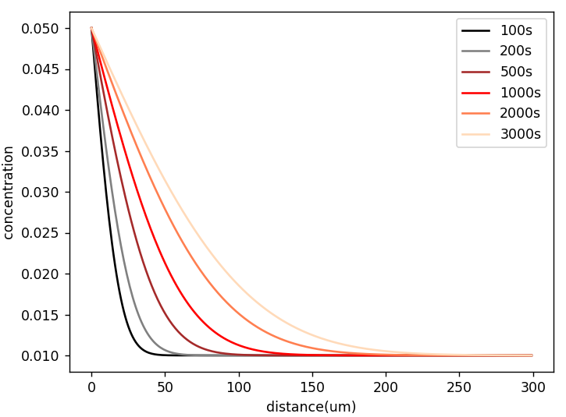
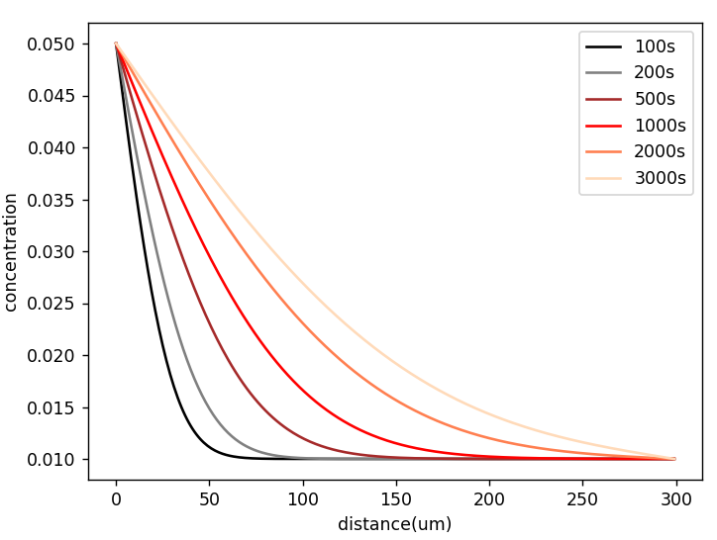
Graphs_Conc vs distance
1373K
1473K

Slide 5
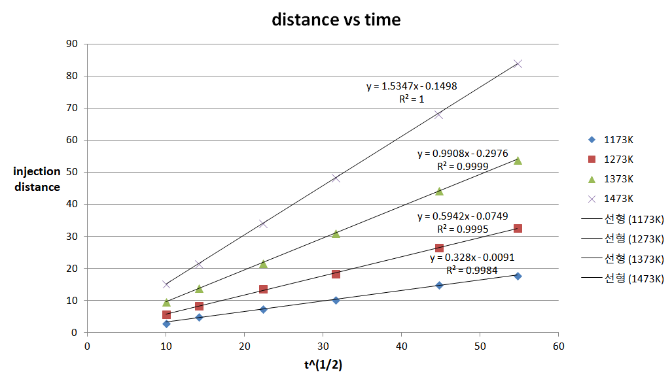
Q1_Injection distance vs time

Slide 6
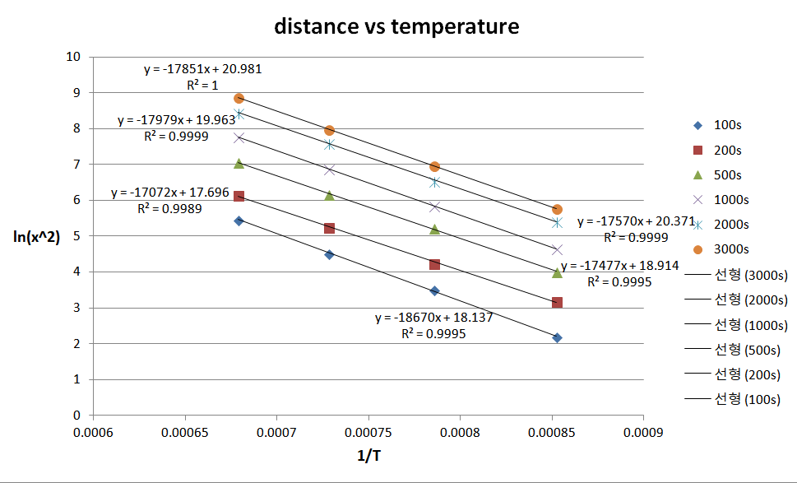
Q2_Injection distance vs temp

Slide 7
Q3_activation energy
추세선 기울기 평균 ⅹ R = 147667.3
상대오차(%) = 0.03

