Slide 1
Numerical Methods - Midterm
신소재공학과
20222102 이마태
1 / 8

Slide 2
문제 및 열역학 수식
Problem
Ps와 Tk 2원계에 대해 Liquid, fcc, bcc 각 상에 대한 열역학 수식화
Ps-Tk 2원계 상태도 계산
열역학 수식
Chemical potential
$$μ_{Tk}^{liq}=∆°G_{Tk}^{bcc→liq}+RT\ln{x_{Tk}^{liq}}+{\left(1−x_{Tk}^{liq}\right)}^{2}\left(L_{0}^{liq}+\left(1−4x_{Tk}^{liq}\right)L_{1}^{liq}\right)$$
$$μ_{Tk}^{fcc}=∆°G_{Tk}^{bcc→fcc}+RT\ln{x_{Tk}^{fcc}}+{\left(1−x_{Tk}^{fcc}\right)}^{2}\left(L_{0}^{fcc}+\left(1−4x_{Tk}^{fcc}\right)L_{1}^{fcc}\right)$$
$$μ_{Tk}^{bcc}=RT\ln{x_{Tk}^{bcc}}+{\left(1−x_{Tk}^{bcc}\right)}^{2}\left(L_{0}^{bcc}+\left(1−4x_{Tk}^{bcc}\right)L_{1}^{bcc}\right)$$
$$μ_{Ps}^{liq}=∆°G_{Ps}^{fcc→liq}+RT\ln\left(1−x_{Tk}^{liq}\right)+{x_{Tk}^{liq}}^{2}\left(L_{0}^{liq}−\left(4x_{Tk}^{liq}−3\right)L_{1}^{liq}\right)$$
$$μ_{Ps}^{fcc}=RT\ln\left(1−x_{Tk}^{fcc}\right)+{x_{Tk}^{fcc}}^{2}\left(L_{0}^{fcc}−\left(4x_{Tk}^{fcc}−3\right)L_{1}^{fcc}\right)$$
$$μ_{Ps}^{bcc}=∆°G_{Ps}^{bcc→fcc}+RT\ln\left(1−x_{Tk}^{bcc}\right)+{x_{Tk}^{bcc}}^{2}\left(L_{0}^{bcc}−\left(4x_{Tk}^{bcc}−3\right)L_{1}^{bcc}\right)$$
L parameter
Liquid
L₀₀ | 12496.8
L₀₁ | -7.99699
L₁₀ | 2397.46
L₁₁ | 0.0056246
fcc
L₀₀ | 8997.62
L₀₁ | -4.9945
L₁₀ | 3599.99
L₁₁ | -0.00668066
bcc
L₀₀ | 7000.31
L₀₁ | -4.02639
2 / 8

Slide 3
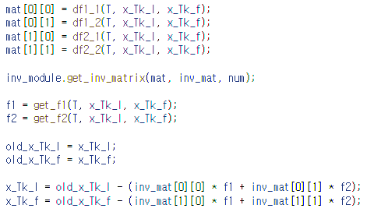
두 상에서의 상태도 얻기
Newton’s Method
f 설정
$μ_{Tk}^{liq}=$ $μ_{Tk}^{fcc}$
$μ_{Ps}^{liq}=$ $μ_{Ps}^{fcc}$
$$μ_{i}^{p}=∆°G_{i}^{ref→p}+RT\ln{x_{i}^{p}}+{\left(1−x_{i}^{p}\right)}^{2}\left(L_{00}^{p}+L_{01}^{p}T+\left(1−4x_{i}^{p}\right)\left(L_{10}^{p}+L_{11}^{p}T\right)\right)$$
$${f_{1}=μ}_{Tk}^{liq}−μ_{Tk}^{fcc}=0$$
$${f_{2}=μ}_{Ps}^{liq}−μ_{Ps}^{fcc}=0$$
Jacobian matrix J(X)
$$J\left(X\right)=\left[\begin{matrix}\frac{∂f_{1}}{∂x_{Tk}^{liq}} & \frac{∂f_{1}}{∂x_{Tk}^{fcc}} \\ \frac{∂f_{2}}{∂x_{Tk}^{liq}} & \frac{∂f_{2}}{∂x_{Tk}^{fcc}}\end{matrix}\right]$$
역행렬
3 / 8

Slide 4
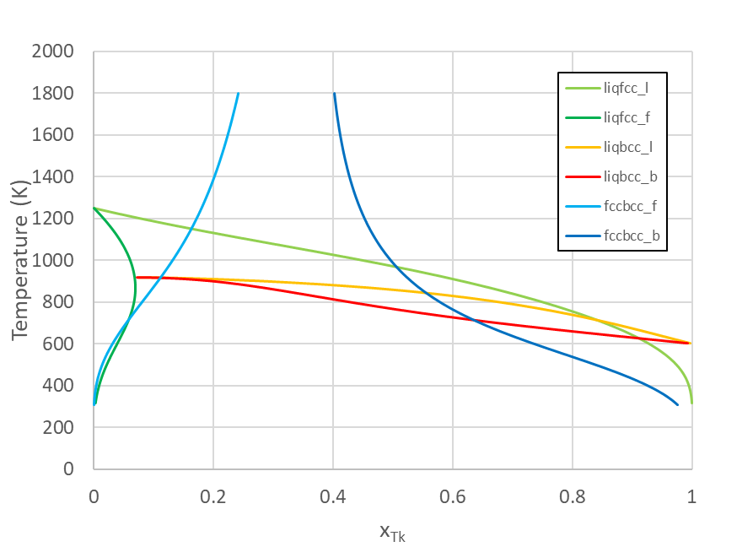
두 상에서의 상태도 얻기
상태도
① liquid-fcc
② liquid-bcc
③ fcc-bcc
$μ_{Tk}^{liq}=$ $μ_{Tk}^{fcc}$
$μ_{Ps}^{liq}=$ $μ_{Ps}^{fcc}$
$μ_{Tk}^{liq}=$ $μ_{Tk}^{bcc}$
$μ_{Ps}^{liq}=$ $μ_{Ps}^{bcc}$
$μ_{Tk}^{fcc}=$ $μ_{Tk}^{bcc}$
$μ_{Ps}^{fcc}=$ $μ_{Ps}^{bcc}$
4 / 8

Slide 5
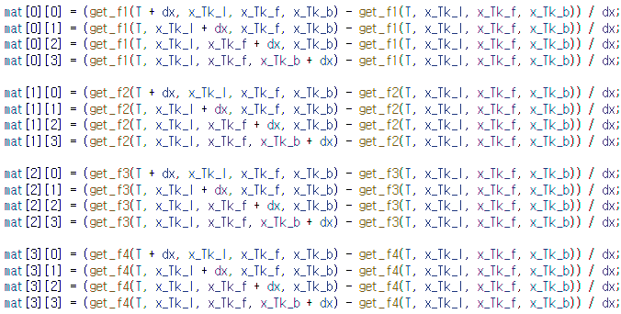
peritectic point 찾기
Newton’s Method
Jacobian matrix J(X)
f 설정
$μ_{Tk}^{liq}=$ $μ_{Tk}^{fcc}=μ_{Tk}^{bcc}$
$μ_{Ps}^{liq}=$ $μ_{Ps}^{fcc}=μ_{Ps}^{bcc}$
$$J\left(X\right)=\left[\begin{matrix}\frac{∂f_{1}}{∂T} & \frac{∂f_{1}}{∂x_{Tk}^{liq}} & \frac{∂f_{1}}{∂x_{Tk}^{fcc}} & \frac{∂f_{1}}{∂x_{Tk}^{bcc}} \\ \frac{∂f_{2}}{∂T} & \frac{∂f_{2}}{∂x_{Tk}^{liq}} & \frac{∂f_{2}}{∂x_{Tk}^{fcc}} & \frac{∂f_{2}}{∂x_{Tk}^{bcc}} \\ \frac{∂f_{3}}{∂T} & \frac{∂f_{3}}{∂x_{Tk}^{liq}} & \frac{∂f_{3}}{∂x_{Tk}^{fcc}} & \frac{∂f_{3}}{∂x_{Tk}^{bcc}} \\ \frac{∂f_{4}}{∂T} & \frac{∂f_{4}}{∂x_{Tk}^{liq}} & \frac{∂f_{4}}{∂x_{Tk}^{fcc}} & \frac{∂f_{4}}{∂x_{Tk}^{bcc}}\end{matrix}\right]$$
$${f_{1}=μ}_{Tk}^{liq}−μ_{Tk}^{fcc}=0$$
$${f_{2}=μ}_{Tk}^{fcc}−μ_{Tk}^{bcc}=0$$
$${f_{3}=μ}_{Ps}^{liq}−μ_{Ps}^{fcc}=0$$
$${f_{4}=μ}_{Ps}^{fcc}−μ_{Ps}^{bcc}=0$$
수치 미분
$$f^{′}\left(x\right)=\frac{f\left(x+dx\right)−f\left(x\right)}{dx}$$
5 / 8

Slide 6
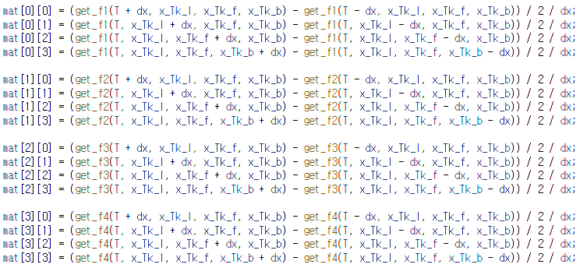
peritectic point 찾기
수치 미분과 해석적 미분 ⇨ 같은 결과
수치 미분 결과
$$f^{′}\left(x\right)=\frac{f\left(x+dx\right)−f\left(x −dx\right)}{2dx}$$
중앙 차분
해석적 미분 결과
해석적 미분
6 / 8

Slide 7
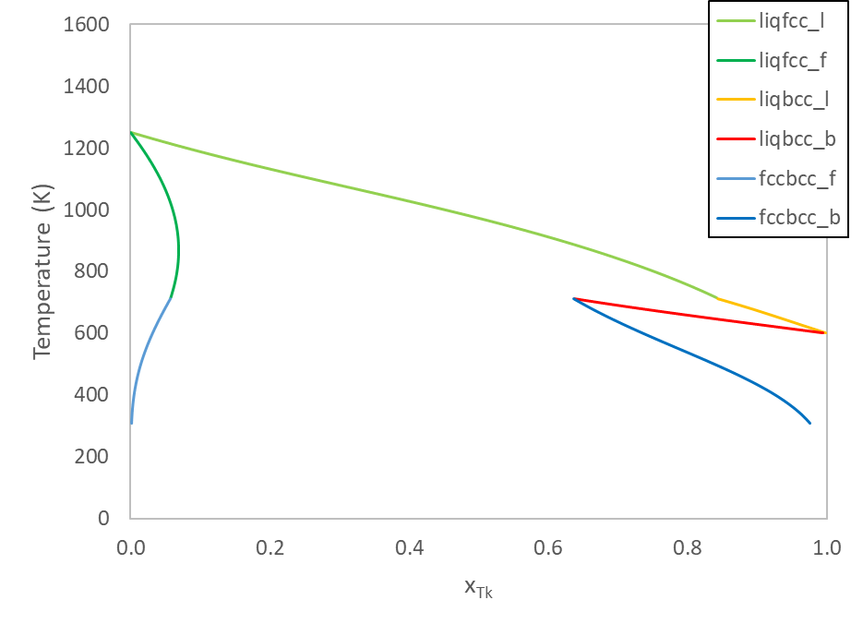
최종 Ps-Tk 상태도
Ps-Tk 상태도
liquid
fcc
liquid + fcc
liquid + bcc
715.982
bcc
fcc + bcc
peritectic point를 구함으로써 영역 구분
7 / 8

Slide 8
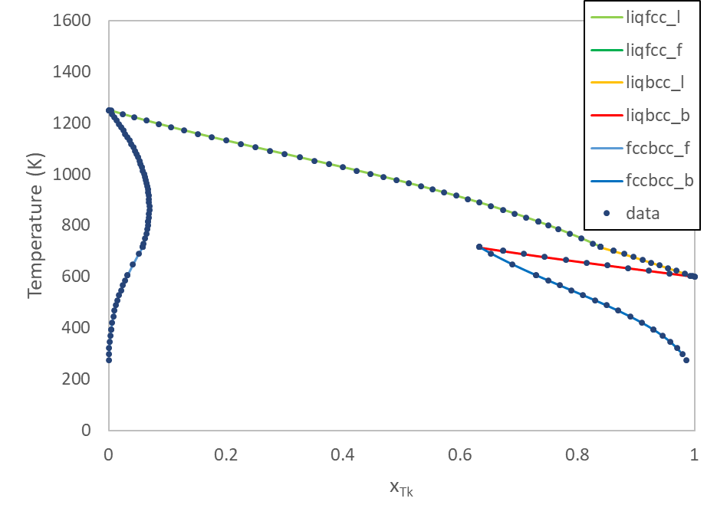
최종 Ps-Tk 상태도
데이터와 비교
715.982
$$x_{Tk}^{liq}=0.839$$
$$x_{Tk}^{fcc}=0.058$$
$$x_{Tk}^{bcc}=0.632$$
 | data | calc | relative error(%)
T | 715.203 | 715.982 | 0.11
x_{Tk}(fcc) | 0.058 | 0.058 | 0.22
x_{Tk}(bcc) | 0.633 | 0.632 | 0.20
x_{Tk}(liq) | 0.840 | 0.839 | 0.09
HW5에서 구했던 L parameter을 이용해 Ps-Tk 상태도를 계산한 결과 주어진 데이터와 일치
열역학 정보를 이용해 파라이터화하고, 성공적으로 Ps-Tk 상태도 재현
8 / 8

