Slide 1
HW3
[AMSE-318] numerical Methods
신소재공학과 20150232 오상호

Slide 2
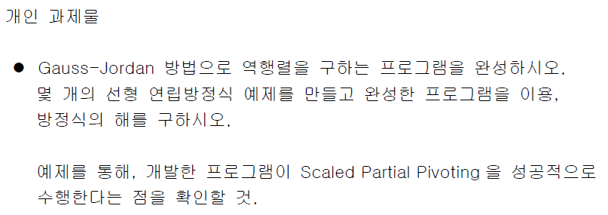
Newton-Raphson Method
Bisect Method

Slide 3
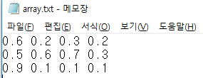
0. Matrix File In
A B

Slide 4
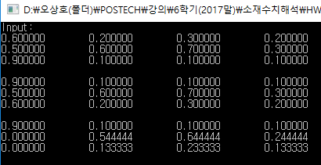
1. Pivoting & Elimination

Slide 5
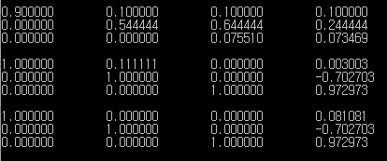
2. Normalization & Elimination

Slide 6
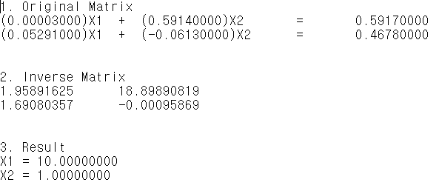
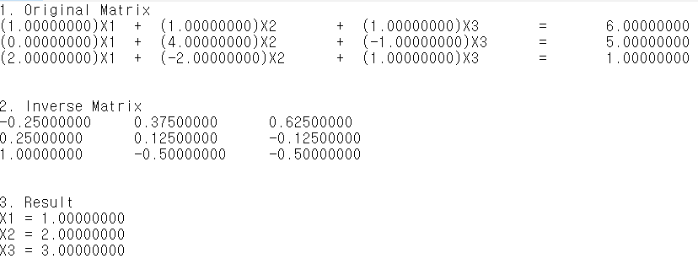
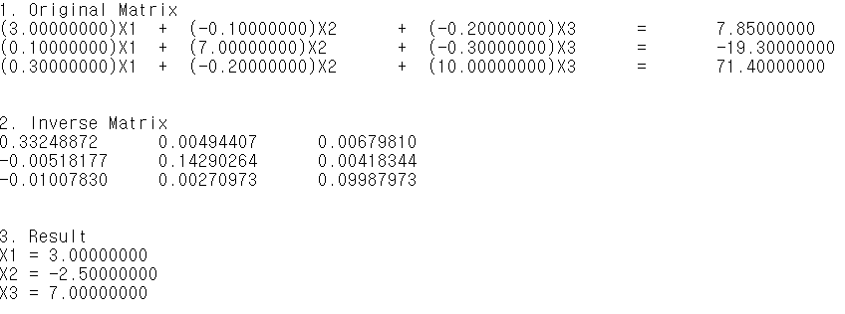
3. Result File Out & Free

