Slide 1
HW7
20190312 신소재공학과 김서현

Slide 2
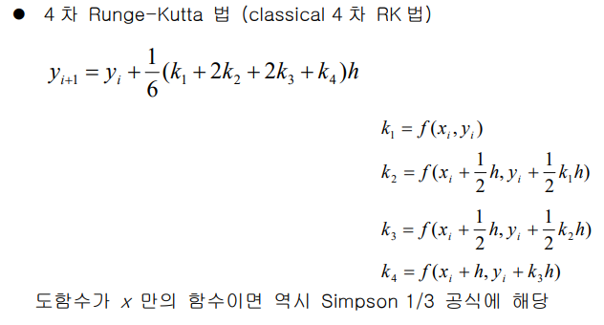
Formulas_ Euler’s method & RK4

Slide 3
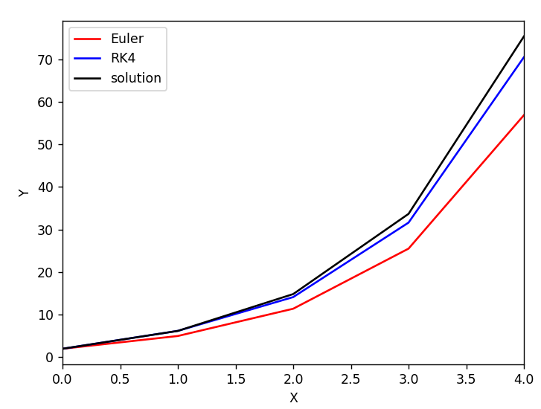
Result1
X0 = 0
Y0 = 2
h=1

Slide 4
Result2 - relative error of integral value at x=4
X0 = 0
Y0 = 2
Euler’s method
RK4 method
h | Relative error(%)
0.1 | 2.4482303105596817
0.2 | 4.905154483702385
0.4 | 9.834406216916058
0.8 | 19.675994823948503
1 | 24.541951019844387
2 | 47.405355704803775
h | Relative error(%)
0.1 | 1.344863806696295*e-05
0.2 | 0.00021578505300849874
0.4 | 0.003465047466015244
0.8 | 0.05505255457328086
1 | 0.13301137542200386
2 | 1.8990201924583658

Slide 5
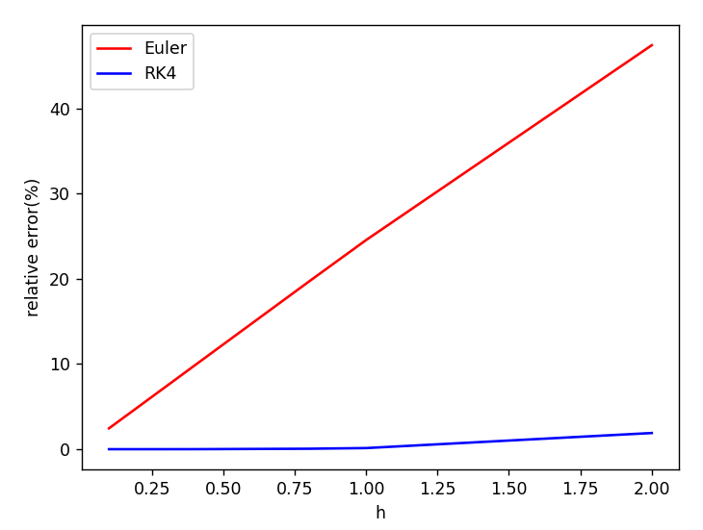
Result2 - Graph

