Slide 1
소재수치해석 HW6
20110073 김용민

Slide 2
value
x | f(x)
1 | 0
2.5 | 0.916291 (ln 2.5)
4 | 1.386294 (ln 4)
6 | 1.791759 (ln 6)

Slide 3
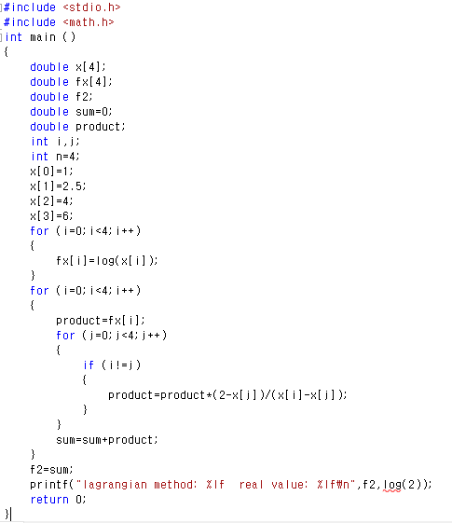
Lagrangian method

Slide 4
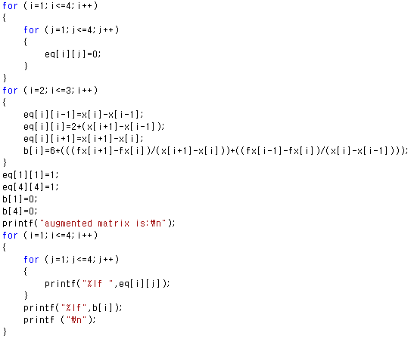
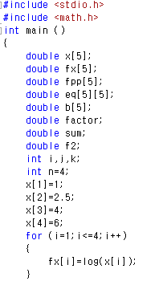
Cubic spline method

Slide 5
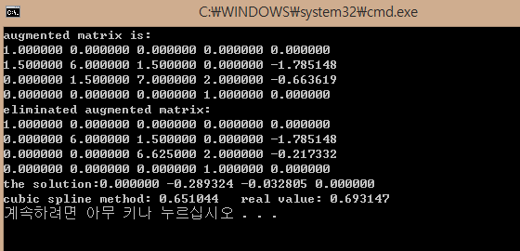
Cubic spline method

Slide 6
