Slide 1
Assn_7
화학공학과 신민철

Slide 3
Reason for Choosing Heun Method

Slide 4
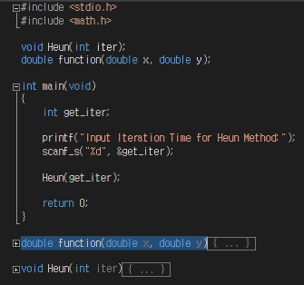
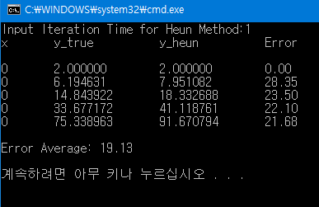
Heun Method with various repeats
Main
Heun
Output

Slide 5
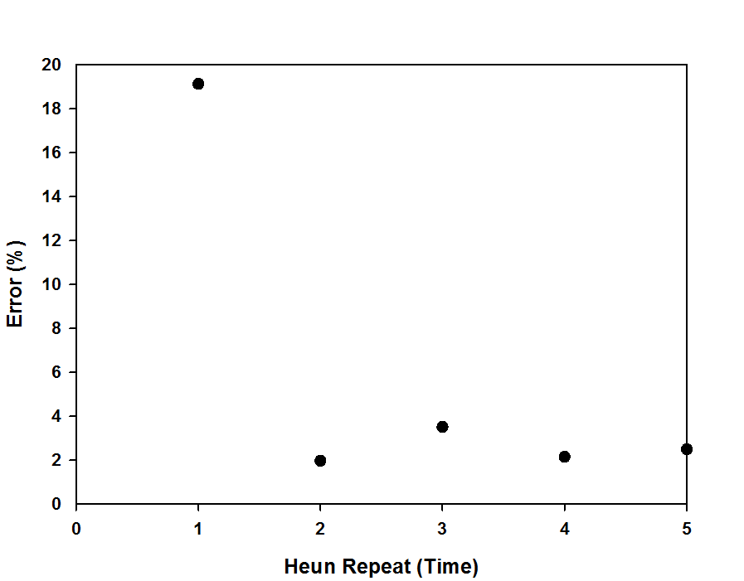
Heun Method with various repeats
19.13
Error가 항상 줄어들지 않는다
3.51
1.97
2.15
2.49

Slide 6
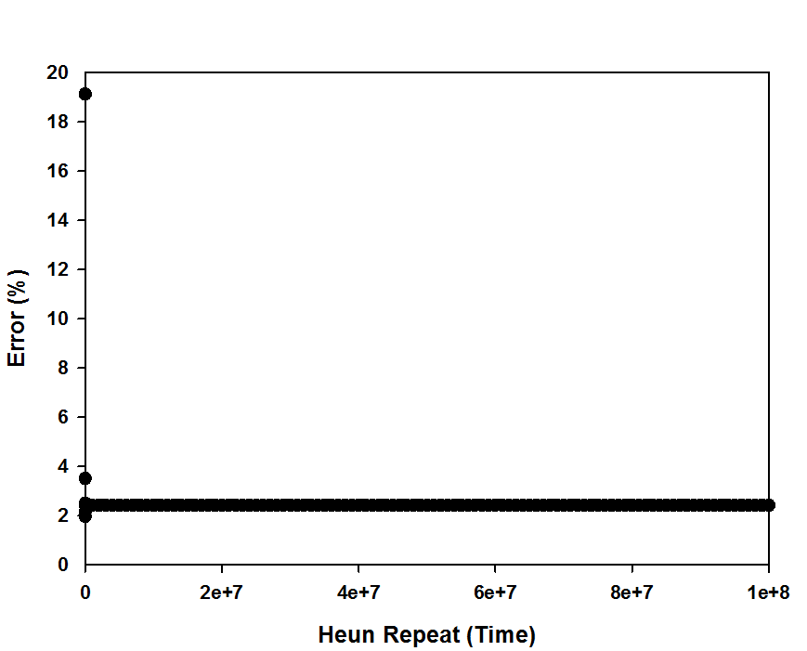
Heun Method with various repeats
Error가 수렴한다!
2.42

Slide 7
Thank you for listening !

