Slide 1
Numerical Method
HW #8
20200552 이형진

Slide 2
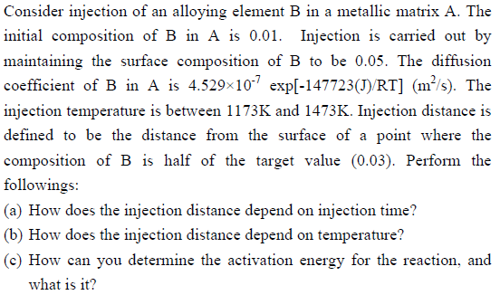
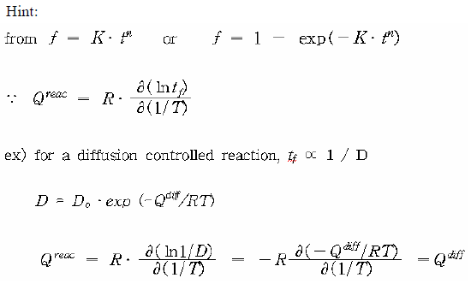
HW8) Partial Differential Equation
[Problem]

Slide 3
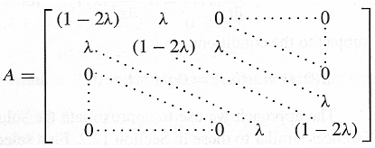
HW8) Partial Differential Equation
[Background]
FDM of Parabolic Problems
FDM: Finite Difference Method, 도함수들을 유한제차분으로 근사하여, 연립방정식으로 미분방정식을 해결
[Setting]
Δx = 0.000002m
Δt = 0.5s
L = 0.0004m
Checked when t = 100s, 200s, 400s, 800s, 1600s
<Initial Value>
C = 0.05 when x = 0
dC/dt = 0 when x = L
C = 0.01 when t = 0

Slide 4
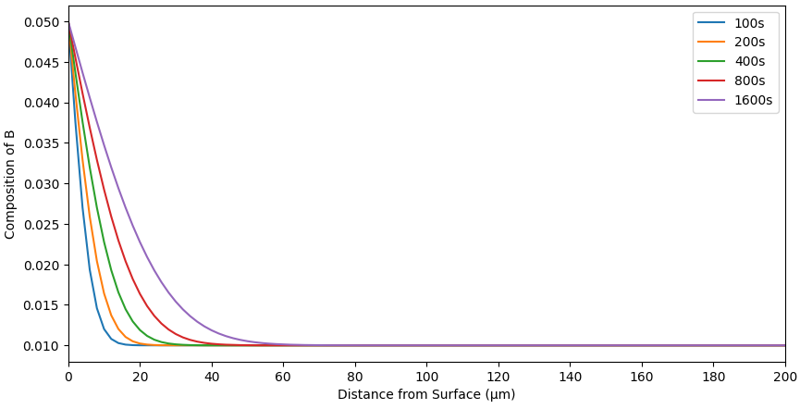
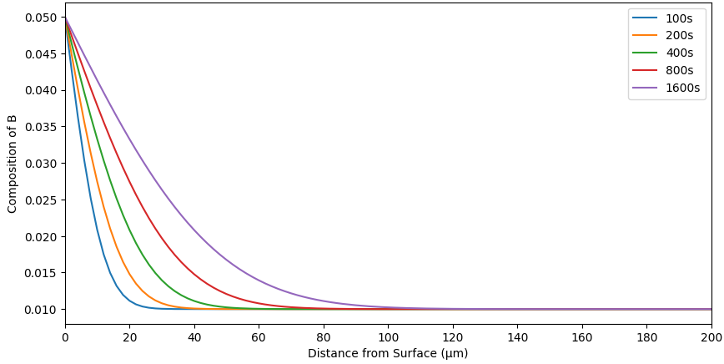
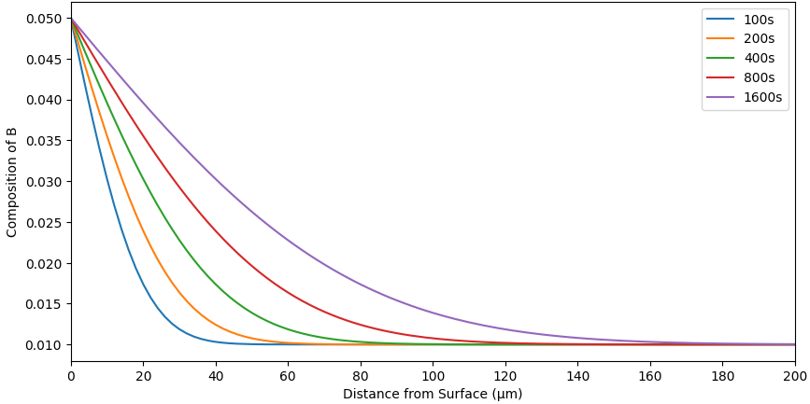
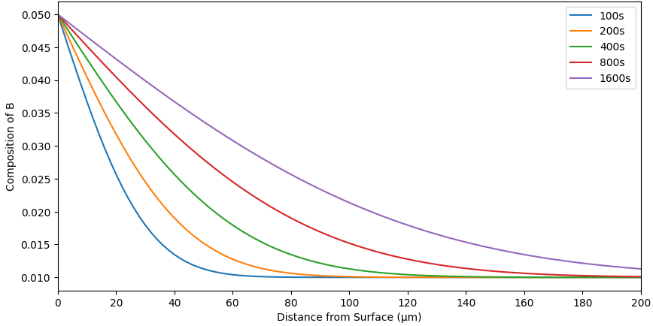
HW8) Partial Differential Equation
[Composition Result at T=1173K, 1273K, 1373K, 1473K]
<1173K>
λ = 0.0157
<1273K>
λ = 0.0514
<1473K>
λ = 0.3404
<1373K>
λ = 0.1418

Slide 5
HW8) Partial Differential Equation
Injection Distance ∝ $\sqrt{t}$

Slide 6
HW8) Partial Differential Equation
Injection Distance ∝$e^{\frac{1}{T}}$

Slide 7
HW8) Partial Differential Equation
Injection Distance ∝ $\sqrt{t}$
$$x=\sqrt{Dt}=\sqrt{D_{0}∙exp(−\frac{Q^{diff}}{RT})}$$
Injection Distance ∝$e^{\frac{1}{T}}$
$$lnx=−\frac{Q^{diff}}{2RT}+C$$
(b)에서의 그래프의 기울기 = -Q/2R = -8826.48 (평균)
Q = 146766.7 J
Calculated Value (J) | 146766.7
Real Value (J) | 147723
Error (%) | 0.64%

