Slide 1
Homework 5
Doyoon Kim
Department of Materials Science and Engineering

Slide 2
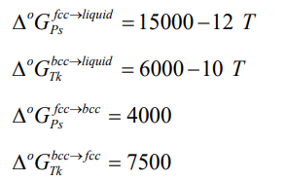
01
Problem
Problem : 각 상의 𝐿 parameter(𝐿₀₀,𝐿₀₁,𝐿₁₀,𝐿₁₁)를 구하라
주어진 자료
(1)
(2) Enthalpy of mixing (J/mol) in liquid
(3) Activity of Tk in liquid at 1500 K (reference state: Liquid Tk)
(4) Enthalpy of Formation in FCC and BCC
(5) Activity of Ps in BCC and Activity of Tk in FCC at 600 K

Slide 3
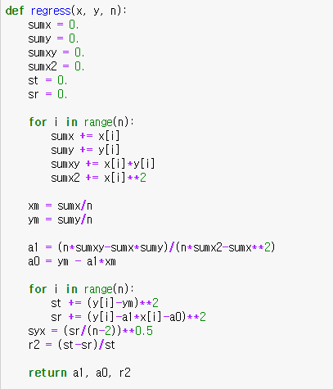
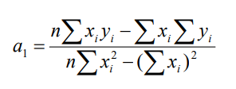
02
Regression Function

Slide 4

02
Case of Liquid
Enthalpy of Mixing
$$∆H_{M}=X_{Ks}\left(1−X_{Ks}\right)L^{p}$$
$$L^{p}=L_{00}+L_{01}X_{Ks}$$
Activity
$$μ_{k}^{liq}=Δ{°G}_{Ks}^{ref→liq}+RTlnX_{Ks}+{\left(1−X_{Ks}\right)}^{2}L^{liq} \left(L^{liq}=L_{0}+L_{1}X_{Ks}\right) \\ μ_{k}^{liq}=Δ°G_{Ks}^{ref→liq}+RTln\left(a_{Ks}\right)$$
Linear Regression
$$\frac{∆H_{m}}{x_{Tk}\left(1−x_{Tk}\right)}=L_{00}−L_{10}+2L_{10}x_{Tk}$$
$$\frac{RT\ln{a_{Tk}}−RT\ln{x_{Tk}}}{{\left(1−x_{Tk}\right)}^{2}}=L_{00}+L_{01}T−L_{10}−L_{11}T+2\left(L_{10}+L_{11}T\right)x_{Tk}$$

Slide 5

02
Case of FCC
Enthalpy of Formation
$$∆H_{f}=X_{Ks}Δ°G_{Tk}^{BCC→FCC}+X_{Tk}\left(1−X_{Tk}\right)L^{FCC}$$
$$L^{FCC}=L_{00}+L_{10}X_{Tk}$$
Activity
$$μ_{k}^{FCC}=Δ{°G}_{Tk}^{BCC→FCC}+RTlnX_{Tk}+{\left(1−X_{Tk}\right)}^{2}L^{FCC} \left(L^{FCC}=L_{0}+L_{1}X_{Tk}\right) \\ μ_{k}^{FCC}=RTln\left(a_{Tk}\right)$$
Linear Regression
$$\frac{∆H_{f}^{fcc}−x_{Tk}∆°G_{Tk}^{bcc→fcc}}{x_{Tk}\left(1−x_{Tk}\right)}=L_{00}−L_{10}+2L_{10}x_{Tk}$$
$$\frac{RT\ln{a_{Tk}}−RT\ln{x_{Tk}−∆°G_{Tk}^{bcc→fcc}}}{{\left(1−x_{Tk}\right)}^{2}}=L_{00}+L_{01}T−L_{10}−L_{11}T+2\left(L_{10}+L_{11}T\right)x_{Tk}$$

Slide 6

02
Case of BCC
Enthalpy of Formation
$$∆H_{f}=X_{Tk}Δ°G_{Tk}^{FCC→BCC}+X_{Tk}\left(1−X_{Tk}\right)L^{BCC}$$
$$L^{BCC}=L_{00}+L_{10}X_{Tk}$$
Activity
$$μ_{Tk}^{BCC}=Δ{°G}_{Tk}^{FCC→BCC}+RTln(X_{Tk})+{\left(1−X_{Tk}\right)}^{2}L^{BCC} \left(L^{BCC}=L_{0}+L_{1}X_{Ps}\right) \\ μ_{Tk}^{BCC}=RTln\left(a_{Tk}\right)$$
Linear Regression
$$\frac{∆H_{f}^{bcc}−\left(1−x_{Tk}\right)∆°G_{Ps}^{fcc→bcc}}{x_{Tk}\left(1−x_{Tk}\right)}=L_{00}−L_{10}+2L_{10}x_{Tk}$$
$$\frac{RT\ln{a_{Ps}}−RT\ln\left(1−x_{Tk}\right)−∆°G_{Ps}^{fcc→bcc}}{{x_{Tk}}^{2}}=L_{00}+L_{01}T−L_{10}−L_{11}T+2\left(L_{10}+L_{11}T\right)x_{Tk}$$

Slide 7
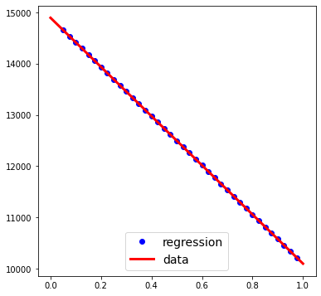
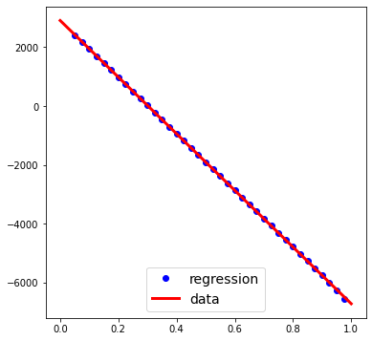
02
Result - Liquid
Result
Parameter
L00:12496.913738310439
L10:-2397.9002909404803
L01:-9.600819273288312
L11:-1.6094527077796996
$$y=−4795.80x+14894.81$$
$$r^{2}=0.9999973$$
$$y=−9624.16x+2907.76$$
$$r^{2}=0.9999973$$
$r≈1$ 이므로 sub-regular solution이다

Slide 8
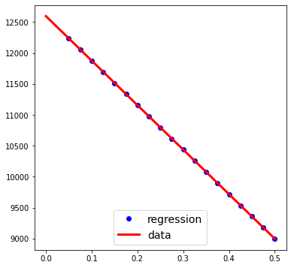
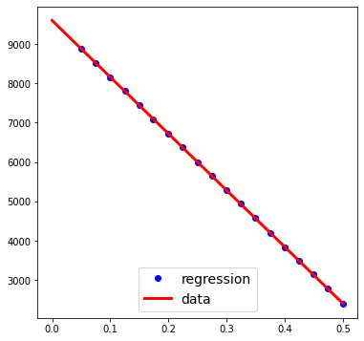
02
Result - FCC
Result
Parameter
L00:8997.710134396166
L10:-3599.6901814709754
L01:-4.396152332822268
L11:-2.3948949780076867
$$y=−7199.38x+12597.40$$
$$r^{2}=0.9999971$$
$$y=−14384.07x+9595.51$$
$$r^{2}=0.9999932$$
$r≈1$ 이므로 sub-regular solution이다

Slide 9
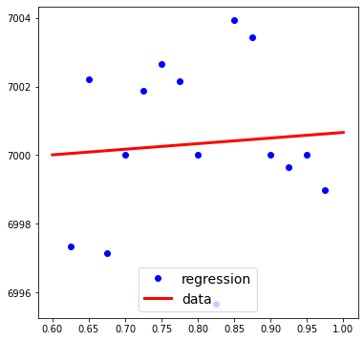
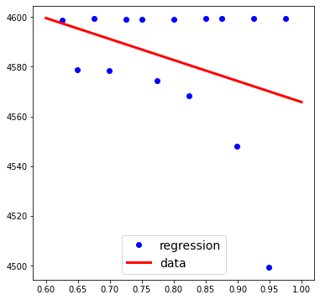
02
Result - BCC
Result
Parameter
L00:6999.84505995766
L10:0.8154944113588759
L01:-3.986352199615394
L11:-0.07177165589312132
$$y=1.630989x+6999.03$$
$$r^{2}=0.0057678$$
$$y=−84.49499x+4650.28$$
$$r^{2}=0.114338$$
$r≪1$ 이므로 regular solution이다

