Slide 1
소재수치해석
HW6
20100425 조 규 봉

Slide 2
1
HW 6
Problem
Regression analysis를 이용하여 Enthalpy of mixing, Activity, Enthalpy of formation의 자료를 통해 Ps , Tk의 열역학모델을 만들어보자.

Slide 3
2
HW 6
Basic Concept – Non ideal solution(Liquid phase)
Enthalpy of Mixing
$$∆H_{m}^{L}=X_{i}(1−X_{i})Ω$$
- Regular solution
$$∆H_{m}^{L}=X_{i}\left(1−X_{i}\right){(L}_{0}+L_{1}X_{i})$$
- Sub-regular solution
$$\frac{∆H_{m}^{L}}{X_{Tk}\left(1−X_{Tk}\right)}={(L}_{0}+L_{1}X_{Tk})$$
Activity
$$RTlna_{i}=RTlnX_{i}+{\left(1−X_{i}\right)}^{2}(Ω+\frac{dΩ}{dX_{i}}X_{i})$$
$$RTlna_{Tk}=RTlnX_{Tk}+{\left(1−X_{Tk}\right)}^{2}(L_{0}+2L_{1}X_{Tk})$$
$$\frac{RTln(\frac{a_{Tk}}{X_{Tk}})}{{\left(1−X_{Tk}\right)}^{2}}={(L}_{0}+{2L}_{1}X_{Tk})$$

Slide 4
2
HW 6
Basic Concept – Non ideal solution (FCC phase)
Enthalpy of Formation
$$∆H_{f}^{F}={X_{Tk}ΔG_{Tk}^{B→F}+ΩX}_{Tk}\left(1−X_{Tk}\right)$$
$$\frac{∆H_{f}^{F}−X_{Tk}ΔG_{Tk}^{B→F}}{X_{Tk}\left(1−X_{Tk}\right)}={(L}_{0}+L_{1}X_{Tk})$$
Activity of Tk in FCC at 600K
$$μ_{Tk}^{F}=ΔG_{Tk}^{B→F}+RTlnX_{Tk}+{\left(1−X_{Tk}\right)}^{2}\left(Ω+\frac{dΩ}{dX_{Tk}}X_{Tk}\right) \\ =ΔG_{Tk}^{B→F}+RTlna_{Tk} \left(wrt. FCC\right) \\ =RTlna_{Tk} (wrt. BCC)$$
$$\frac{RTln\left(\frac{a_{Tk(wrt.BCC)}}{X_{Tk}}\right)−ΔG_{Tk}^{B→F}}{{\left(1−X_{Tk}\right)}^{2}}={(L}_{0}+{2L}_{1}X_{Tk})$$

Slide 5
2
HW 6
Basic Concept – Non ideal solution (BCC phase)
Enthalpy of Formation
$$∆H_{f}^{B}={X_{Ps}ΔG_{Ps}^{F→B}+ΩX}_{Ps}\left(1−X_{Ps}\right)$$
$$\frac{∆H_{f}^{B}−X_{Ps}ΔG_{Ps}^{B→F}}{X_{Ps}\left(1−X_{Ps}\right)}={(L}_{0}+L_{1}X_{Ps})$$
Activity of Ps in BCC at 600K
$$μ_{Ps}^{B}=ΔG_{Ps}^{F→B}+RTlnX_{Ps}+{\left(1−X_{Ps}\right)}^{2}\left(Ω+\frac{dΩ}{dX_{Ps}}X_{Ps}\right) \\ =ΔG_{Ps}^{F→B}+RTlna_{Ps} \left(wrt. BCC\right) \\ =RTlna_{Ps} (wrt. FCC)$$
$$\frac{RTln\left(\frac{a_{Ps(wrt.FCC)}}{X_{Ps}}\right)−ΔG_{Ps}^{F→B}}{{\left(1−X_{Ps}\right)}^{2}}={(L}_{0}+{2L}_{1}X_{Ps})$$

Slide 6
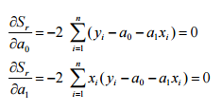
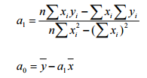
2
HW 6
Basic Concept – Regression
deviation
minimizing
$$S_{t}=\sum_{i=1}^{n}{{\left(y_{i}−\overline{y}\right)}^{2}}$$

Slide 7
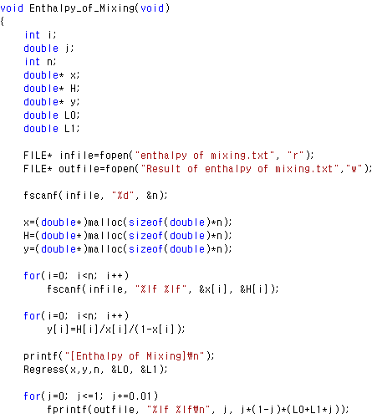
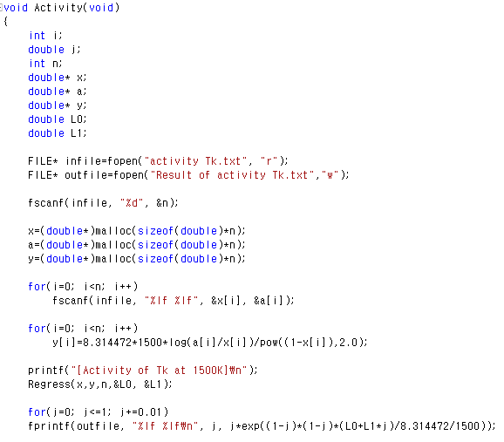
3
HW 6
Codes – Basic structure

Slide 8
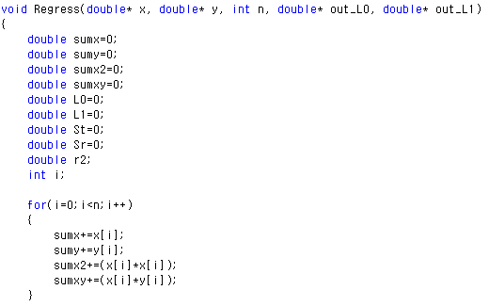
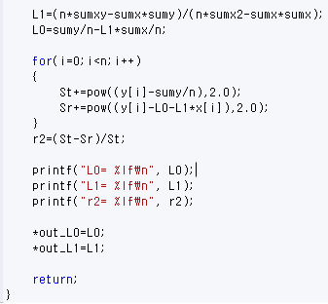
3
HW 6
Codes – Regression

Slide 9
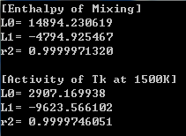
4
HW 6
Results – Liquid phase
두 경우가 서로 L0, L1이 다르기 때문에
Temperature dependence가 있음을 알 수 있음
→ 실제로는 2L1값! L1= -4811.783051
각각 대입해서 계산해보면
$$Ω=\left(14894.23−7.99T\right)+\left(−4794.93−0.0112T\right)X_{Tk}$$

Slide 10
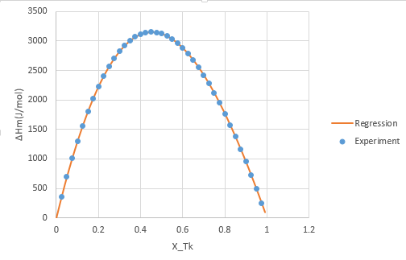
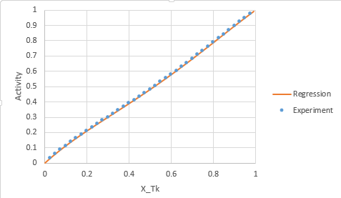
4
HW 6
Results – Liquid phase
Enthalpy of Mixing
Activity at 1500K
$R^{2}=$0.99999713
$R^{2}=$0.9999746

Slide 11
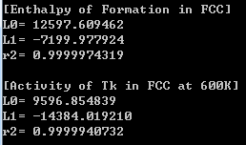
4
HW 6
Results – FCC
Not equal ! Temperature dependence !!
→ 실제로는 2L1값! L1= -7192.009605
$$Ω=\left(12597.61−5.00126T\right)+\left(−7199.978−0.01328T\right)X_{Tk}$$

Slide 12
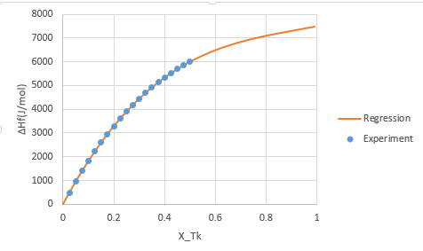
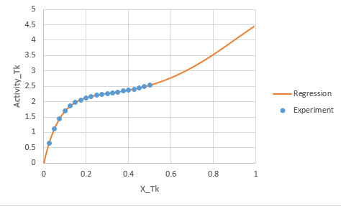
4
HW 6
Results – FCC
Enthalpy of Formation in FCC
Activity of Tk in FCC at 600K
$R^{2}=$0.99999743
$R^{2}=$0.99999407

Slide 13
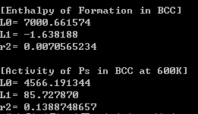
4
HW 6
Results – BCC
Not equal ! Temperature dependence !! Not sub-regular model
?
$$Ω=\left(7000.6616−4.05745T\right)$$

Slide 14
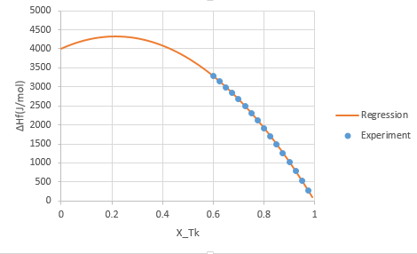
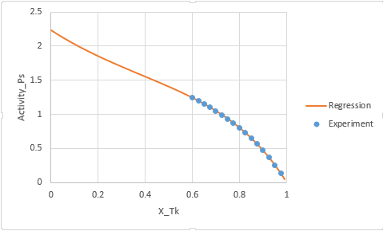
4
HW 6
Results – BCC
Enthalpy of Formation in BCC
Activity of Ps in BCC at 600K

Slide 15
5
HW 6
Conclusion
-Liquid, FCC는 sub-regular solution model, BCC는 regular solution model을 따른다.
-이번 HW6 에서 얻은 Ω값들을 이용하여 Mid-term에서 Ps-Tk phase diagram을 만드는데 사용할 수 있을 것이다!

Slide 16
감사합니다.

