Slide 1
HW#6. Regression
20100380 유종명

Slide 2
The assignment was about…
Miterm data중 액상에서의 H_mixing과 활동도 값을 회귀분석을 이용하여 fitting해보기.

Slide 3
Thermo-dynamical background
Enthalpy of mixing
Activity
$$RTln\left(\frac{a_{B}}{X_{B}}\right)={\left(1−X_{B}\right)}^{2}(Ω+\frac{dΩ}{dX_{B}}X_{B})$$
$$y= \frac{RTln(\frac{a_{B}}{X_{B}})}{{(1−X_{B})}^{2} }=L_{0}+{2L}_{1}X_{B}=a_{0}+a_{1}x$$
$$∆H_{mix}=ΩX_{A}X_{B}=(L_{0}+L_{1}X_{B})(1−X_{B})X_{B}$$
$$y= \frac{ΔH_{mix}}{(1−X_{B})X_{B}}=L_{0}+L_{1}X_{B}=a_{0}+a_{1}x$$

Slide 4
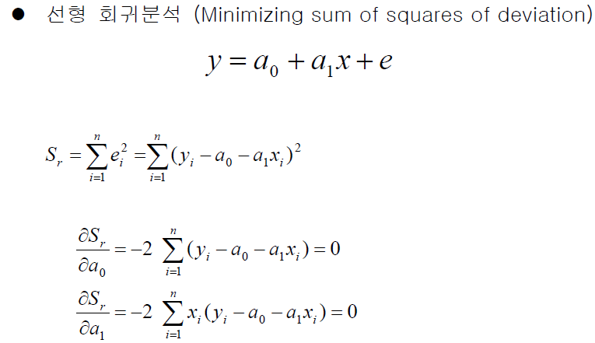
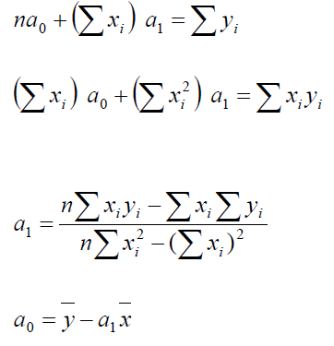
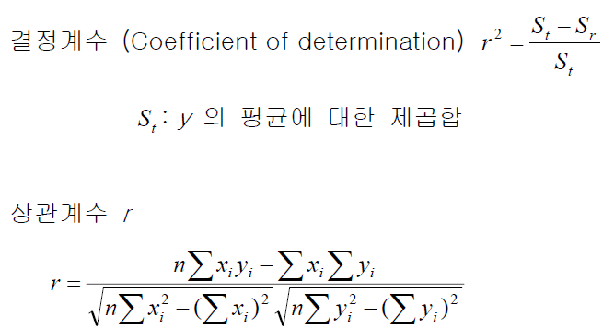
Introduction to Regression method

Slide 5
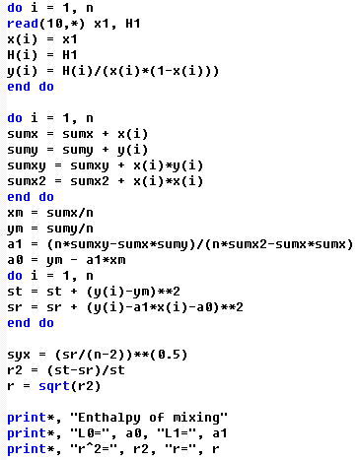
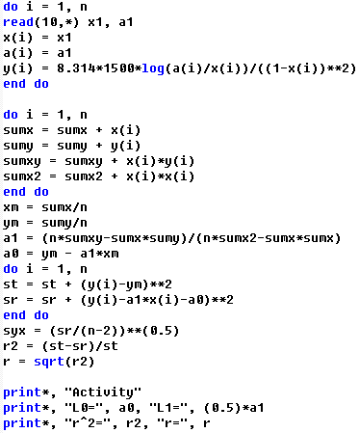
Codes

Slide 6
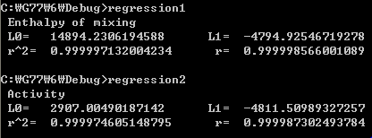
Calculated L values

Slide 7
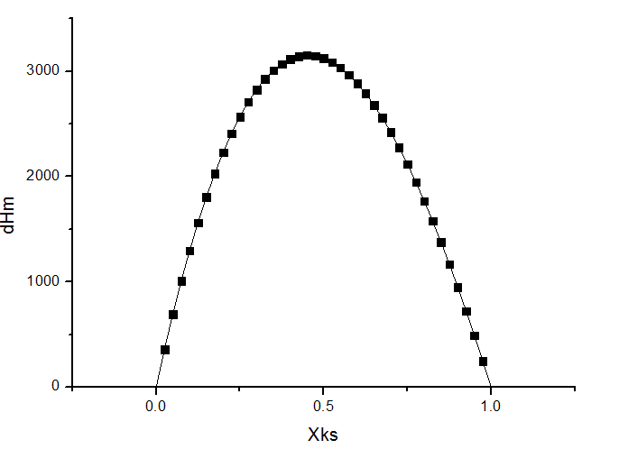
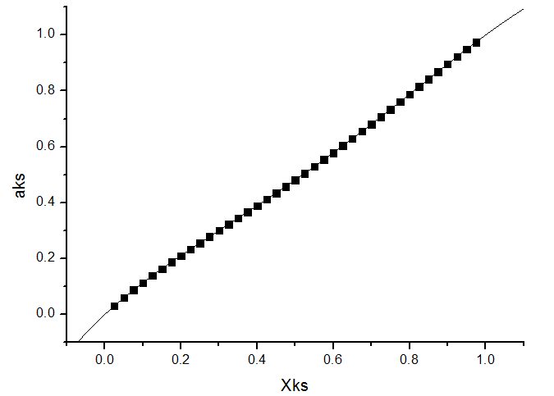
Enthalpy of mixing
Activity

