Slide 1
AMSE318 HW2 with python
49004547 Seokjee SHIN

Slide 2
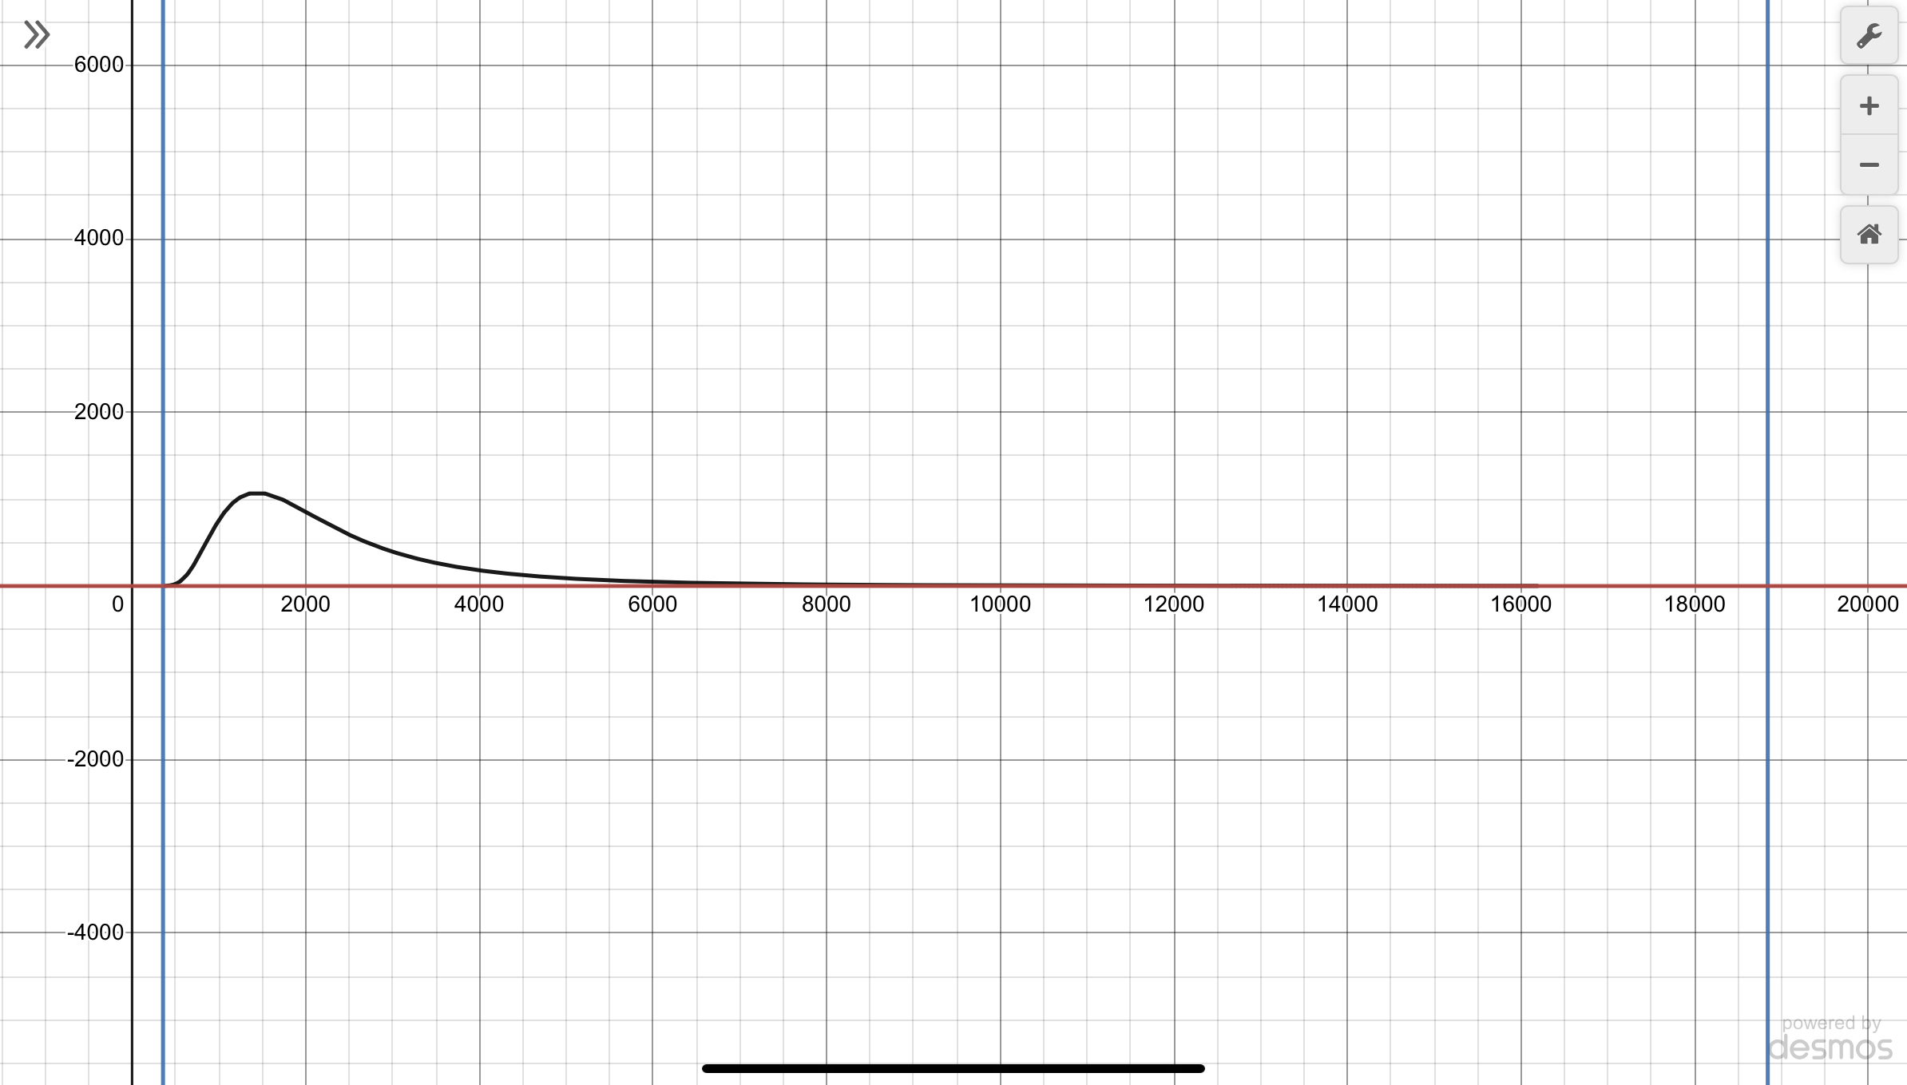
Error Reasoning
Avoiding error 1:
T should be greater than 0 due to 1/T and log T
Use “if” statement to filter the initial values for T
Avoiding error 2:
The program should not run forever (=inefficiently)
Create a maximum number of iteration that program can run (for my code, used loop function)
Avoiding error 3:
Continuing Avoiding error 1 with calculated T which should still be greater than 0
Use “if” statement during the calculation for new T values
Additional way to avoid error:
I made the code generalized meaning it can be used for other formulas. However, if this was tailored just for the given formula, I could’ve set a boundary for possible T values as it has two possible values around 350K or 19000K
Notes:
Find the temperature that yields a vapor pressure of 0.5 atm using two different methods including the Newton-Raphson and compare the convergence speed.
Then can be many types of numerical error during running the code. Clarify the reason for the error and suggest a way to avoid it.

Slide 5
Conclusion of HW2
Newton-Rapson Method is better than bisection method as it has faster convergence speed with even with one variable. If we have very small range to test such as 200 to 400K, then bisection method may work faster with less iteration.
With given condition, the temperature the yields a vapor pressure of 0.5 atm is 355K

