Slide 1
Homework 3
Doyoon Kim
Department of Materials Science and Engineering

Slide 2
01
Algorithm Structure
Read file
Error 메시지 출력
Extra elimination to make identical matrix
Inverse Matrix
Yes
No
Change to matrix form
Pivot이 0인가?
Pivot and Scaling
Gaussian Elimination

Slide 3
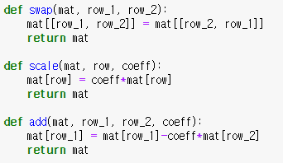
01
Algorithm Structure
<Library>
<기본 연산>
Numpy : array 처리(matrix inversion 기능 사용 X)
Pandas : Excel csv file → Matrix 변환
<Excel File read>

Slide 4
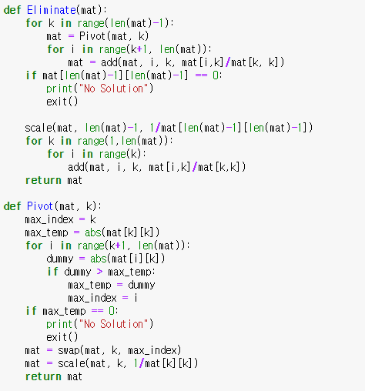
01
Algorithm Structure
First Elimination
Second Elimination
Maximum 값 결정
Swap, Scaling

Slide 5
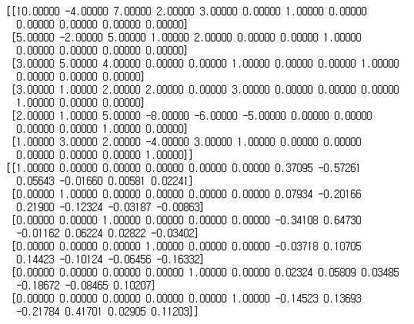
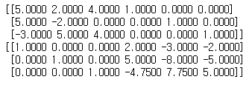
01
Algorithm Structure
Example(연립방정식, Inverse Matrix)

