Slide 1
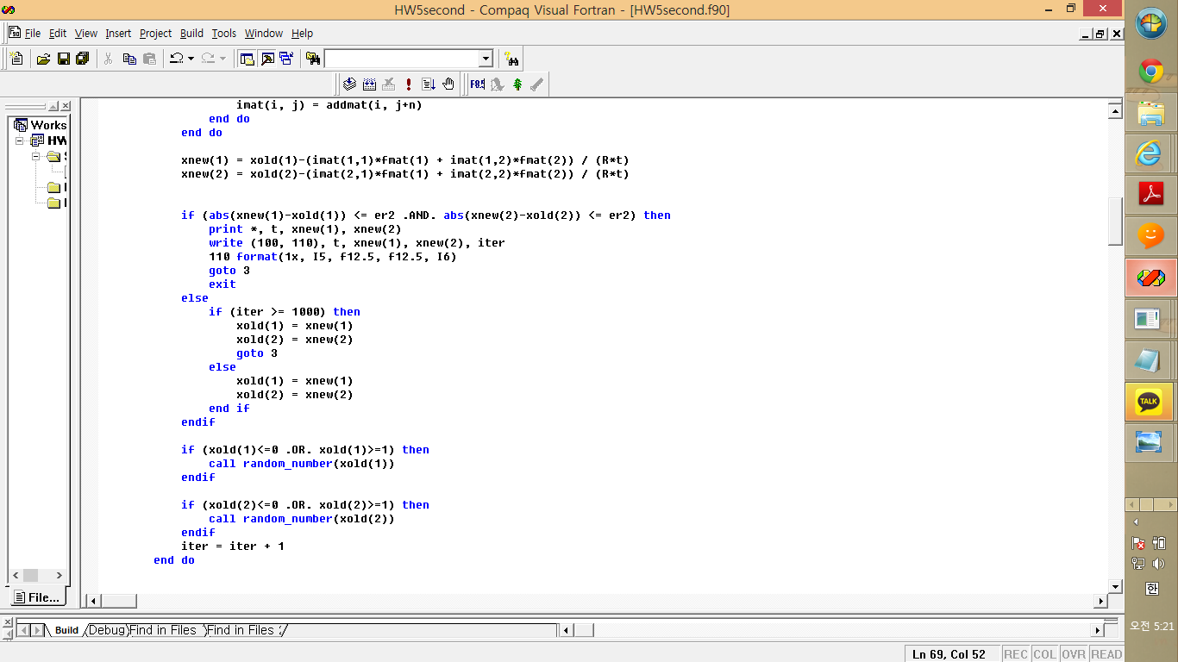
Non-linear equation
재료수치해석 hw5
20100098 최원미

Slide 2
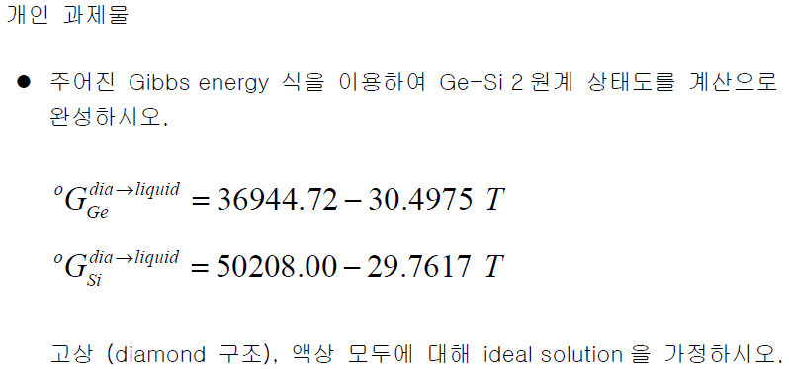
Phase diagram, question

Slide 3
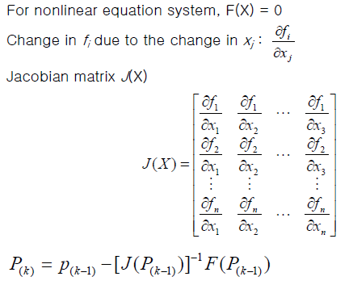
Phase diagram, question

Slide 4
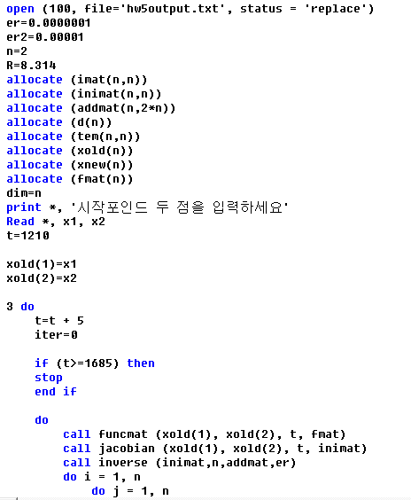
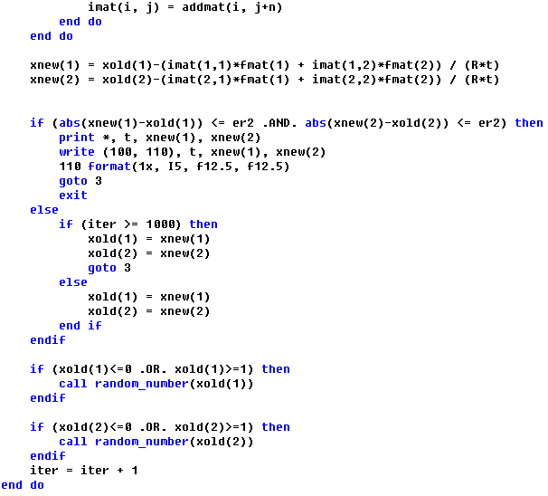
Phase diagram, code

Slide 5
Phase diagram, code

Slide 6
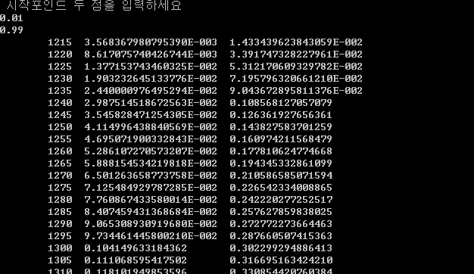
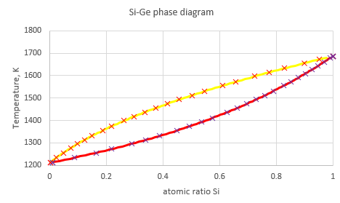
Phase diagram, result
Ge
Si

Slide 7
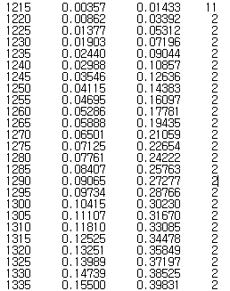
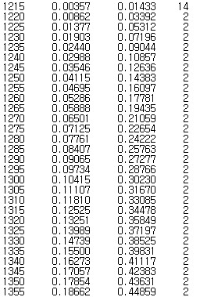
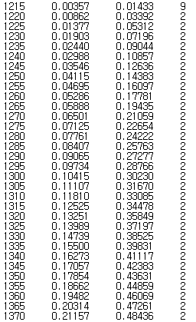
Phase diagram, result
Case 1, 0.001 0.999
Case 2, 0.01 0.99
Case 3, 0.4 0.6
Temperature x1 x2 iteration
Temperature x1 x2 iteration
Temperature x1 x2 iteration

