Slide 1
HW#9
Partial-Differential Equations
: Finite-Difference Methods for Parabolic Problems
20100304, MSE
LEE MISO

Slide 2
Problem
Consider injection of an alloying element B in a metallic matrix A. The initial composition of B in A is 0.01. Injection is carried out by maintaining the surface composition of B to be 0.05. The diffusion coefficient of B in A is 4.529×10⁻⁷ exp[-147723(J)/RT] (m²/s). The injection temperature is between 1173K and 1473K. Injection distance is defined to be the distance from the surface of a point where the composition of B is half of the target value (0.03). Perform the followings:
(a) How does the injection distance depend on injection time?
(b) How does the injection distance depend on temperature?
(c) How can you determine the activation energy for the reaction, and c what is it?
Injection distance : 목표치의 절반(=0.03)만큼 주입된 distance

Slide 3
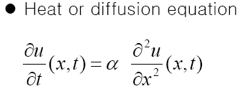
Theory
Finite-Difference Methods for Parabolic Problems
λ =

Slide 4
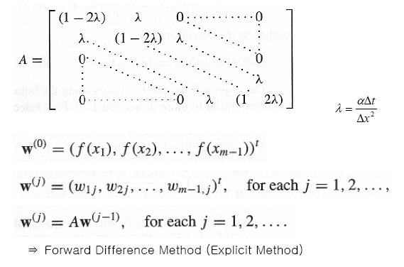
Theory

Slide 5
Result : 1173K
Δt = 1sec, Δx = 0.000001m = 1μm, λ = 0.119650179

Slide 6
Result : 1273K
Δt = 1sec, Δx = 0.000001m = 1μm, λ = 0.393235277

Slide 7
Result : 1373K
Δt = 0.1sec, Δx = 0.000001m = 1μm, λ = 0.108672598

Slide 8
Result : 1473K
Δt = 0.1sec, Δx = 0.000001m = 1μm, λ = 0.261605181

Slide 9
Solution
(a) How does the injection distance depend on injection time?

Slide 10
Solution
(b) How does the injection distance depend on temperature?
ln x ∝ -1/T

Slide 11
Solution
(c) How can you determine the activation energy for the reaction, and c what is it?
Slope가 일정하지 않고, 실제값과 차이를 보인다.
∵ injection distance에 대한 낮은 정확도

Slide 12
Solution
(c) How can you determine the activation energy for the reaction, and c what is it?
Error = 3.48*10⁻⁴
오차원인 : Δt 를 온도에 따라 다르게 설정하였고, Δt의 한계.

Slide 13
THANK YOU !

