Slide 1
HW #2
2021-09-23
지원재

Slide 2
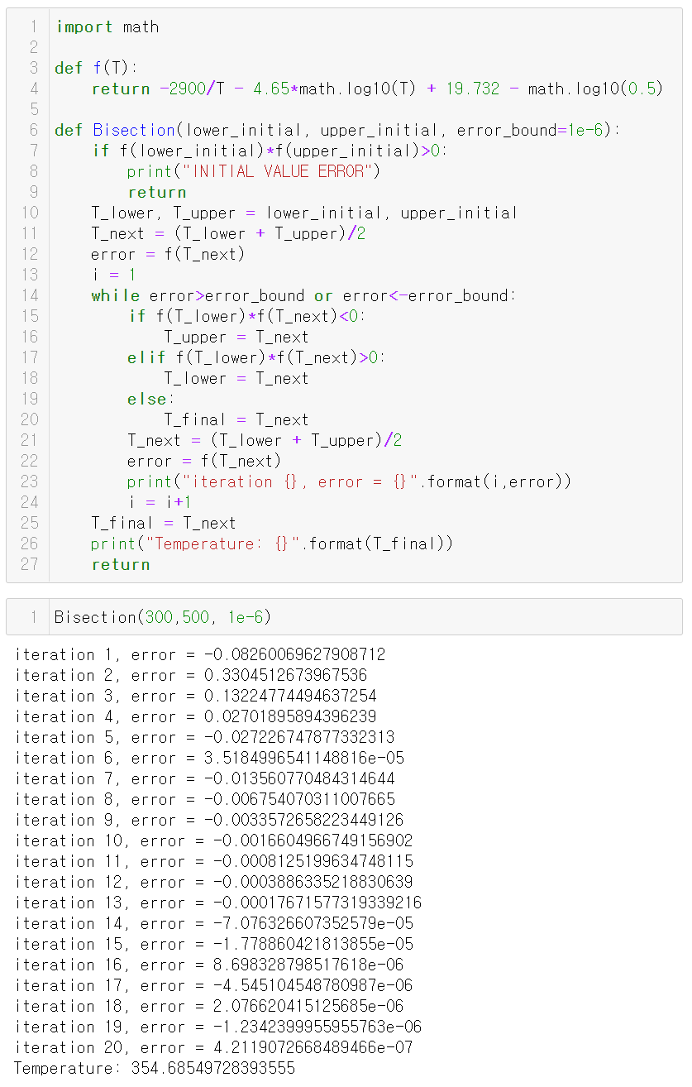
Bisection Method - Code
$$f\left(T\right)=−\frac{2900}{T}−4.65logT+19.732−log0.5$$
두 초기값의 함수값의 부호가 다르도록 설정
$$\left|error\right|<ε={10}^{-6}$$
Bisection method

Slide 3
Bisection Method - Results
Bisection(lower initial, upper initial, error bound)

Slide 4
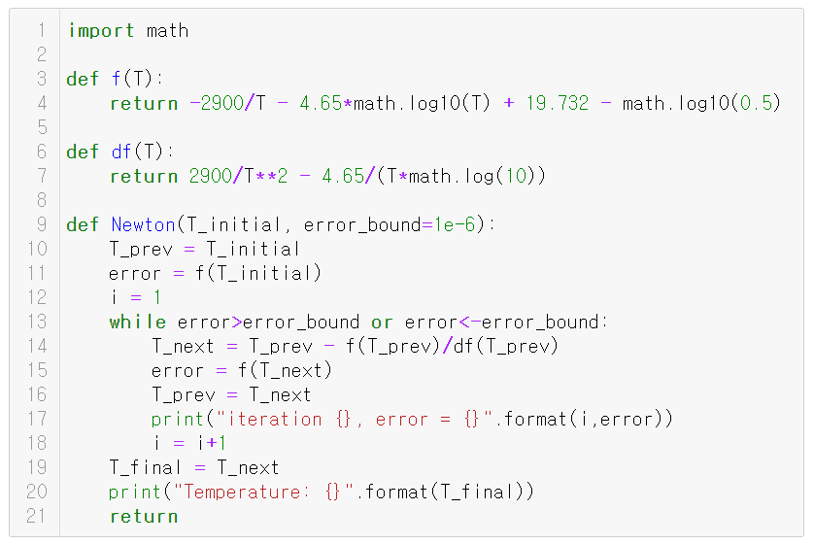
Newton Method - Code
$$f\left(T\right)=−\frac{2900}{T}−4.65logT+19.732−log0.5$$
$$\frac{df\left(T\right)}{dT}=\frac{2900}{T^{2}}−\frac{4.65}{Tln10}$$
Newton method

Slide 5
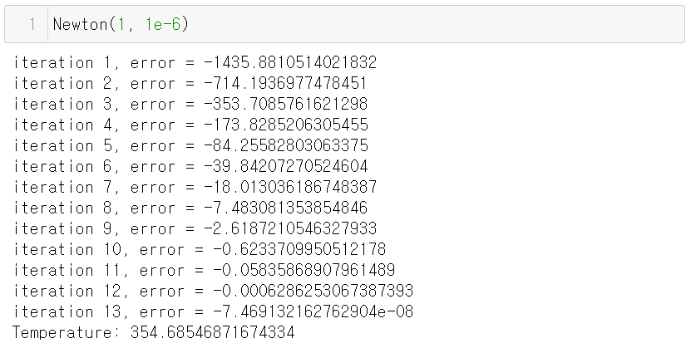
Newton Method - Results
Newton(initial value, error bound)

Slide 6
Thank You

