Slide 1
Final Term Project
Doyoon Kim
Department of Materials Science and Engineering

Slide 2
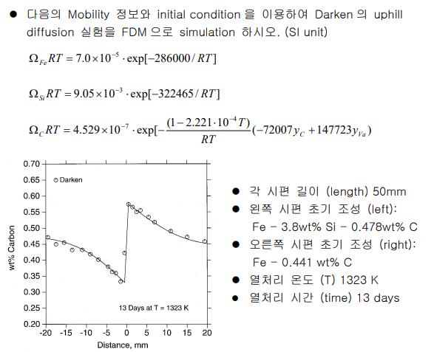
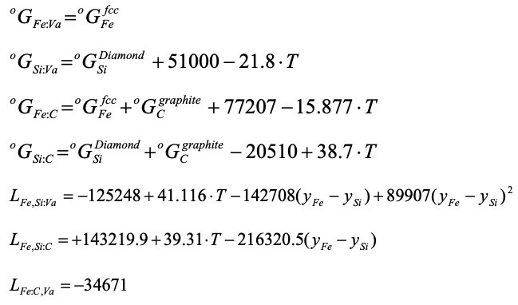
01
Background
Problem
Left side | Right side
Fe : 95.722 % | Fe : 99.5589 %
Si : 3.800 % | Si : 0.0001 %
C : 0.478 % | C : 0.441 %

Slide 3
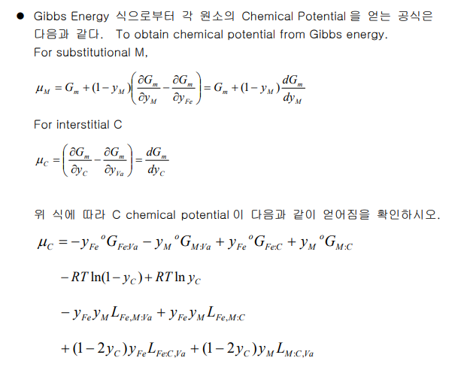
01
Background
Question 1
Solution
$$G_{m}=y_{Fe}y_{va}G°_{Fe:va}+y_{Si}y_{va}G°_{Si:va}+y_{Fe}y_{C}G°_{Fe:C}+y_{Si}y_{C}G°_{Si:C}$$
$$+RT\left(y_{Fe}lny_{Fe}+y_{Si}lny_{Si}\right)+RT(y_{va}lny_{va}+y_{C}lny_{C})$$
$$+y_{Fe}y_{Si}y_{va}L_{Fe, Si:va}+y_{Fe}y_{Si}y_{va}L_{Fe, Si:va}+y_{Fe}y_{Si}y_{va}L_{Fe, Si:va}+y_{Fe}y_{Si}y_{va}L_{Fe, Si:va}$$
$$\frac{∂G_{m}}{∂y_{C}}=−\left(1−y_{si}\right)G°_{Fe:va}−y_{si}G°_{Si:va}+\left(1−y_{Si}\right)G°_{Fe:C}+y_{Si}G°_{Si:C}$$
$$+RTln\left(\frac{y_{C}}{1−y_{C}}\right)−y_{Si}\left(1−y_{Si}\right)L_{Fe, Si:va}+y_{Si}\left(1−y_{Si}\right)L_{Fe, Si:C}$$
$$+\left(1−y_{Si}\right)\left(1−2y_{C}\right)L_{Fe, C:va}+y_{Si}\left(1−2y_{C}\right)L_{Si:C,Va}$$
$$μ_{C}=−y_{Fe}G°_{Fe:va}−y_{Si}G°_{Si:va}+y_{Fe}G°_{Fe:C}+y_{Si}G°_{Si:C}$$
$$+RT\{lny_{C}−ln{(1−y}_{C})\}−{y_{Fe}y}_{Si}L_{Fe, Si:va}+{y_{Fe}y}_{Si}L_{Fe, Si:C}$$
$$y_{Fe}\left(1−2y_{C}\right)L_{Fe, C:va}+y_{Si}\left(1−2y_{C}\right)L_{Si:C,Va}$$

Slide 4
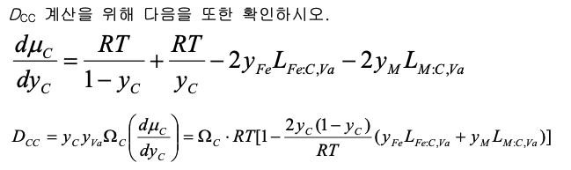
01
Background
Question 2
Solution
$$D_{CC}=y_{C}y_{Va}Ω_{C}\left(\frac{dμ_{C}}{dy_{C}}\right)=y_{C}\left(1−y_{C}\right)Ω_{C}\frac{∂^{2}G_{m}}{∂y_{C}^{2}}$$
$$\frac{∂G_{m}}{∂y_{C}}=−\left(1−y_{si}\right)G°_{Fe:va}−y_{si}G°_{Si:va}+\left(1−y_{Si}\right)G°_{Fe:C}+y_{Si}G°_{Si:C}$$
$$+RTln\left(\frac{y_{C}}{1−y_{C}}\right)−y_{Si}\left(1−y_{Si}\right)L_{Fe, Si:va}+y_{Si}\left(1−y_{Si}\right)L_{Fe, Si:C}$$
$$+\left(1−y_{Si}\right)\left(1−2y_{C}\right)L_{Fe, C:va}+y_{Si}\left(1−2y_{C}\right)L_{Si:C,Va}$$
$$\frac{∂^{2}G_{m}}{∂y_{C}^{2}}=RT\left(\frac{1}{y_{C}}+\frac{1}{{1−y}_{C}}\right)−2\left(1−y_{Si}\right)L_{Fe:C, Va}−2y_{Si}L_{Si:C, Va}$$
$$D_{CC}=y_{C}\left(1−y_{C}\right)Ω_{C}\left\{RT\left(\frac{1}{y_{C}}+\frac{1}{{1−y}_{C}}\right)−2\left(1−y_{Si}\right)L_{Fe:C, Va}−2y_{Si}L_{Si:C, Va}\right\}$$

Slide 5
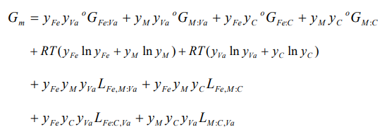
02
Main Equations
$D_{CC}, D_{CSi}, D_{SiC},D_{SiSi}$
$$D_{CC}=y_{C}\left(1−y_{C}\right)Ω_{c}\frac{∂^{2}G_{m}}{∂y_{C}^{2}}$$
$$D_{CSi}=y_{C}(1−y_{C})Ω_{c}\frac{∂^{2}G_{m}}{∂y_{Si}∂y_{C}}$$
$D_{SiC}=y_{Si}(1−y_{Si})Ω_{Si}(\frac{∂G_{m}}{∂y_{C}}+\left(1−y_{Si}\right)\frac{∂^{2}G_{m}}{∂y_{Si}∂y_{C}})$ $−y_{Si} \left(1−y_{Si}\right)Ω_{Fe}\left(\frac{∂G_{m}}{∂y_{C}}−y_{Si}\frac{∂^{2}G_{m}}{∂y_{Si}∂y_{C}}\right)$
$$D_{SiSi}$$
$$D_{SiSi}=y_{Si}{\left(1−y_{Si}\right)}^{2}Ω_{Si}\frac{∂^{2}G_{m}}{∂y_{Si}^{2}}+y_{Si}^{2}(1−y_{Si})Ω_{Fe}\frac{∂^{2}G_{m}}{∂y_{Si}^{2}}$$
편 미분하여 대입

Slide 6
02
Main Equations
Modifying Fick’s Law
$$y_{C,i}^{j+1}=y_{C,i}^{j}+\frac{Δt}{{\left(Δx\right)}^{2}}\left(\sqrt{D_{CC,i+1}D_{CC,i}}\left(y_{C,i+1}^{j}−y_{C,i}^{j}\right)−\sqrt{D_{CC,i}D_{CC,i−1}}\left(y_{C,i}^{j}−y_{C,i−1}^{j}\right)\right) +\frac{Δt}{{\left(Δx\right)}^{2}}\left(\sqrt{D_{CSi,i+1}D_{CSi,i}}\left(y_{Si,i+1}^{j}−y_{Si,i}^{j}\right)−\sqrt{D_{CSi,i}D_{CSi,i−1}}\left(y_{Si,i}^{j}−y_{Si,i−1}^{j}\right)\right)$$
$$y_{Si,i}^{j+1}=y_{Si,i}^{j}+\frac{Δt}{{\left(Δx\right)}^{2}}\left(\sqrt{D_{SiC,i+1}D_{SiC,i}}\left(y_{C,i+1}^{j}−y_{C,i}^{j}\right)−\sqrt{D_{SiC,i}D_{SiC,i−1}}\left(y_{C,i}^{j}−y_{C,i−1}^{j}\right)\right)+\frac{Δt}{{\left(Δx\right)}^{2}}\left(\sqrt{D_{SiSi,i+1}D_{SiSi,i}}\left(y_{Si,i+1}^{j}−y_{Si,i}^{j}\right)−\sqrt{D_{SiSi,i}D_{SiSi,i−1}}\left(y_{Si,i}^{j}−y_{Si,i−1}^{j}\right)\right)$$
Solve by FDM

Slide 7
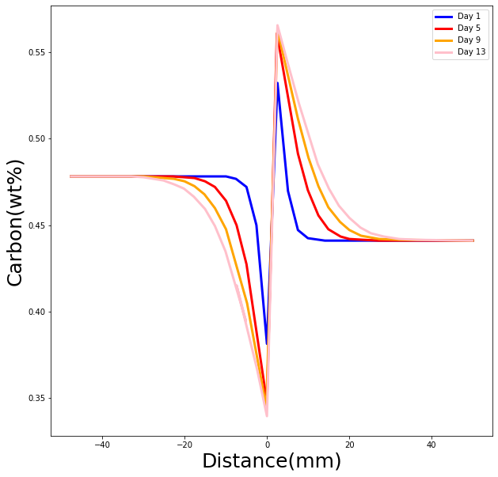
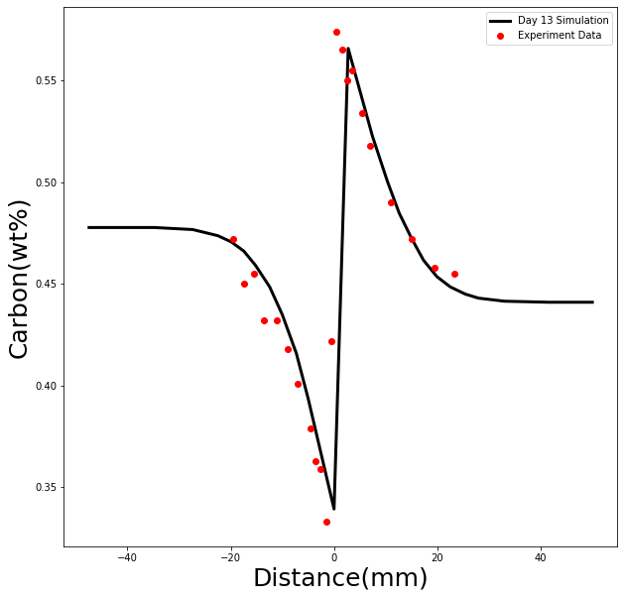
03
Result

Slide 8
Thank you for listening

