Slide 1
Numerical Methods #Mid
20150164 신소재공학과 김성진

Slide 2
Theoretical Background
$μ_{i}^{β}=Δ°G_{i}^{α→β}+RT\ln{a_{i}}(ref.β)=RT\ln{a_{i}}(ref.α)$
Phase Equilibrium: 3 Newton Mtds of 2x2 matrix (6 lines)
$μ_{i}^{L}=μ_{i}^{BCC}$, $μ_{i}^{BCC}=μ_{i}^{FCC}$, $μ_{i}^{L}=μ_{i}^{FCC} (i=Ks, Ps)$
Eutectic (or Peritectic) point: Newton Mtd of 4x4 matrix
$μ_{i}^{L}=μ_{i}^{BCC}=μ_{i}^{FCC} (i=Ks, Ps)$
Using (sub)regular mixing term in HW#5

Slide 3
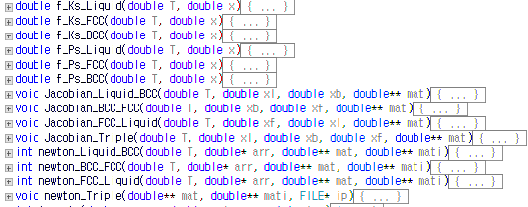
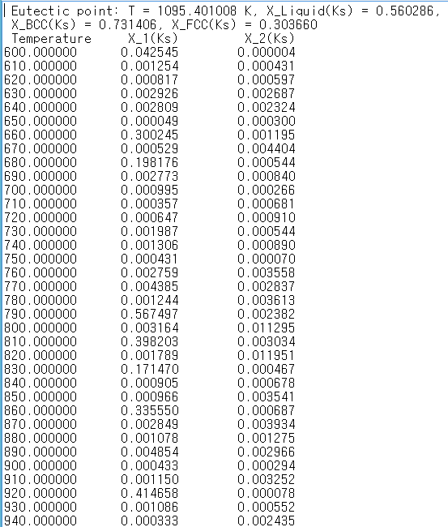
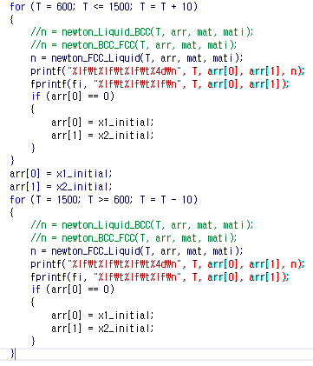
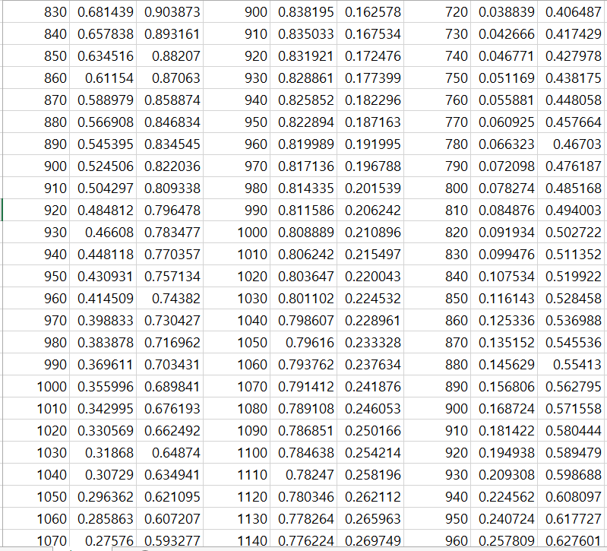
Code

Slide 4
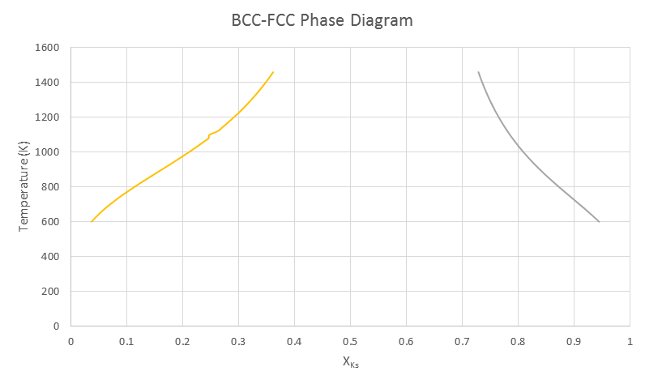
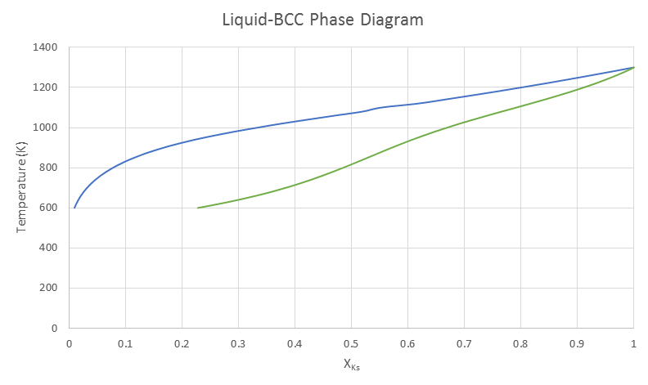
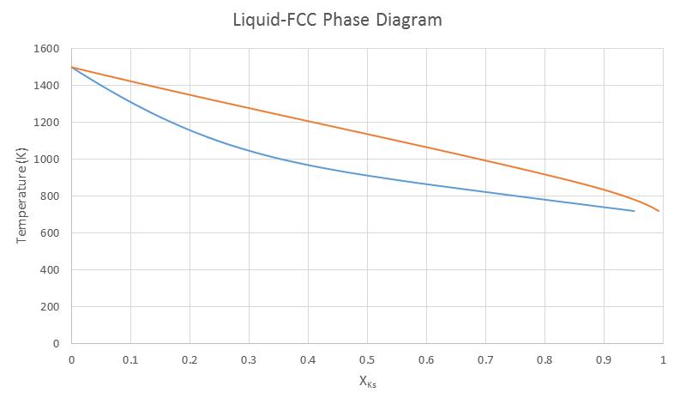
Graphs

Slide 5
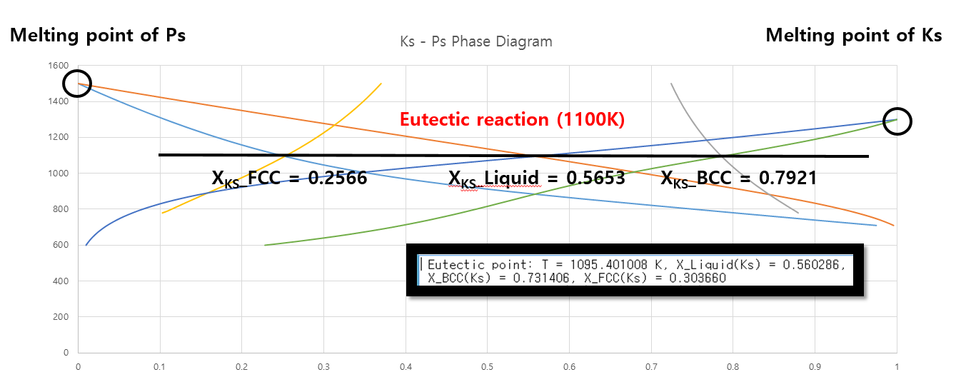
Analysis

Slide 6
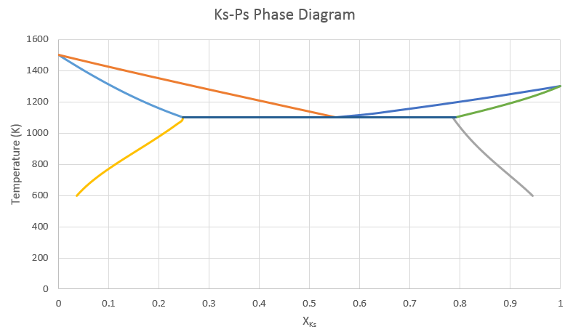
Conclusion
L
α + L
β + L
α (FCC)
Β
(BCC)
α + β

