Slide 1
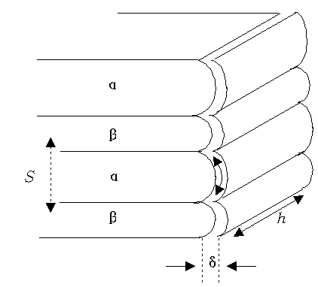
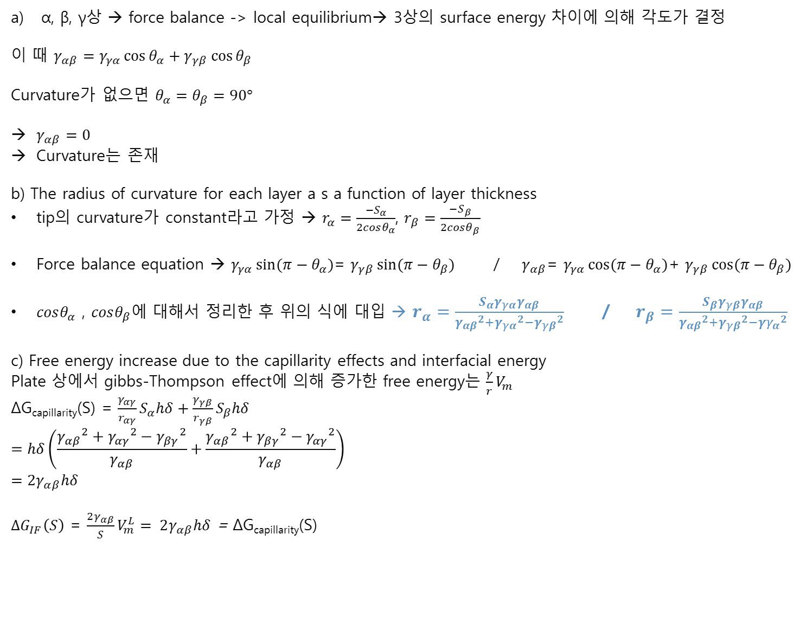
HW#4-1
α, β, γ상 → force balance -> local equilibrium→ 3상의 surface energy 차이에 의해 각도가 결정
이 때 $γ_{αβ}=γ_{γα}\cos{θ_{α}}+γ_{γβ}\cos{θ_{β}}$
Curvature가 없으면 $θ_{α}=θ_{β}=90°$
$γ_{αβ}=0$
Curvature는 존재
b) The radius of curvature for each layer a s a function of layer thickness
tip의 curvature가 constant라고 가정 → $r_{α}=\frac{−S_{α}}{2cosθ_{α}}$, $r_{β}=\frac{−S_{β}}{2cosθ_{β}}$
Force balance equation → $γ_{γα}\sin{(π−θ_{α})}$= $γ_{γβ}\sin{(π−θ_{β})}$ / $γ_{αβ}$= $γ_{γα}\cos{{(π−θ}_{α})}$+ $γ_{γβ}\cos{{(π−θ}_{β})}$
$cosθ_{α}$ , $cosθ_{β}$에 대해서 정리한 후 위의 식에 대입 → $r_{α}=\frac{S_{α}γ_{γα}γ_{αβ}}{{γ_{αβ}}^{2}+{γ_{γα}}^{2}−{γ_{γβ}}^{2}}$ / $r_{β}=\frac{S_{β}γ_{γβ}γ_{αβ}}{{γ_{αβ}}^{2}+{γ_{γβ}}^{2}−{{γγ}_{α}}^{2}}$
c) Free energy increase due to the capillarity effects and interfacial energy
Plate 상에서 gibbs-Thompson effect에 의해 증가한 free energy는 $\frac{γ}{r}V_{m}$
ΔG_{capillarity}(S) = $\frac{γ_{αγ}}{r_{αγ}}S_{α}hδ+\frac{γ_{γβ}}{r_{γβ}}S_{β}hδ$
$$=hδ\left(\frac{{γ_{αβ}}^{2}+{γ_{αγ}}^{2}−{γ_{βγ}}^{2}}{γ_{αβ}}+\frac{{γ_{αβ}}^{2}+{γ_{βγ}}^{2}−{γ_{αγ}}^{2}}{γ_{αβ}}\right)$$
$$=2γ_{αβ}hδ$$
$∆G_{IF}\left(S\right)$ = $\frac{2γ_{αβ}}{S}V_{m}^{L}= 2γ_{αβ}hδ$ = ΔG_{capillarity}(S)
$$γ_{γα}$$
$$γ_{αβ}$$
$$θ_{α}$$
$$θ_{γ}$$
$$γ$$
$$θ_{β}$$
$$γ_{γβ}$$
20120353 신소재공학과 문석호

Slide 2

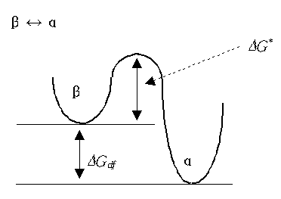
HW#4-2
a) The time dependence of the average grain size
$\overline{R}=kt^{n}$→ $ln\overline{R}=lnk+nlnt$ (t=MCS)
Initial # of grains = 64000, Total MCS = 900
Temperature level : 2, 7, 12, 17 20
The temperature dependence of grain growth and the activation energy
Polycrystalline solids 내에서의 grain growth는 다음의 식을 따름
Net jump frequency $v=v_{0}exp⁡(\frac{−∆G^{∗}}{RT}$)$\frac{∆G_{df}}{RT} ( if ∆G_{df}≪RT)$
Growth rate= $\frac{dR}{dt}= λv=λv_{0}exp⁡(\frac{−∆G^{∗}}{RT}\text{)}\frac{∆G_{df}}{RT}$ ($λ$=jump distance)
$\overline{R}=kt^{n} \text{→} \frac{dR}{dt}=nkt^{n−1}$= $λv_{0}exp⁡(\frac{−∆G^{∗}}{RT}\text{)}\frac{∆G_{df}}{RT}$
$A= λv_{0}\frac{∆G_{df}}{R}$ 라고 하면
$Tnkt^{n−1}$ = $Aexp⁡(\frac{−∆G^{∗}}{RT}\text{)}$ → $ln(Tnkt^{n−1})=lnA−\frac{∆G^{∗}}{RT}$
∴ T ↑ → $∆G^{∗}$↑
Temperature | n | k
2 | 0.187 | 3.3784
7 | 0.2385 | 2.5620
12 | 0.3054 | 1.7647
17 | 0.3251 | 1.5815
20 | 0.3573 | 1.3364

