Slide 1
소재수치해석 final
20110073 김용민

Slide 2
목차
지정종목-Simulation of Darken’s uphill diffusion
Assignment
Theory
code
Result & Discussion
자유종목-Solving Bessel’s equation using numerical method
Assignment
Theory
code
Result & Discussion

Slide 3
지정종목-Simulation of Darken’s uphill diffusion

Slide 4
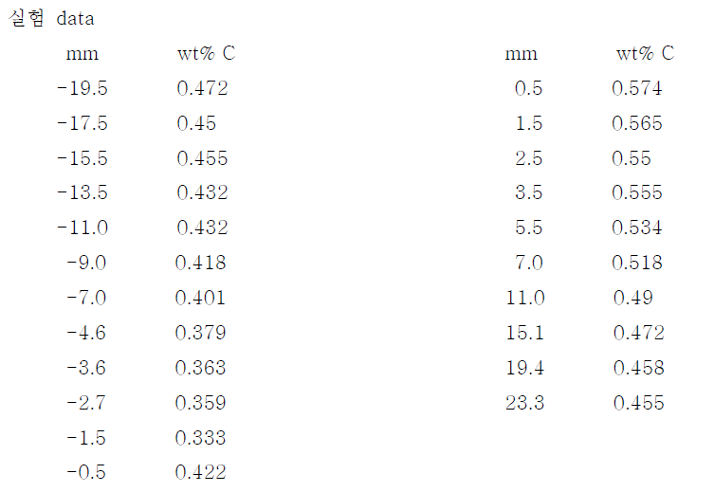
Assignment

Slide 5
Assignment

Slide 6
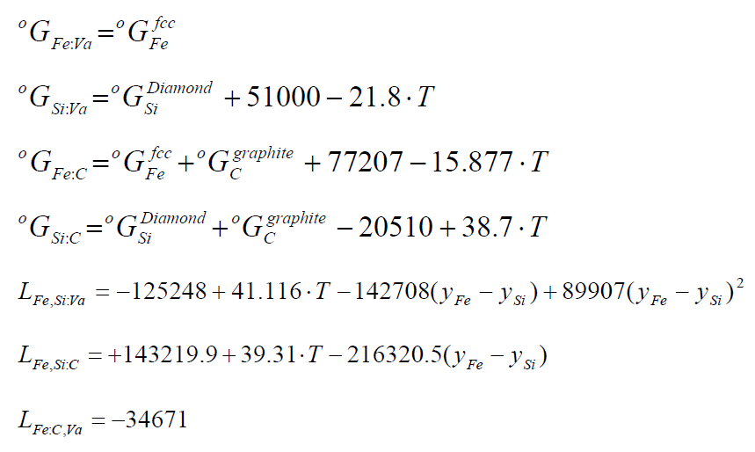
Assignment

Slide 7
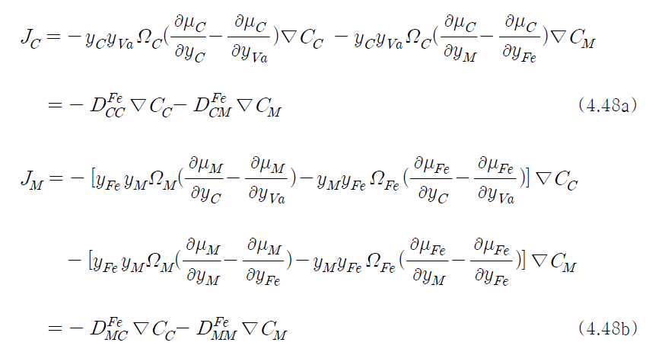
Theory
$x_{k}=\frac{\frac{m_{k}}{M_{k}}}{\sum_{i}{\frac{m_{i}}{M_{i}}}}, m_{k}=\frac{M_{k}m_{k}}{\sum_{i}{M_{i}m_{i}}}$
$u_{k}=\frac{x_{k}}{\sum_{i∈S}{x_{i}}}, y_{k}=u_{k}$

Slide 8
Theory
Initial condition:
y_{Si}=0.0731608, y_{C}=0.0215191 (x<0)
y_{Si}=0, y_{C}=0.0205956 (x<0)
boundary condition:
y_{Si}=0.0731608, y_{C}=0.0215191 (x=-0.05)
y_{Si}=0, y_{C}=0.0205956 (x=0.05)
Fe=55.845 g/mol
Si=28.0855 g/mol
C=12.0107 g/mol

Slide 9
Theory
$D_{CC}^{Fe}=y_{C}y_{va}Ω_{C}\left(\frac{∂μ_{C}}{∂y_{C}}−\frac{∂μ_{C}}{∂y_{va}}\right)=y_{C}\left(1−y_{C}\right)Ω_{C}\frac{dμ_{C}}{dy_{C}}$
$D_{CSi}^{Fe}=y_{C}y_{va}Ω_{C}\left(\frac{∂μ_{C}}{∂y_{Si}}−\frac{∂μ_{C}}{∂y_{Fe}}\right)=y_{C}\left(1−y_{C}\right)Ω_{C}\frac{dμ_{C}}{dy_{Si}}$
$D_{SiC}^{Fe}=y_{Fe}y_{Si}Ω_{Si}\left(\frac{∂μ_{Si}}{∂y_{C}}−\frac{∂μ_{Si}}{∂y_{va}}\right)−y_{Fe}y_{Si}Ω_{Fe}\left(\frac{∂μ_{Fe}}{∂y_{C}}−\frac{∂μ_{Fe}}{∂y_{va}}\right)=y_{Si}\left(1−y_{Si}\right)\left(Ω_{Si}\frac{dμ_{Si}}{dy_{C}}−Ω_{C}\frac{dμ_{Fe}}{dy_{C}}\right)$
$D_{SiSi}^{Fe}=y_{Fe}y_{Si}Ω_{Si}\left(\frac{∂μ_{Si}}{∂y_{Si}}−\frac{∂μ_{Si}}{∂y_{Fe}}\right)−y_{Fe}y_{Si}Ω_{Fe}\left(\frac{∂μ_{Fe}}{∂y_{Si}}−\frac{∂μ_{Fe}}{∂y_{Fe}}\right)=y_{Si}\left(1−y_{Si}\right)\left(Ω_{Si}\frac{dμ_{Si}}{dy_{Si}}−Ω_{C}\frac{dμ_{Fe}}{dy_{Si}}\right)$

Slide 10
Theory
$μ_{C}=\frac{dG_{m}}{dy_{C}}$
$μ_{Si}=G_{m}+\left(1−y_{Si}\right)\frac{dG_{m}}{dy_{Si}}$
$μ_{Fe}=G_{m}+y_{Si}\frac{dG_{m}}{dy_{Fe}}=G_{m}−y_{Si}\frac{dG_{m}}{dy_{Si}}$

Slide 11
Theory
$\frac{dμ_{C}}{dy_{C}}=\frac{d^{2}G_{m}}{d{y_{C}}^{2}}=RT\left(\frac{1}{y_{C}}−\frac{1}{1−y_{C}}\right)−2\left(1−y_{Si}\right)L_{Fe:C,va}$
$\frac{dμ_{C}}{dy_{Si}}=\frac{d}{dy_{Si}}\frac{dG_{m}}{dy_{C}}=−148717+76.377T+\left(1−2y_{Si}\right)\left(L_{Fe,Si:C}−L_{Fe,Si:va}\right)+34671\left(1−2y_{C}\right)+y_{Si}\left(1−y_{Si}\right)\left(L_{Fe,Si:C}−L_{Fe,Si:va}\right)$
$\frac{dμ_{Si}}{dy_{C}}=\frac{dG_{m}}{dy_{C}}+\left(1−y_{Si}\right)\frac{dμ_{C}}{dy_{Si}}$
$\frac{dμ_{Si}}{dy_{Si}}=\left(1−y_{Si}\right)\frac{d^{2}G_{m}}{d{y_{Si}}^{2}}$
$\frac{dμ_{Fe}}{dy_{C}}=\frac{dG_{m}}{dy_{C}}−y_{Si}\frac{dμ_{C}}{dy_{Si}}$
$\frac{dμ_{Fe}}{dy_{Si}}=−y_{Si}\frac{d^{2}G_{m}}{d{y_{Si}}^{2}}$

Slide 12
Theory
$\frac{dG_{m}}{dy_{C}}=\left(1−y_{Si}\right)\left(77207−15.877T\right)+y_{Si}\left(−71510−60.5T\right)+RT\left(\ln{y_{C}}−\ln\left(1−y_{C}\right)\right)−34671\left(1−y_{Si}\right)\left(1−2y_{C}\right)+y_{Si}\left(1−y_{Si}\right)\left(L_{Fe,Si:C}−L_{Fe,Si:va}\right)$
$\frac{d^{2}G_{m}}{d{y_{Si}}^{2}}$=$RT\left(\frac{1}{y_{Si}}−\frac{1}{1−y_{Si}}\right)−2\left(1−y_{C}\right)L_{Fe,Si:va}+2\left(1−2y_{Si}\right)\left(1−y_{C}\right)\frac{dL_{Fe,Si:va}}{dy_{Si}}+y_{Si}\left(1−y_{Si}\right)\left(1−y_{C}\right)\frac{d^{2}L_{Fe,Si:va}}{d{y_{Si}}^{2}}−2y_{C}L_{Fe,Si:C}+2\left(1−2y_{Si}\right)y_{C}\frac{dL_{Fe,Si:C}}{dy_{Si}}+y_{Si}\left(1−y_{Si}\right)y_{C}\frac{d^{2}L_{Fe,Si:C}}{d{y_{Si}}^{2}}$

Slide 13
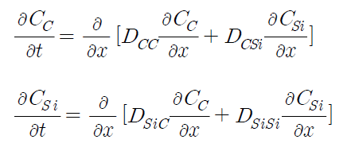
Theory

Slide 14
Theory
$y_{C,i}^{j+1}=\left(\frac{Δt}{{\left(Δx\right)}^{2}}\sqrt{D_{CC,i−1}×D_{CC,i}}\right)y_{C,i−1}^{j}+\left(1−\frac{Δt}{{\left(Δx\right)}^{2}}\left(\sqrt{D_{CC,i−1}×D_{CC,i}}−\sqrt{D_{CC,i+1}×D_{CC,i}}\right)\right)y_{C,i}^{j}$+$\left(\frac{Δt}{{\left(Δx\right)}^{2}}\sqrt{D_{CC,i+1}×D_{CC,i}}\right)y_{C,i+1}^{j}$
$+\left(\frac{Δt}{{\left(Δx\right)}^{2}}\sqrt{D_{CSi,i−1}×D_{CSi,i}}\right)y_{Si,i−1}^{j}−\frac{Δt}{{\left(Δx\right)}^{2}}\left(\sqrt{D_{CSi,i−1}×D_{CSi,i}}−\sqrt{D_{CSi,i+1}×D_{CSi,i}}\right)y_{Si,i}^{j}$+$\left(\frac{Δt}{{\left(Δx\right)}^{2}}\sqrt{D_{CSi,i+1}×D_{CSi,i}}\right)y_{Si,i+1}^{j}$
$y_{Si,i}^{j+1}=\left(\frac{Δt}{{\left(Δx\right)}^{2}}\sqrt{D_{SiC,i−1}×D_{CSi,i}}\right)y_{C,i−1}^{j}−\frac{Δt}{{\left(Δx\right)}^{2}}\left(\sqrt{D_{SiC,i−1}×D_{SiC,i}}−\sqrt{D_{SiC,i+1}×D_{SiC,i}}\right)y_{C,i}^{j}$+$\left(\frac{Δt}{{\left(Δx\right)}^{2}}\sqrt{D_{SiC,i+1}×D_{SiC,i}}\right)y_{C,i+1}^{j}$
$+\left(\frac{Δt}{{\left(Δx\right)}^{2}}\sqrt{D_{SiSi,i−1}×D_{SiSi,i}}\right)y_{Si,i−1}^{j}+\left(1−\frac{Δt}{{\left(Δx\right)}^{2}}\left(\sqrt{D_{SiSi,i−1}×D_{SiSi,i}}−\sqrt{D_{SiSi,i−1}×D_{SiSi,i}}\right)\right)y_{Si,i}^{j}$+$\left(\frac{Δt}{{\left(Δx\right)}^{2}}\sqrt{D_{SiSi,i+1}×D_{SiSi,i}}\right)y_{Si,i+1}^{j}$

Slide 15
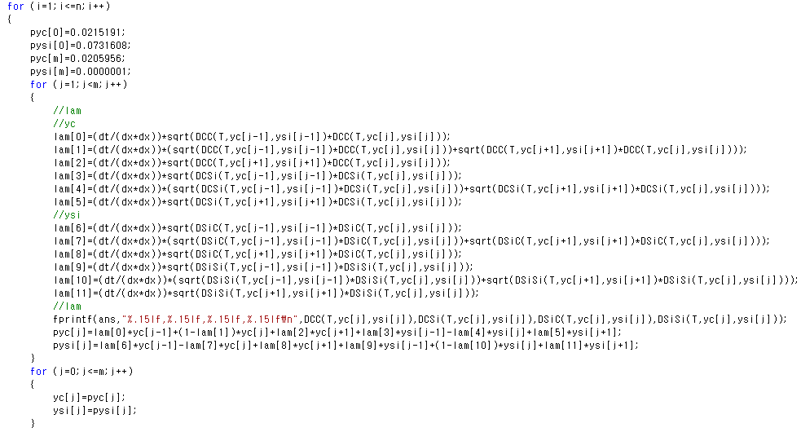
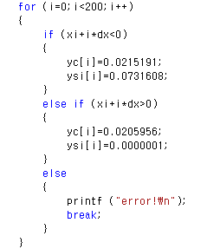
Code

Slide 16
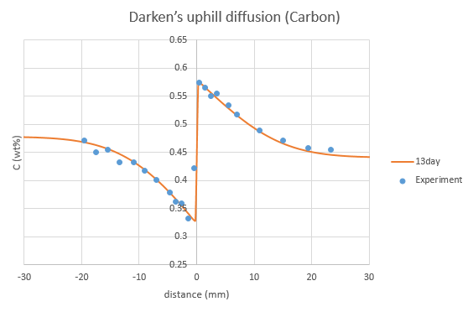
Result & Discussion

Slide 17
Result & Discussion

Slide 18
Result & Discussion

Slide 19
자유종목-Solving Bessel’s equation using numerical method

Slide 20
Assignment
Bessel’s equation:
$x^{2}y^{′′}+xy^{′}+\left(x^{2}−ν^{2}\right)y=0$

Slide 21
Theory
Bessel’s equation
Laplace’s equation을 원통형 좌표계나 구면 좌표계에서 풀 때 발생
Ex)
Solution
$ν$가 정수인 경우
$y=c_{1}J_{ν}\left(x\right)+c_{2}Y_{ν}\left(x\right)$
$ν$가 정수가 아닌 경우
$y=c_{1}J_{ν}\left(x\right)+c_{2}J_{−ν}\left(x\right)$
$J_{ν}\left(x\right)$: Bessel function of the first kind
$Y_{ν}\left(x\right)$: Bessel function of the second kind

Slide 22
Theory
Bessel function of the first kind
$J_{ν}\left(x\right)=\sum_{m=0}^{∞}{\frac{{\left(−1\right)}^{m}}{m!Γ\left(m+ν+1\right)}{\left(\frac{x}{2}\right)}^{2m+ν}}={\left(\frac{x}{2}\right)}^{n}\sum_{m=0}^{∞}{\frac{{\left(−1\right)}^{m}}{m!\left(m+n\right)!}{\left(\frac{x}{2}\right)}^{2m}} \left(if ν=n∈Z\right)$
$J_{ν}\left(x\right)$의 값은 알려져 있으므로 initial condition을 $J_{ν}\left(x\right)$를 이용하면 계산값과 실제값을 비교할 수 있다. (solution이 $J_{ν}\left(x\right)$가 되므로)

Slide 23
Theory
$$x^{2}y^{′′}+xy^{′}+\left(x^{2}−ν^{2}\right)y=0$$
$$→{\left(iΔx\right)}^{2}\left(\frac{y\left(x_{i+1}\right)−2y\left(x_{i}\right)+y\left(x_{i−1}\right)}{{\left(Δx\right)}^{2}}\right)+\left(iΔx\right)\left(\frac{y\left(x_{i+1}\right)−y\left(x_{i−1}\right)}{2Δx}\right)+\left({\left(iΔx\right)}^{2}−ν^{2}\right)y\left(x_{i}\right)=0$$
$$→\left(i^{2}+\frac{i}{2}\right)y_{i+1}−\left(2i^{2}−{\left(iΔx\right)}^{2}+ν^{2}\right)y_{i}+\left(i^{2}−\frac{i}{2}\right)y_{i−1}=0$$
$$→y_{i+1}=\frac{\left(2i^{2}−{\left(iΔx\right)}^{2}+ν^{2}\right)y_{i}−\left(i^{2}−\frac{i}{2}\right)y_{i−1}}{\left(i^{2}+\frac{i}{2}\right)}$$
Initial condition
$$y_{1}=a$$
$${y_{1}}^{′}=\frac{y_{2}−y_{0}}{2Δx}=b$$
$$y_{0}=y_{2}−2bΔx$$

Slide 24
Code

Slide 25
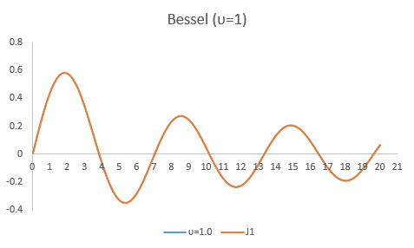
Result & Discussion
$$y\left(0.02\right)=1$$
$$y^{′}\left(0.02\right)=0$$
$$y\left(0.02\right)=0.01$$
$y^{′}\left(0.02\right)=0$.5

Slide 26
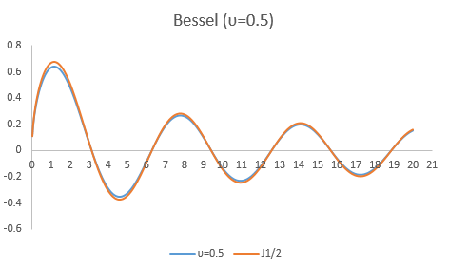
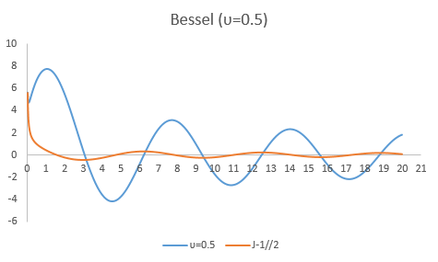
Result & Discussion
$$J_{1/2}\left(x\right)=\sqrt{\frac{2}{πx}}\sin{x}, J_{−1/2}\left(x\right)=\sqrt{\frac{2}{πx}}\cos{x}$$
$$y\left(0.02\right)=0.11283$$
$$y^{′}\left(0.02\right)=2.82001$$
$$y\left(0.02\right)=5.64077$$
$$y^{′}\left(0.02\right)=−141.132$$

Slide 27
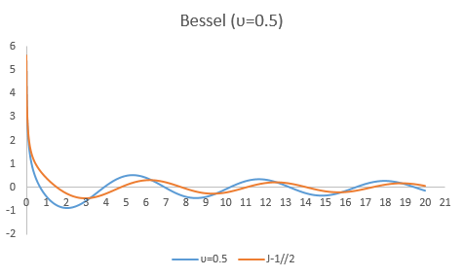
Result & Discussion
$$y\left(0.02\right)=5.64077$$
$$y\left(0.04\right)=3.986232$$

