Slide 1
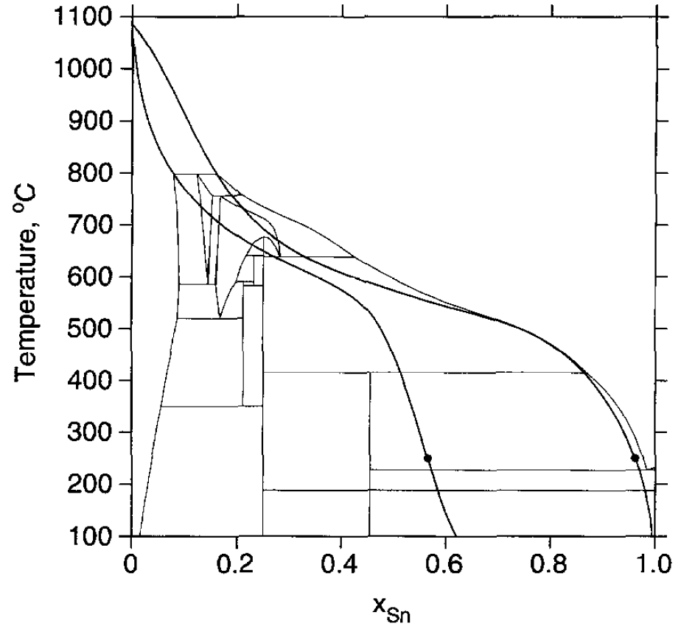
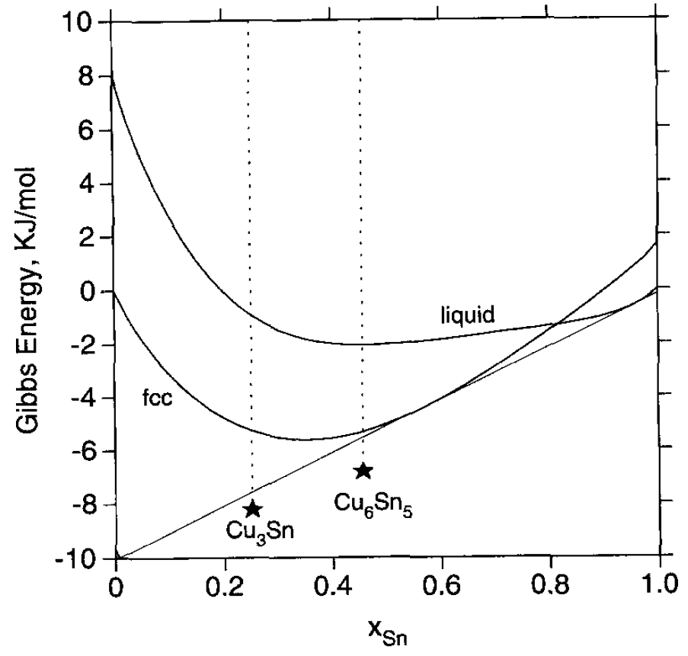
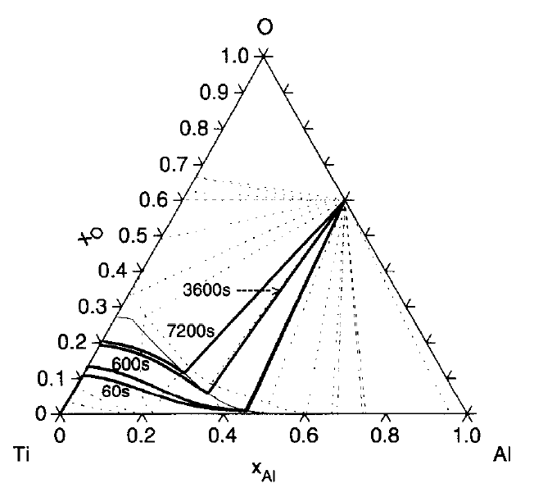
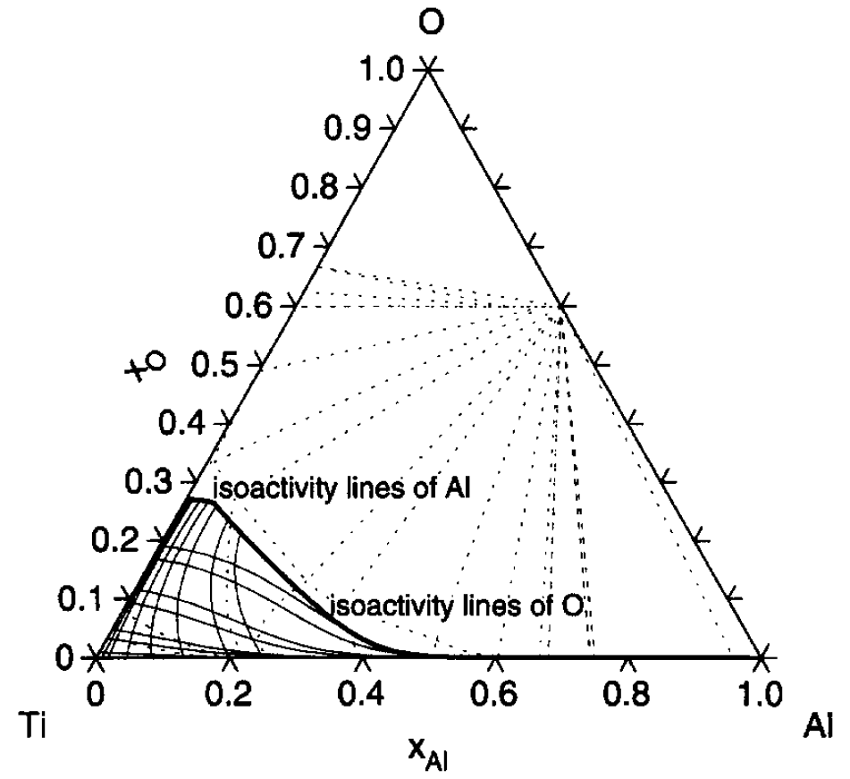
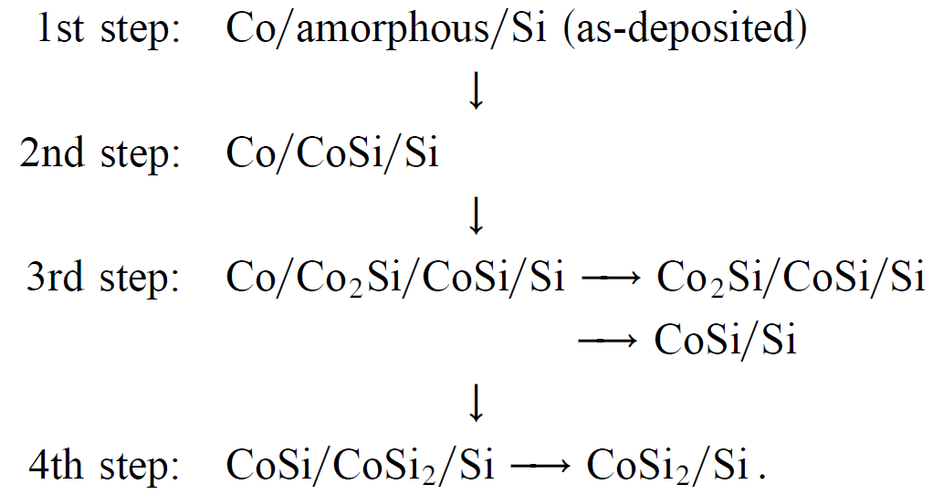
Interfacial reaction simulation
Local equilibrium of metastable phase at interface → driving force for interfacial compound = $∆G_{meta stable}−∆G_{compound}$, highest driving force → first forming compound.
Evolution of interfacial compound can be determined by multicomponent diffusion simulation.
Formation of interfacial compound → change of local equilibrium at interface → formation of new interfacial compound.
Lower driving force → higher temperature and longer reaction time are needed

