Slide 1
Numerical Method
Dept. Material Science & Engineering
Undergraduate Course (4th year)
Chang Jae Yu

Slide 2
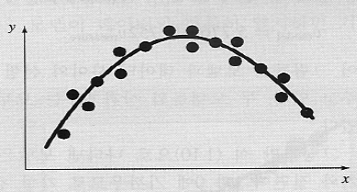
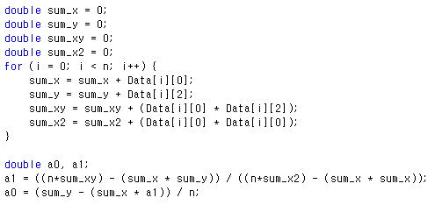
Homework #6
Regression -> Enthalpy of Mixing
$$∆H_{m}^{α}=X_{A}^{0}H_{A}^{ref→α}+X_{B}^{0}H_{B}^{ref→α}+X_{A}X_{B}(L_{0}^{0}−\left(X_{A}−X_{B}\right)L_{1}^{0})$$
$${∆H_{mix}=X}_{A}X_{B}\left(L_{0}^{0}−\left(X_{A}−X_{B}\right)L_{1}^{0}\right)=X_{A}{(1−X}_{A})\left(L_{0}^{0}−\left({2X}_{A}−1\right)L_{1}^{0}\right)$$
$$\frac{∆H_{mix}}{X_{A}{(1−X}_{A})}=L_{0}^{0}−\left({2X}_{A}−1\right)L_{1}^{0}$$
Minimizing sum of squares of deviation

Slide 3
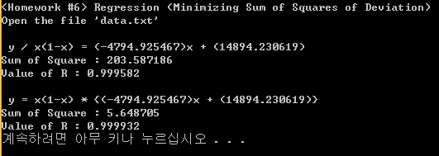
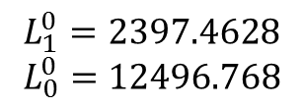
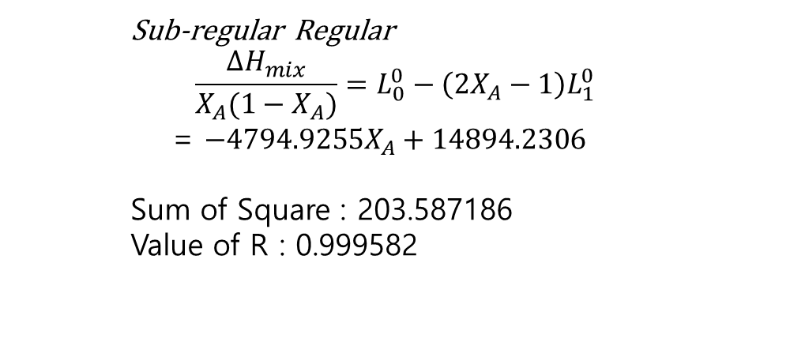
Homework #6
Sub-regular Regular
$$\frac{∆H_{mix}}{{X_{A}(1−X}_{A})}=L_{0}^{0}−\left({2X}_{A}−1\right)L_{1}^{0}$$
= $−4794.9255X_{A}+14894.2306$
Sum of Square : 203.587186
Value of R : 0.999582
$L_{0}^{0}−\left({2X}_{A}−1\right)L_{1}^{0}$ =
$$−4794.9255X_{A}+14894.2306$$
$$L_{1}^{0}=2397.4628$$
$$L_{0}^{0}=12496.768$$

Slide 4
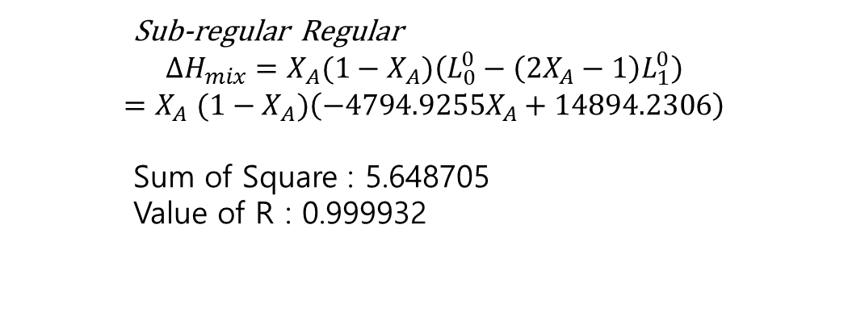
Homework #6
Sub-regular Regular
$${∆H_{mix}=X}_{A}{(1−X}_{A})\left(L_{0}^{0}−\left({2X}_{A}−1\right)L_{1}^{0}\right)$$
$${=X}_{A}{(1−X}_{A})\left(−4794.9255X_{A}+14894.2306\right)$$
Sum of Square : 5.648705
Value of R : 0.999932
$L_{0}^{0}−\left({2X}_{A}−1\right)L_{1}^{0}$ =
$$−4794.9255X_{A}+14894.2306$$
$$L_{1}^{0}=2397.4628$$
$$L_{0}^{0}=12496.768$$

Slide 5
Homework #6
Excel -> Function of Adding Trend Line
$$=−4794.9255X_{A}+14894.2306$$
$$X_{A}{(1−X}_{A})\left(−4794.9255X_{A}+14894.2306\right)$$
$$=4795.9{X_{A}}^{3}−19689{X_{A}}^{2}+14894X_{A}$$

Slide 6
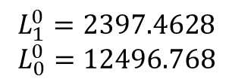
Question & Answer
$$\frac{∆H_{mix}}{{X_{A}(1−X}_{A})}=L_{0}^{0}−\left({2X}_{A}−1\right)L_{1}^{0}$$
= $−4794.9255X_{A}+14894.2306$
$${∆H_{mix}=X}_{A}{(1−X}_{A})\left(L_{0}^{0}−\left({2X}_{A}−1\right)L_{1}^{0}\right)$$
$${=X}_{A}{(1−X}_{A})\left(−4794.9255X_{A}+14894.2306\right)$$
$$L_{1}^{0}=2397.4628$$
$$L_{0}^{0}=12496.768$$
(Sub-regular Solution Model)

