Slide 1
Numerical Method - HW#7
20090432 김동훈

Slide 2
HW#7
Integrate f(x) = 0.2+25x-200x²+675x³-900x⁴+400x⁵ from x=0 to x=0.8 using
Midpoint, Trapezoidal, Simpson and Romberg integration method.

Slide 3
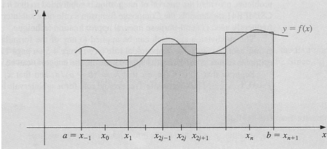
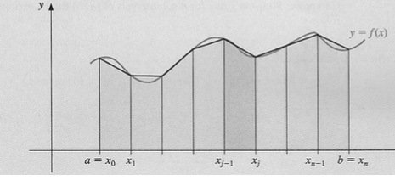
HW#7 - Theory
Midpoint Rule
Trapezoid Rule

Slide 4
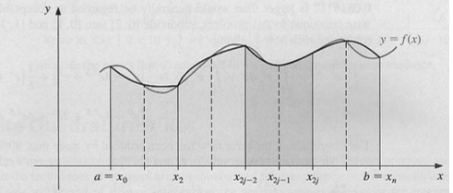
HW#7 - Theory
Simpson Rule
Romberg Method

Slide 5
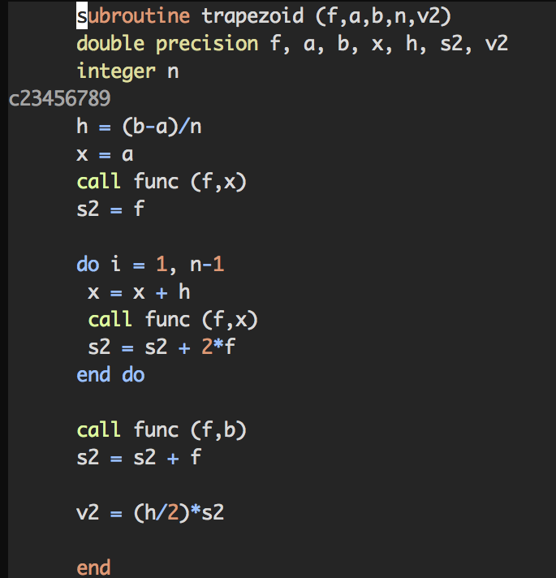
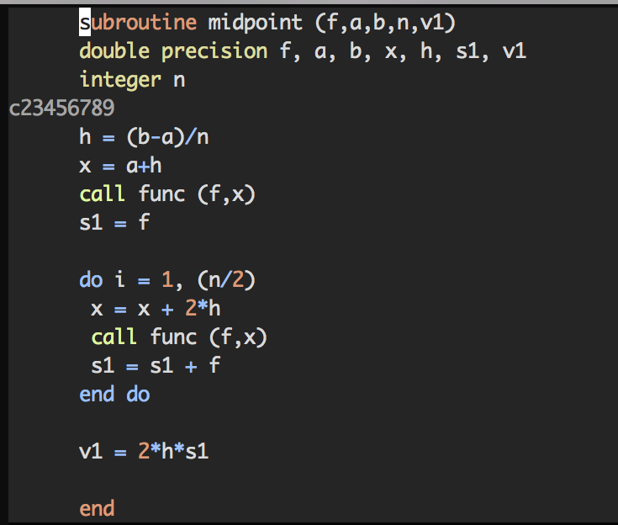
HW#7 - code

Slide 6
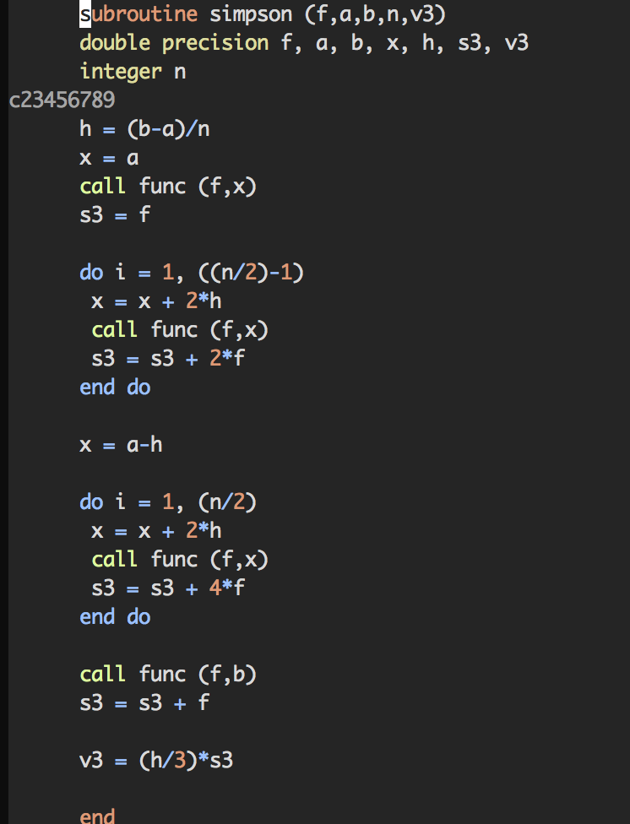
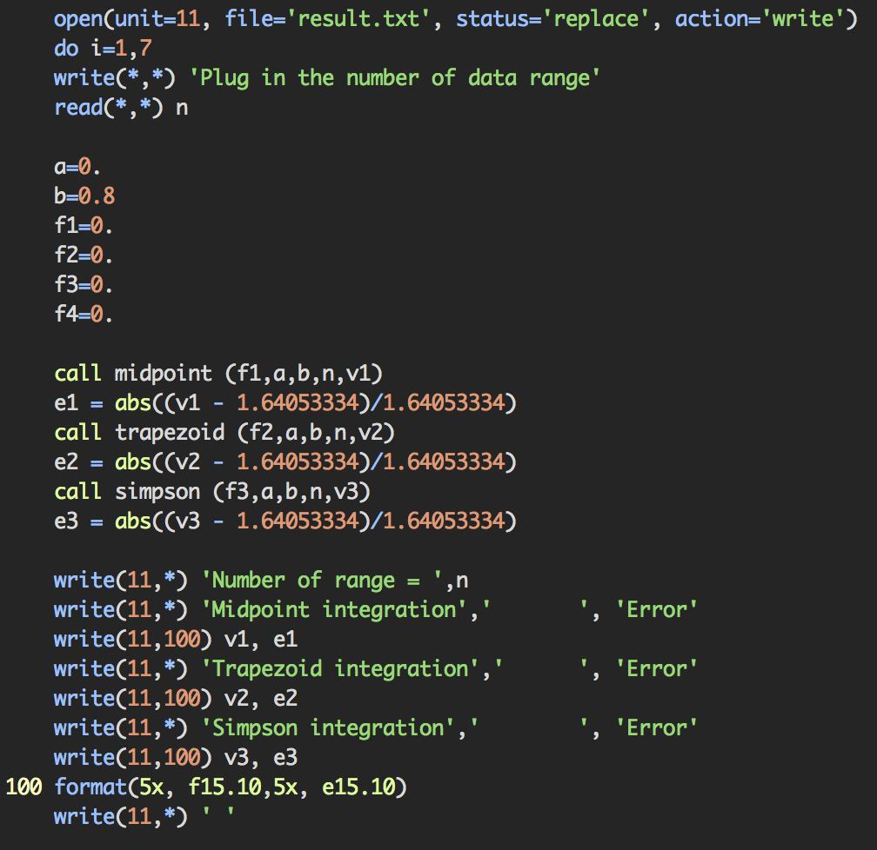
HW#7 - code

Slide 7
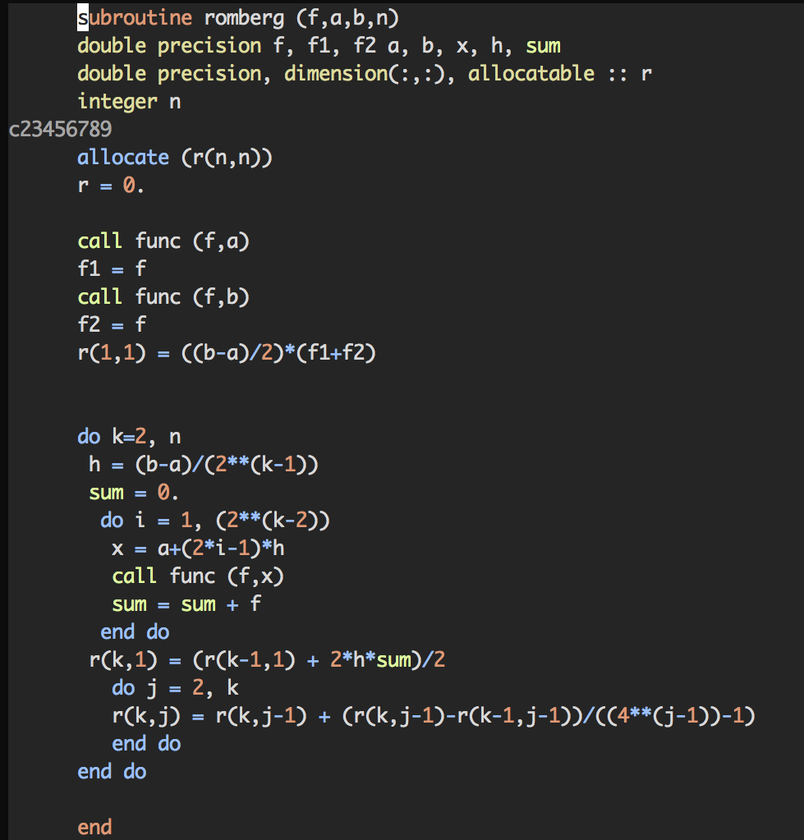
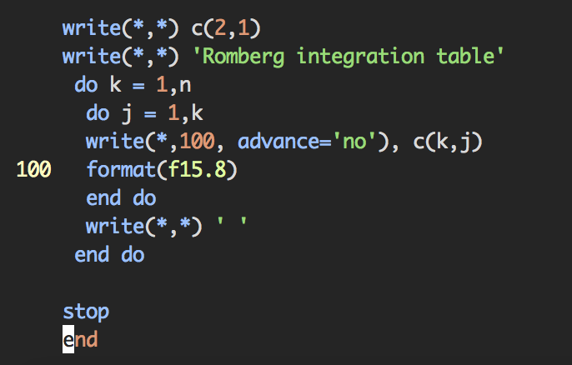
HW#7 - code

Slide 8
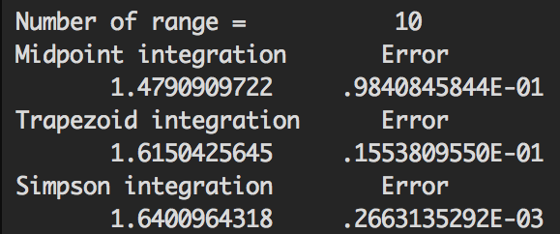
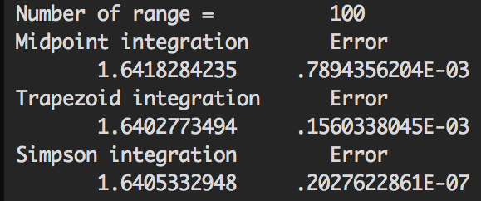
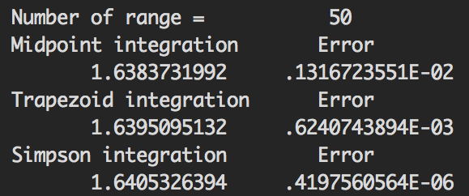
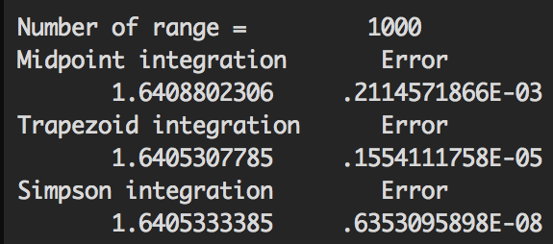
HW#7 - result
Midpoint vs Trapezoid vs Simpson
Real = 1.64053334

Slide 9
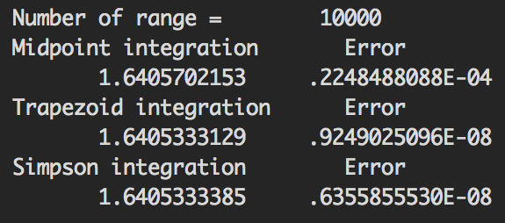
HW#7 - result
Midpoint vs Trapezoid vs Simpson
Real = 1.64053334

Slide 10
HW#7 - result
Romberg integration method
Very fast convergence(n=3)!
Real = 1.64053334

Slide 11
HW#7 - result
Among Midpoint, Trapezoid, Simpson integration method, Simpson method
has the best accuracy when there are not many data points.
Romberg integration method has very fast convergence.

Slide 12
Thank you!

