Slide 1
재료수치해석 hw6
20100098 최원미

Slide 2
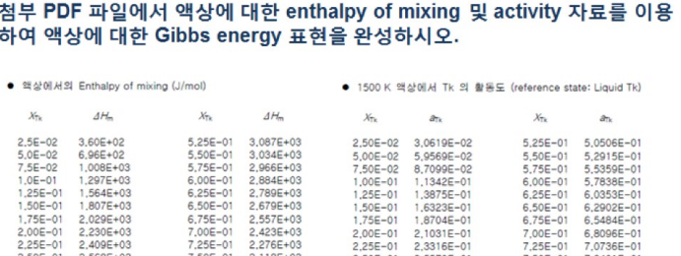
question,
Enthalpy of mixing
Activity
비선형방정식의 선형화
비선형방정식의 선형화
Linear regression !

Slide 3
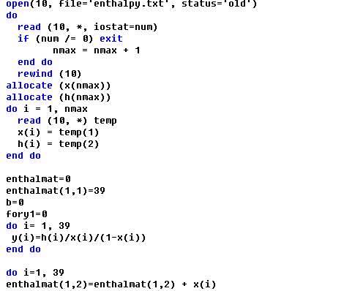
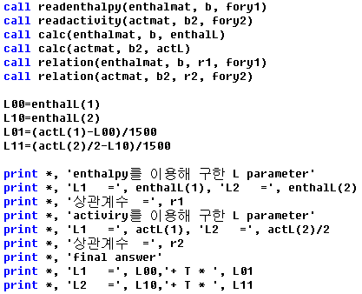
code,
Main function
Subroutine

Slide 4
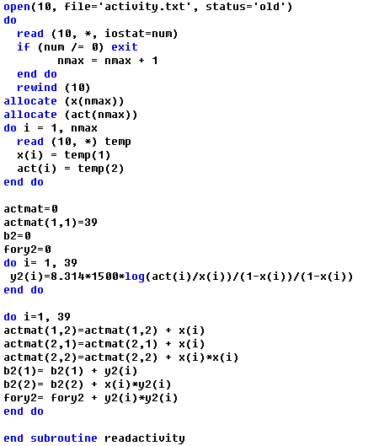
code,
Main function
Subroutine

Slide 5
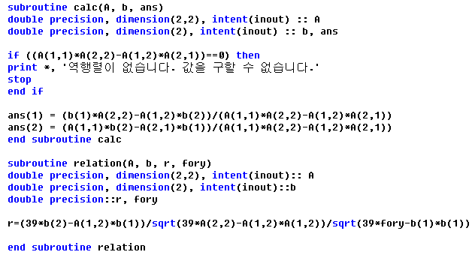
code,
Main function
Subroutine

Slide 6
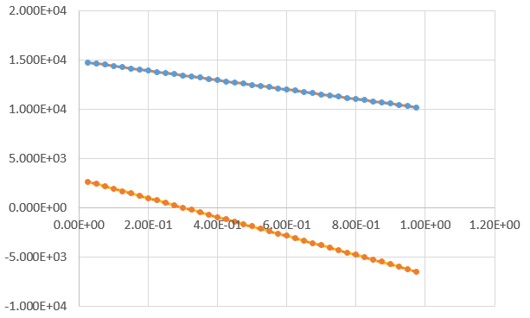
result,
$$∆G^{M}=∆H^{M}−T∆S^{M}$$
$=(\left(14894.23−7.99T\right)−\left(4794.93+0.011T\right)X_{Tk}\left(1−X_{Tk}\right)−T(\left(1−X_{Tk}\right)\ln\left(1−X_{Tk}\right)+X_{Tk}lnX_{Tk})$
Enthalpy of mixing
Activity

